Slide 1

CareerOneStop for ReEntry Job Seekers

Slide 2
AGENDA
Brief CareerOneStop Overview
CareerOneStop Tools & Content for Individuals Reentering the Workforce
Q&A

Slide 3

CareerOneStop Key Features

Slide 4

CareerOneStop – closed-link tablet version

Slide 5
LIVE SITE DEMO

Slide 6
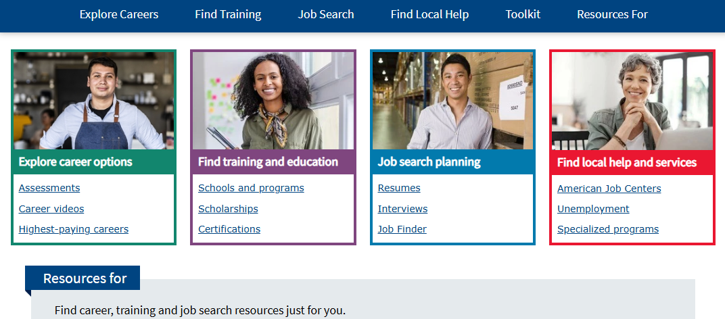
CareerOneStop Homepage – public facing

Slide 7
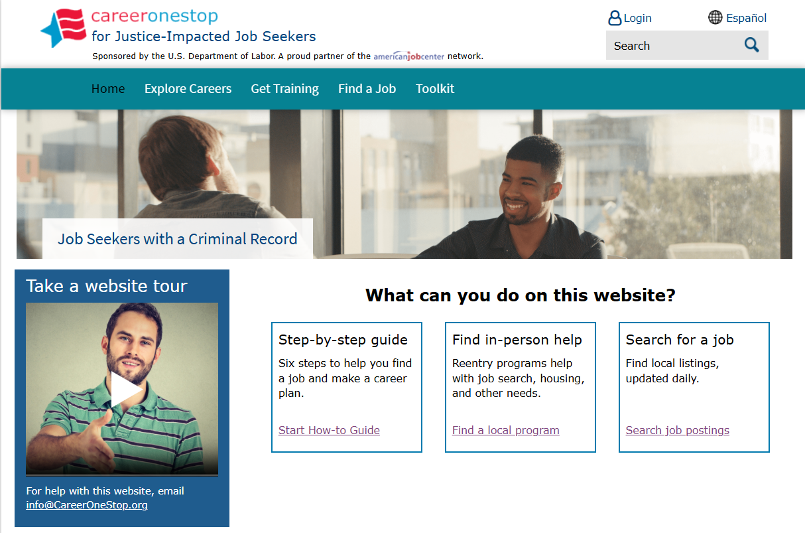
CareerOneStop for ReEntry Job Seekers Homepage

Slide 8
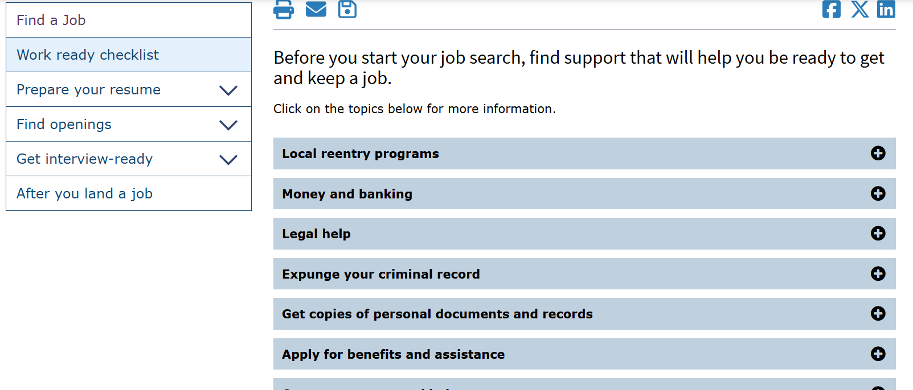
Work Ready Checklist

Slide 9
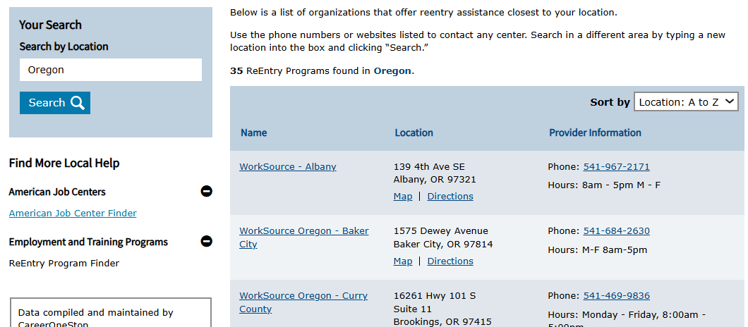
ReEntry Program Finder Results

Slide 10
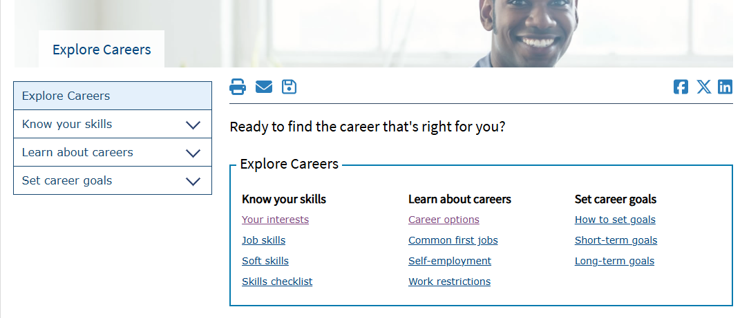
Identifying Careers

Slide 11
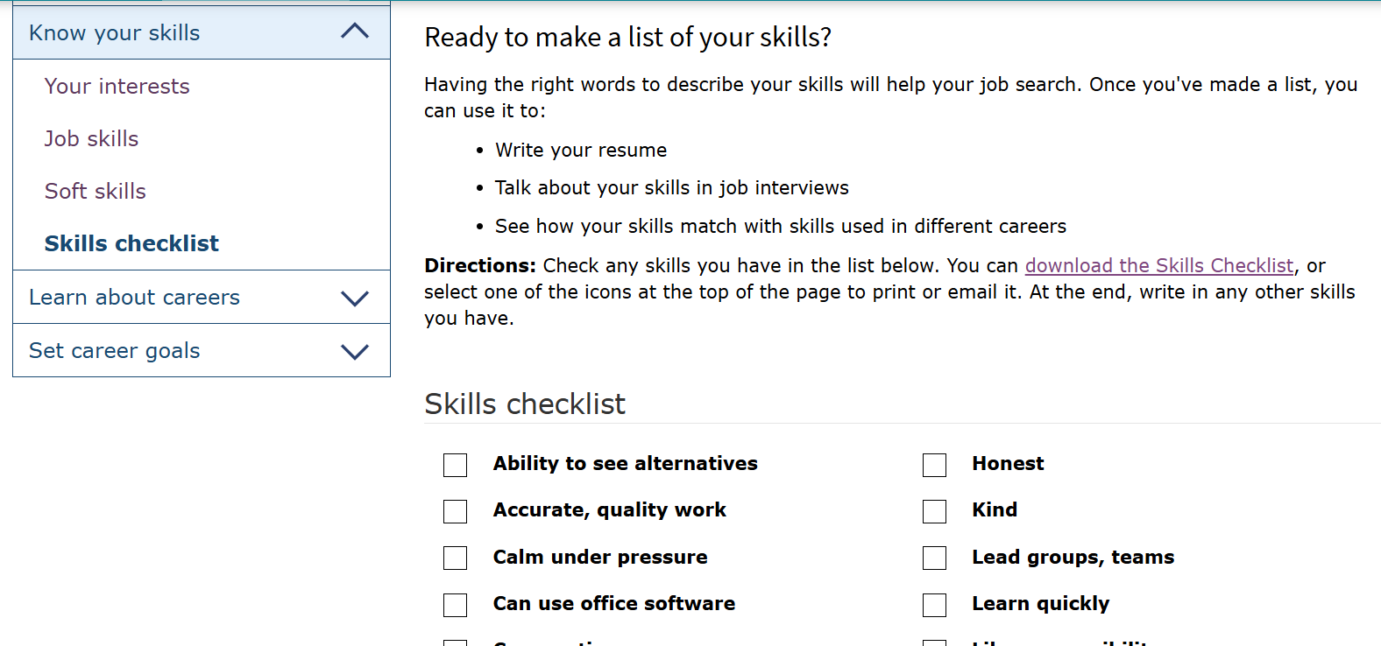
Skills Checklist

Slide 12
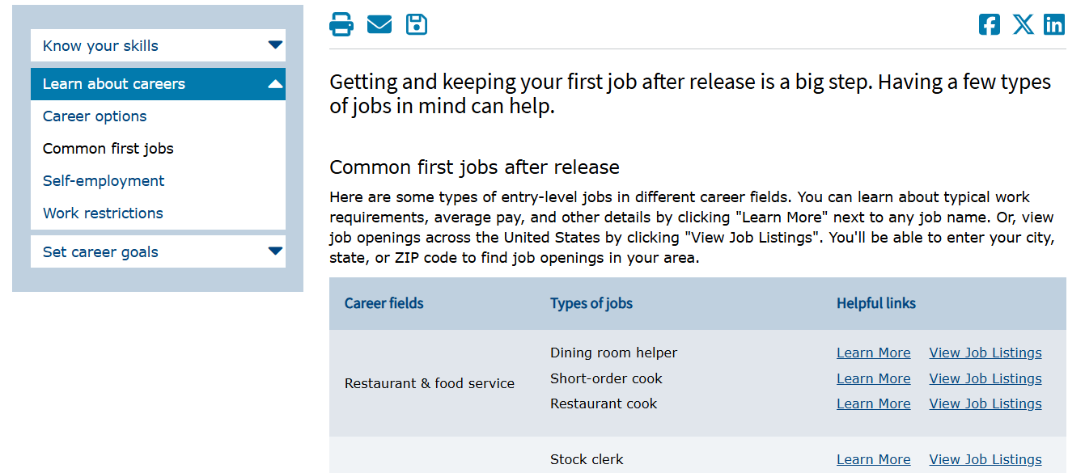
Common First Jobs After Incarceration

Slide 13
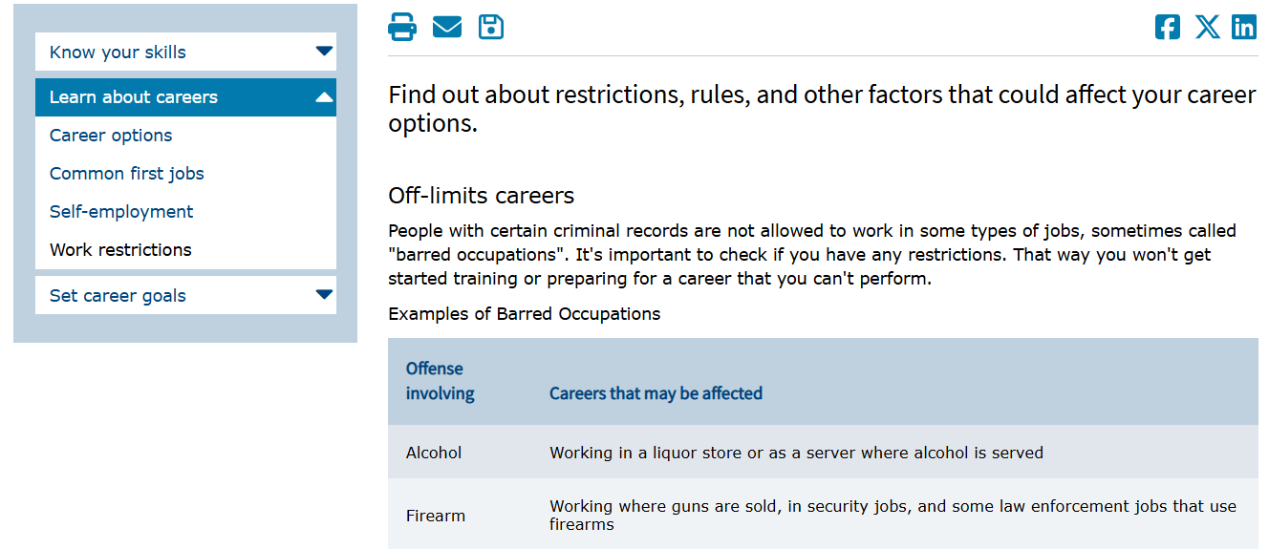
Employment Restrictions

Slide 14
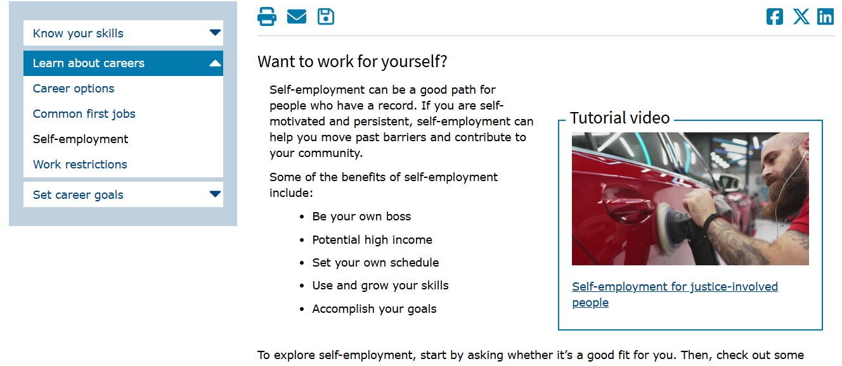
Self-Employment

Slide 15
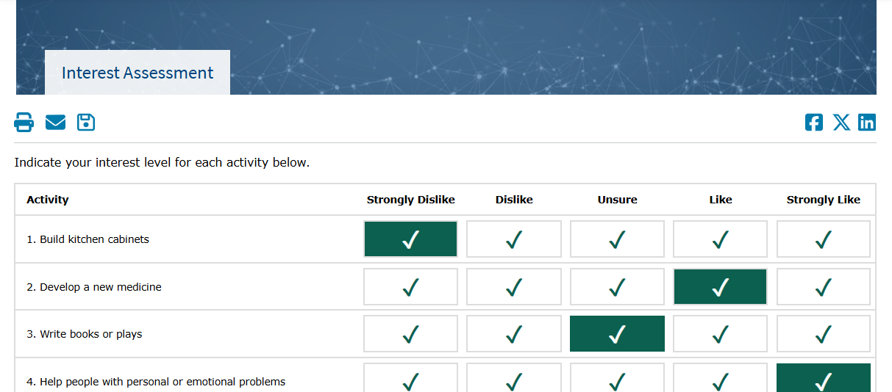
Interest Assessment

Slide 16
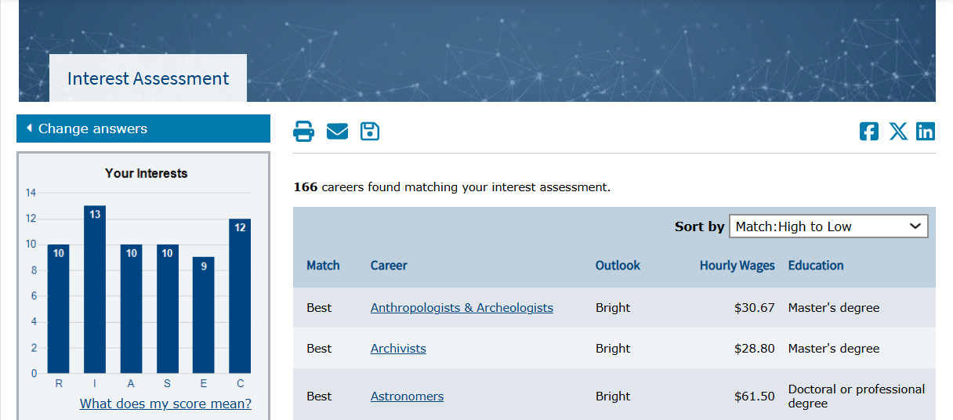
Interest Assessment Results

Slide 17
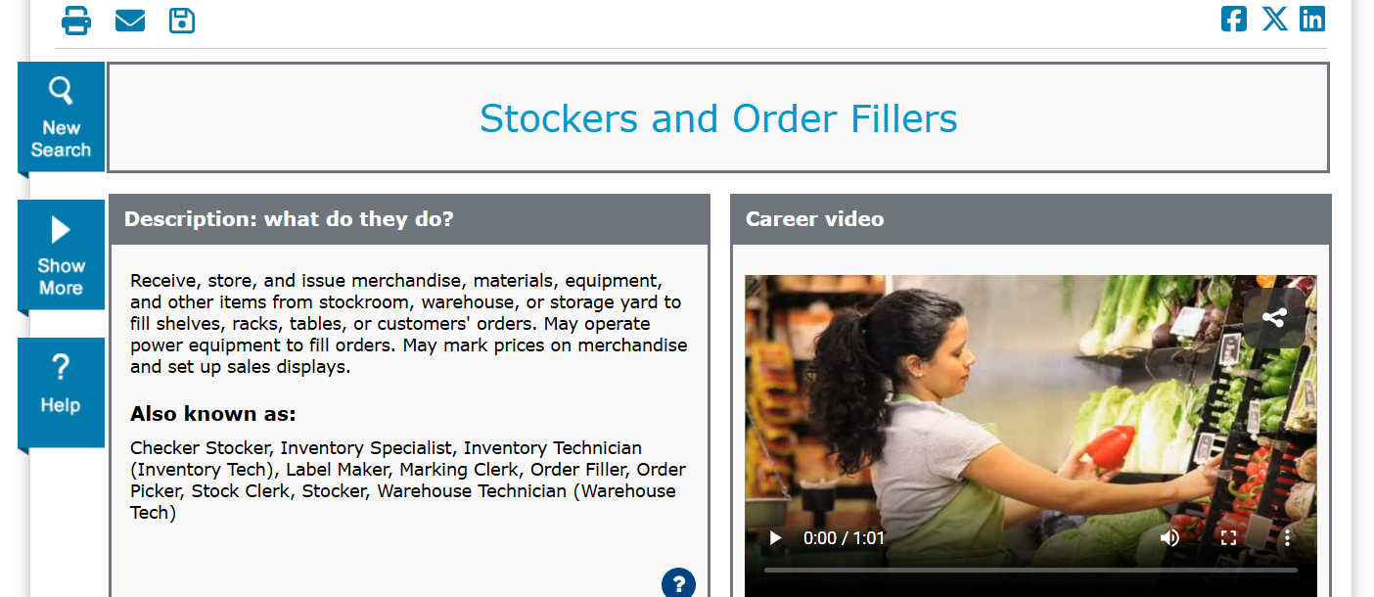
Occupation Profile

Slide 18
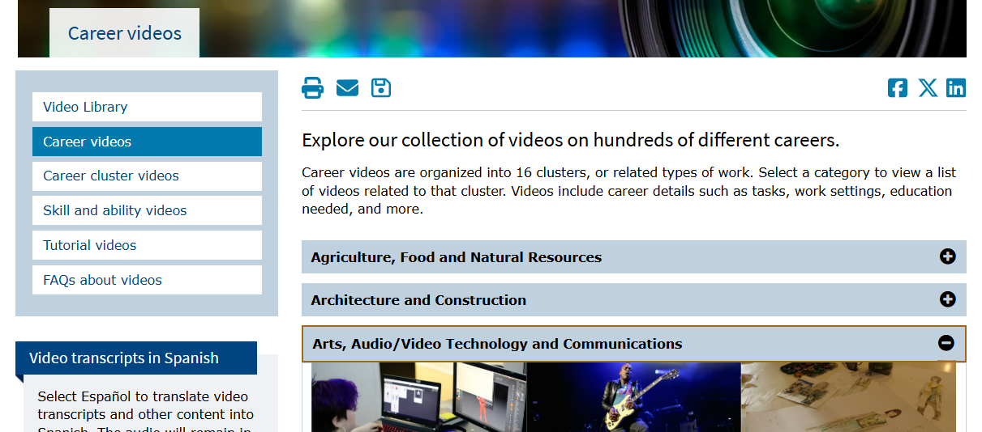
Career Videos

Slide 19
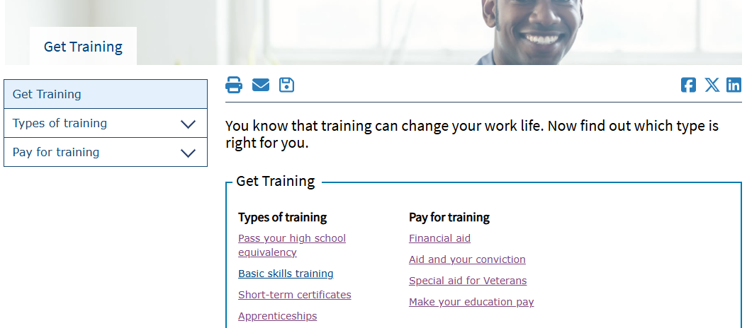
Get Training

Slide 20
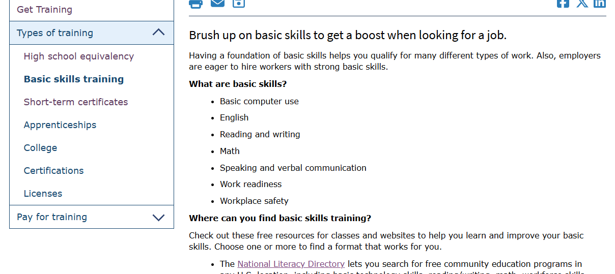
Basic Skills and Digital Literacy Resources

Slide 21
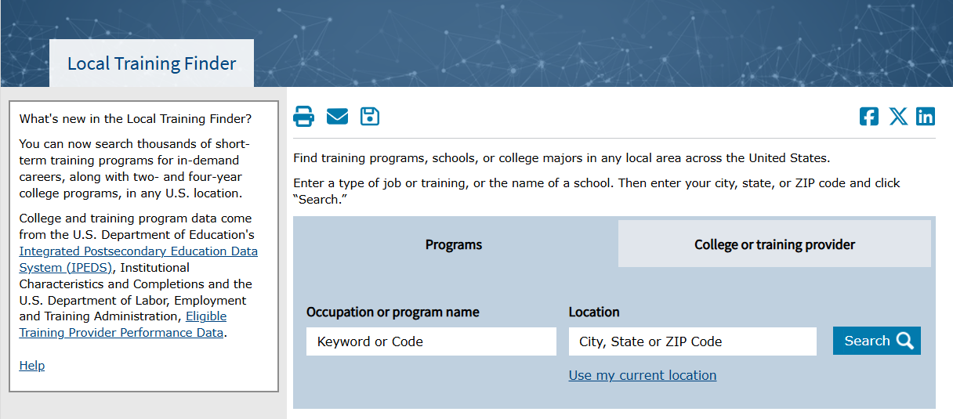
Local Training Finder

Slide 22
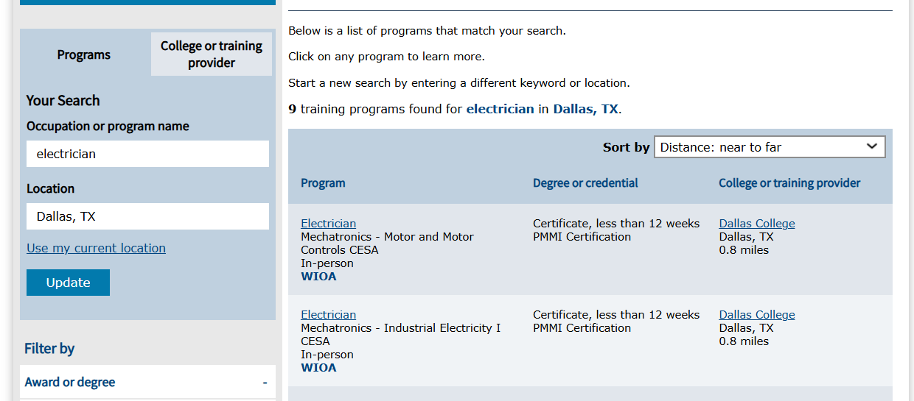
Local Training Finder Results

Slide 23
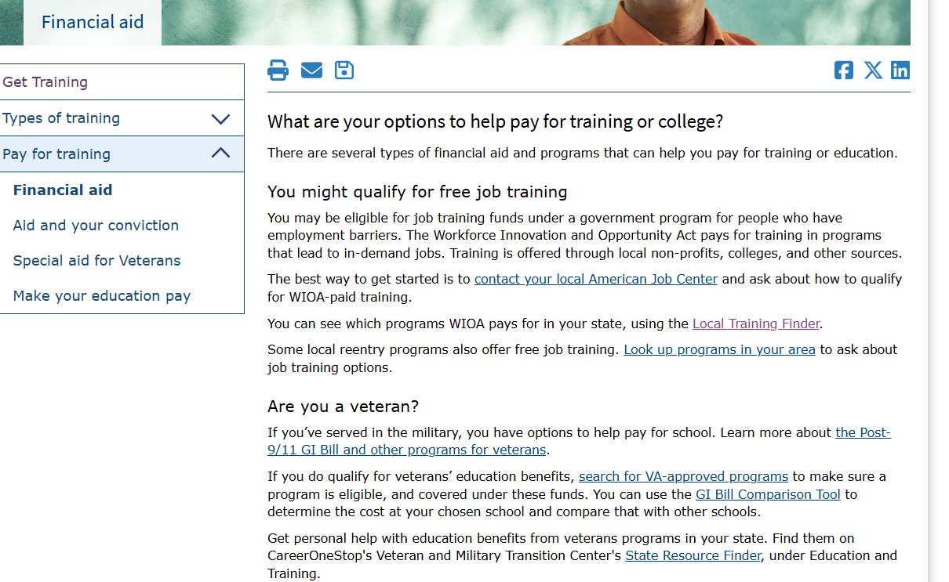
Financial Aid

Slide 24
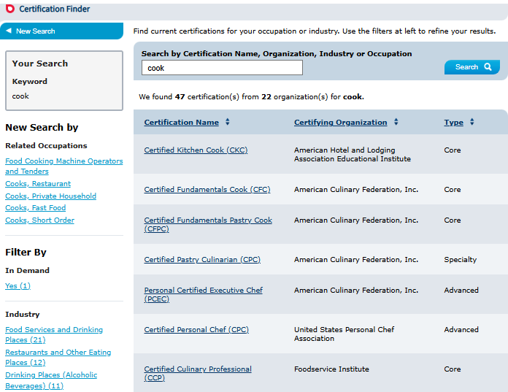
Certification Finder

Slide 25
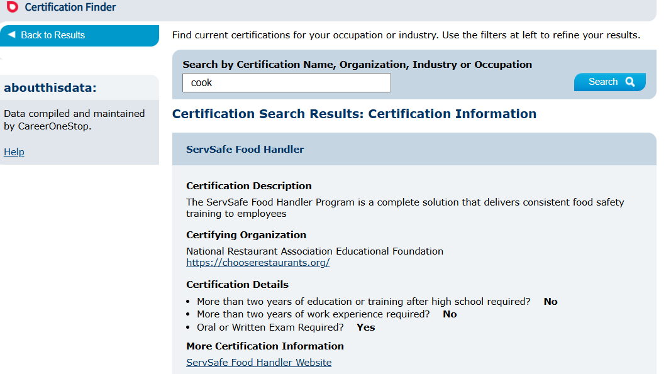
Certification Finder Detail Page

Slide 26
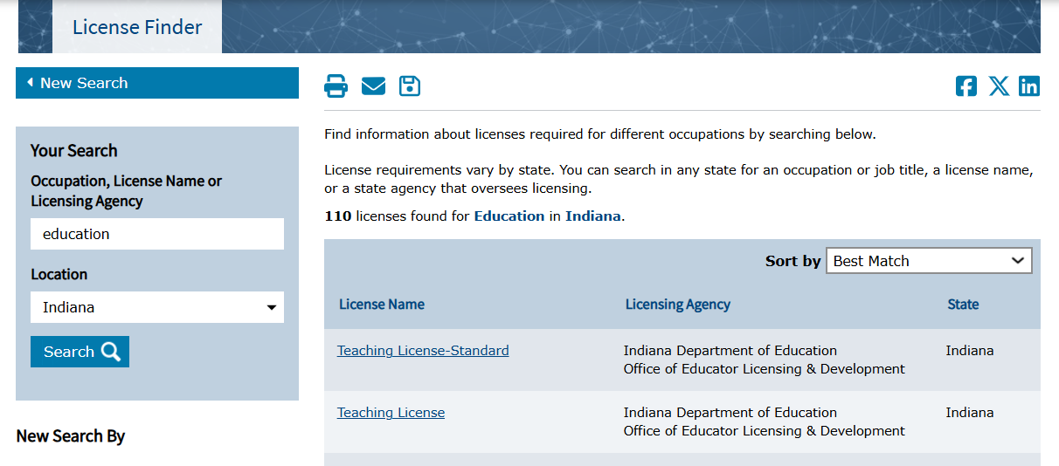
License Finder

Slide 27
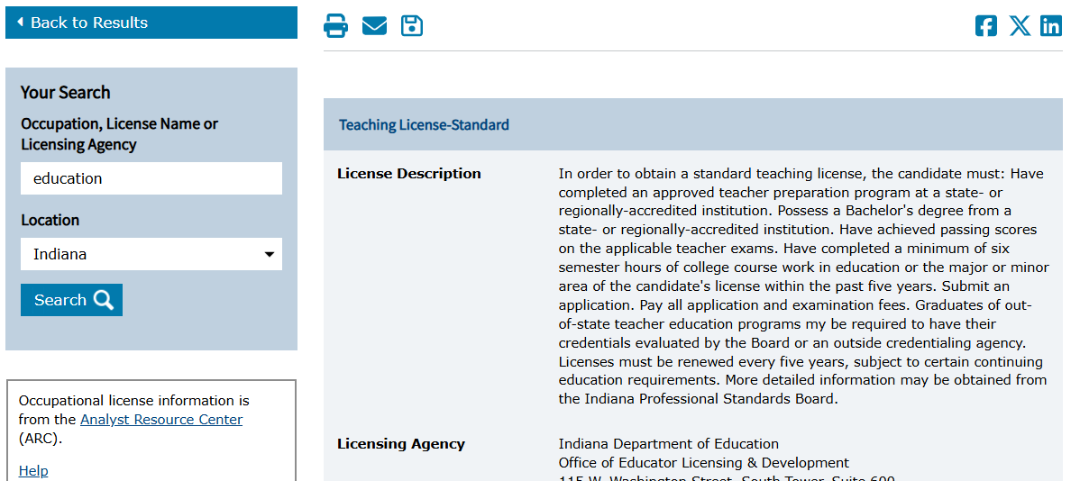
License Finder Detail Page

Slide 28
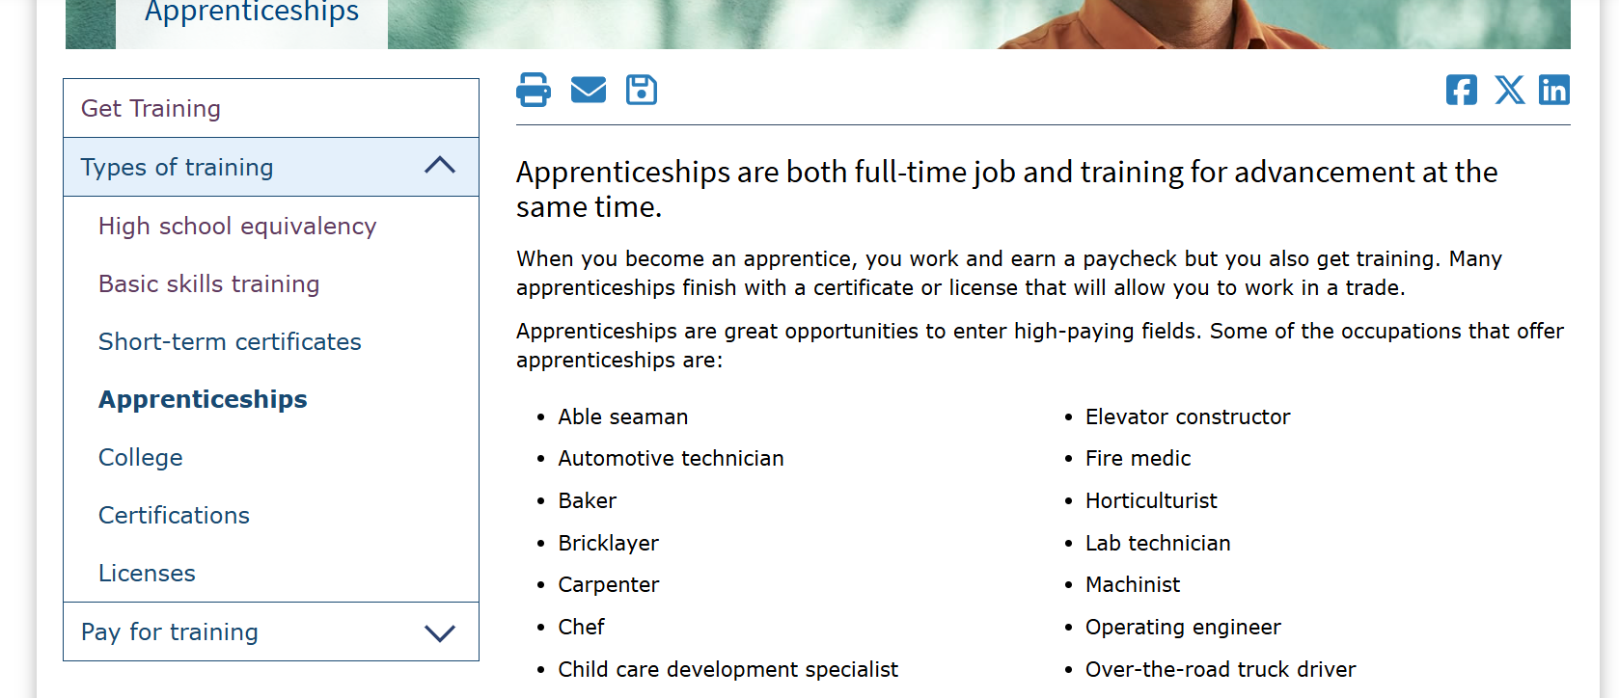
Apprenticeships

Slide 29
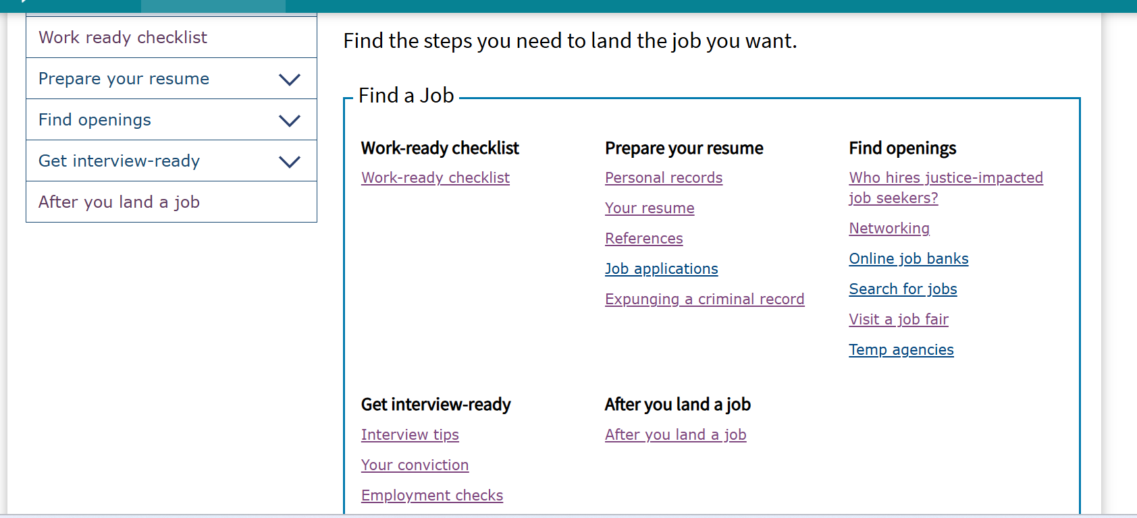
Find a Job

Slide 30
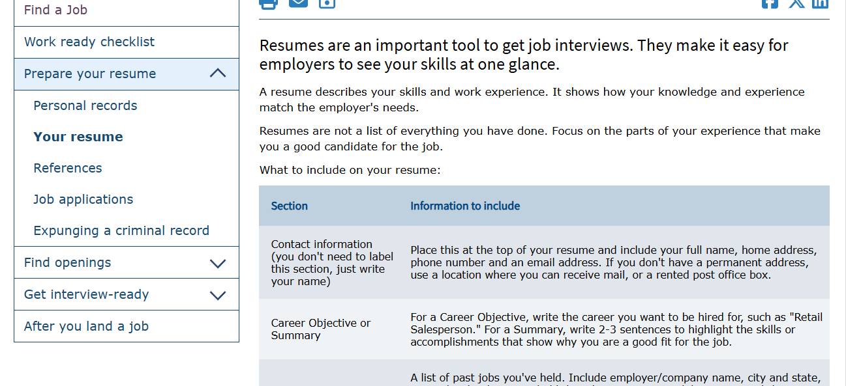
Resumes

Slide 31
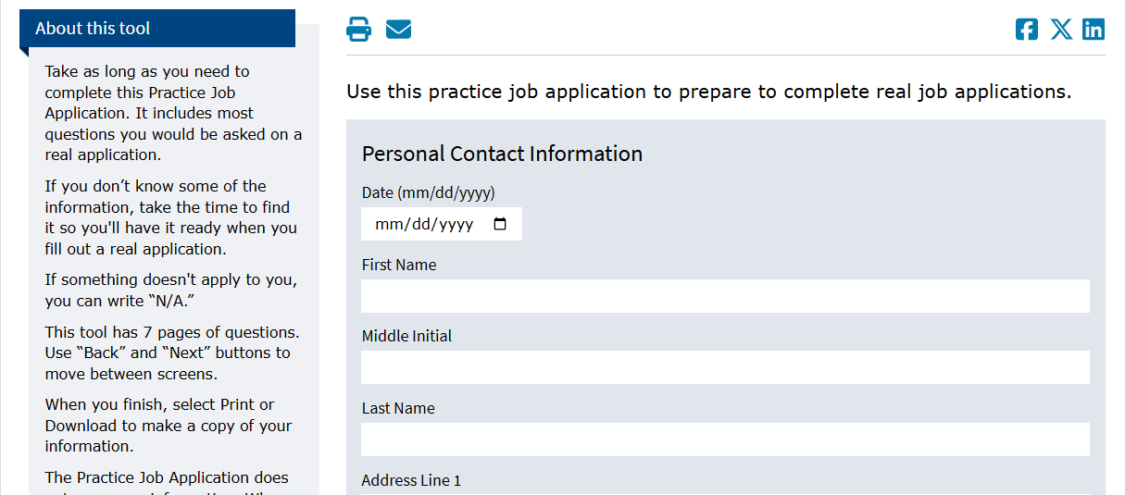
Practice Job Application

Slide 32
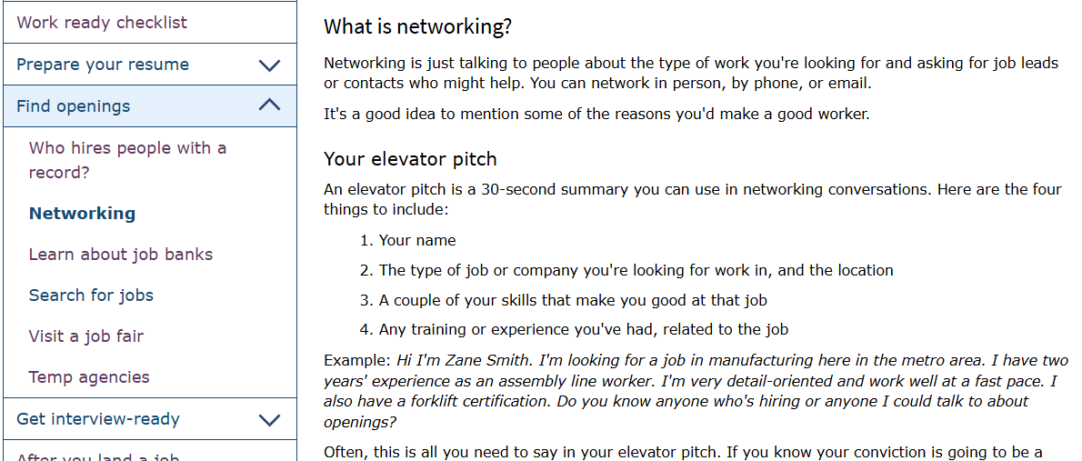
Networking & Elevator Pitch

Slide 33
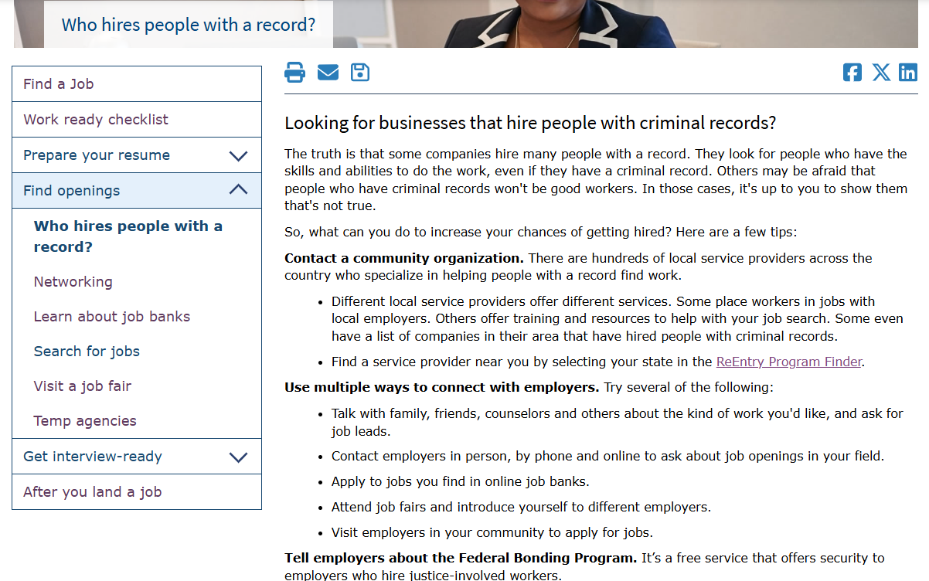
Who Hires People With a Record?

Slide 34
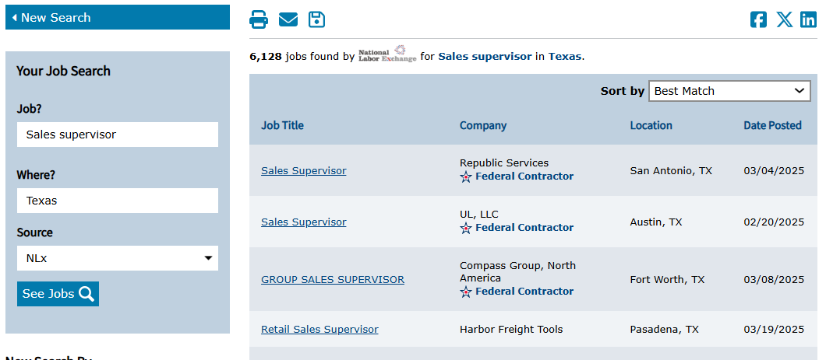
Job Finder

Slide 35
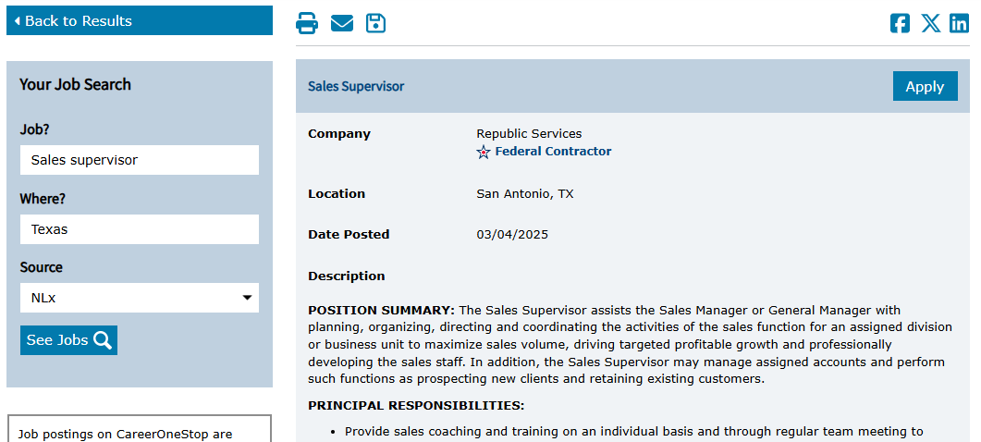
Job Finder Detail Page

Slide 36
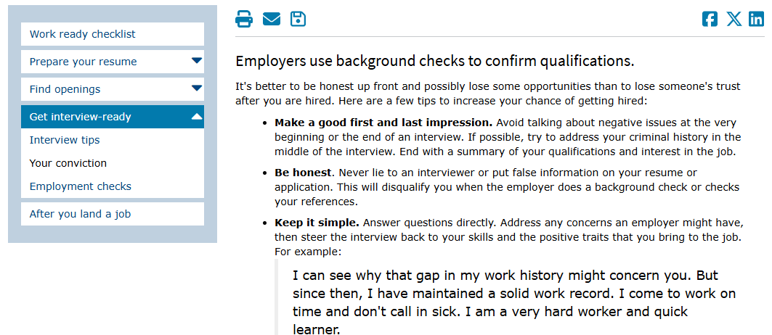
Your Conviction

Slide 37
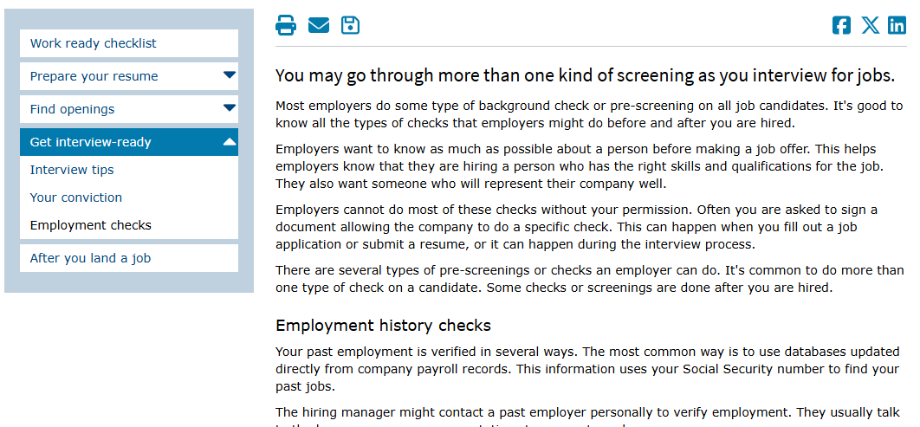
Employment Checks

Slide 38
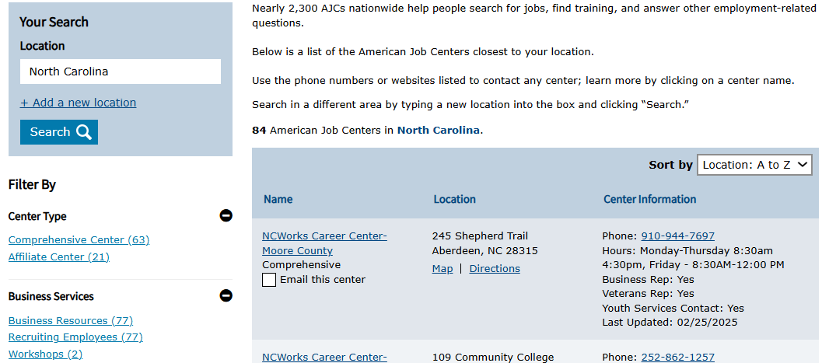
American Job Center Finder

Slide 39
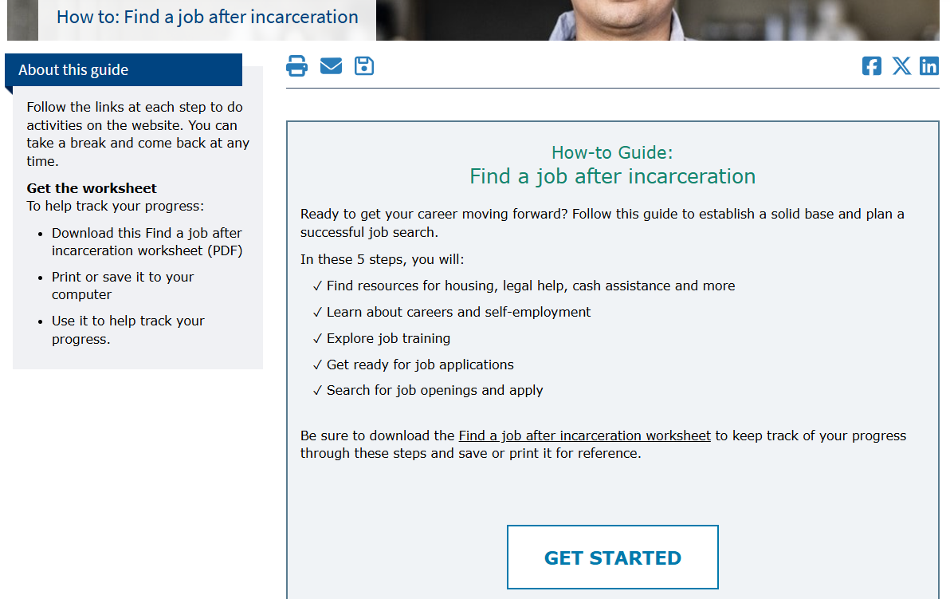
How-to Guide: Find a Job After Incarceration

Slide 40
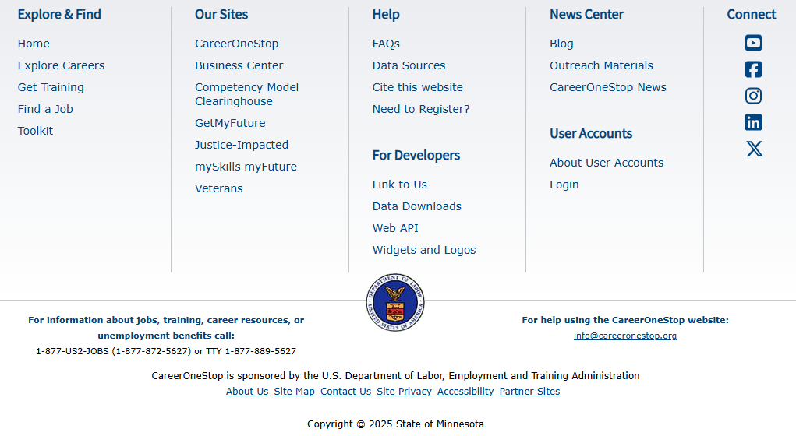
Footer

Slide 41
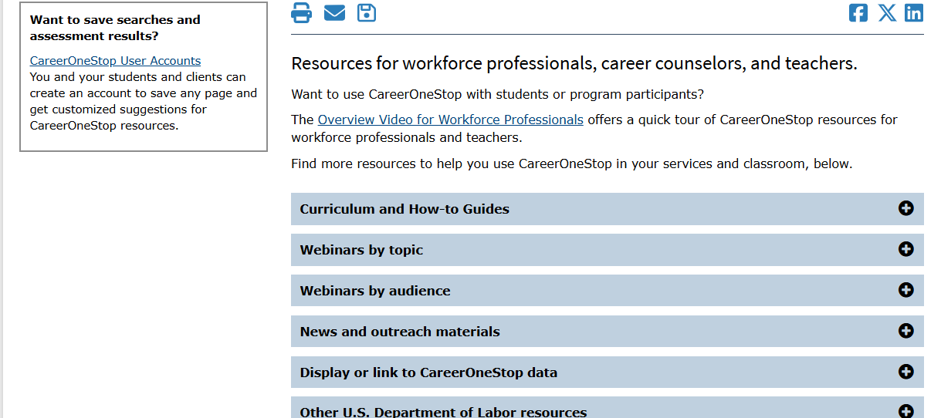
Career Advisors

Slide 42
Thank You for participating!

