Slide 1
EXPAND
TRAINING OPTIONS FOR YOUR CUSTOMERS

Slide 2
AGENDA
Brief CareerOneStop Overview
CareerOneStop Tools & Content
Questions

Slide 3
CareerOneStop Key Features
Trustworthy
National
Scope
No Cost

Slide 4
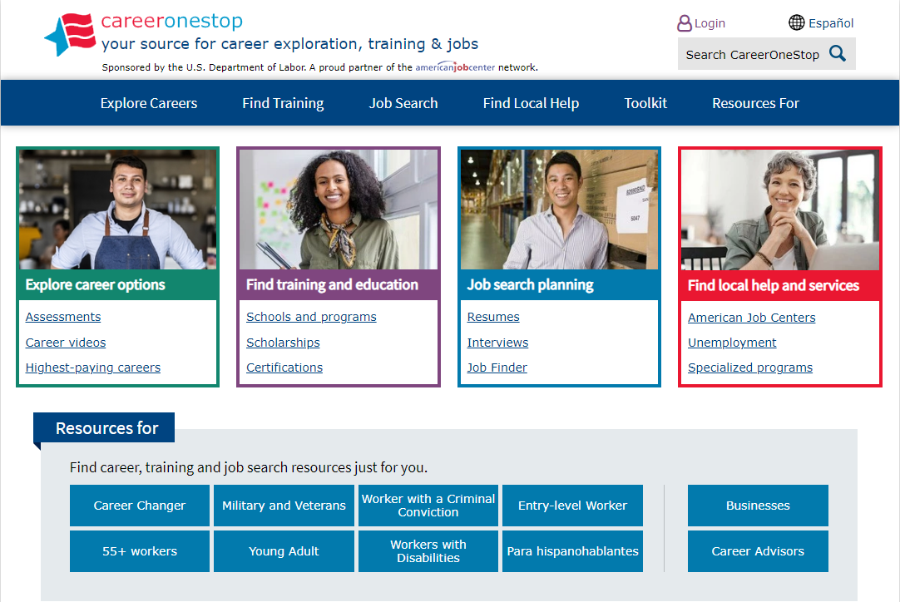
CareerOneStop Homepage

Slide 5
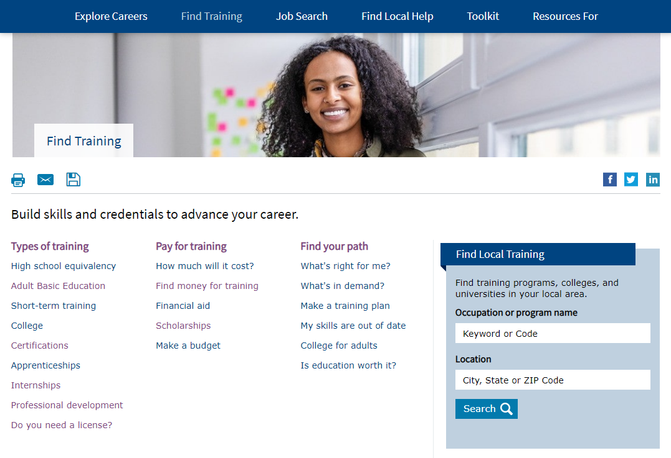
Find Training

Slide 6
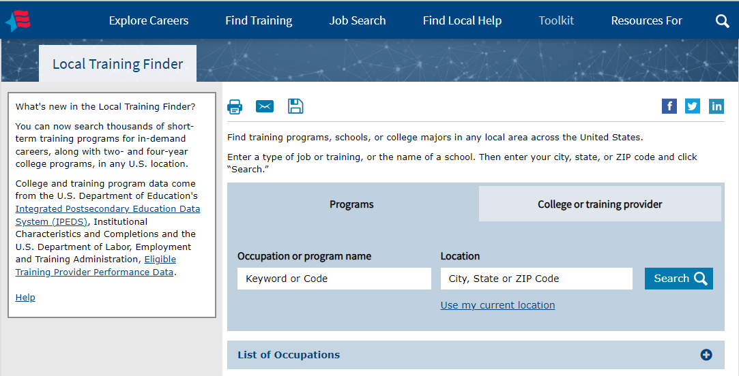
Local Training Finder

Slide 7
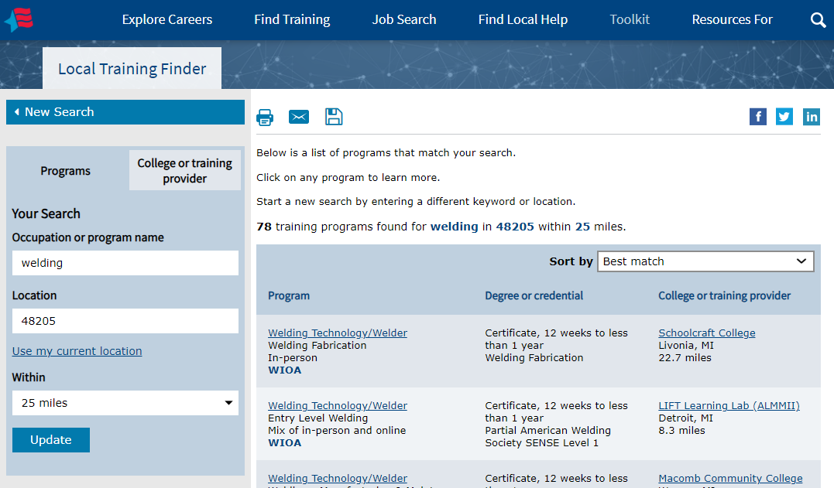
Local Training Finder – Results Page

Slide 8
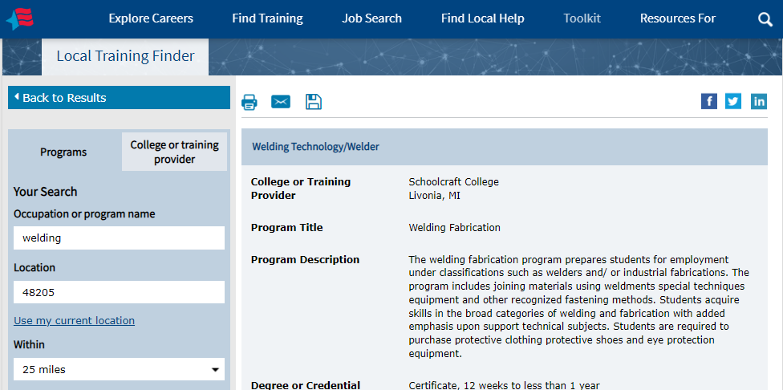
Local Training Finder – Detail Page (WIOA)

Slide 9
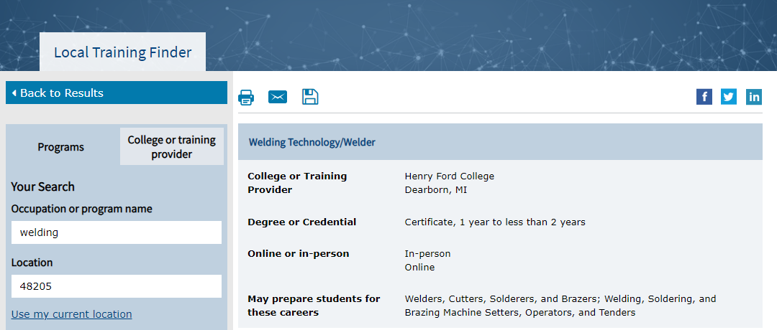
Local Training Finder – Detail Page (IPEDS)

Slide 10
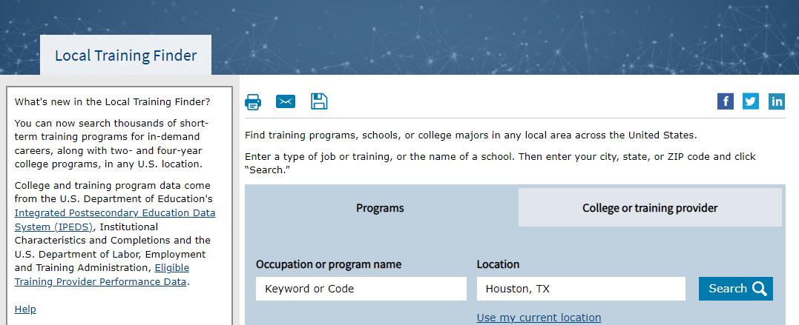
Local Training Finder – Provider Search

Slide 11
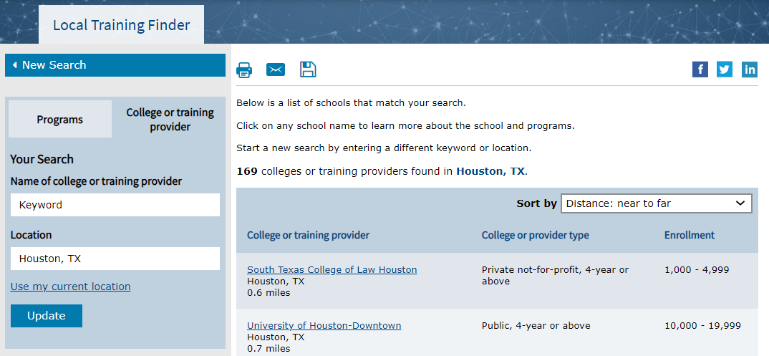
Local Training Finder – Provider Search Results

Slide 12
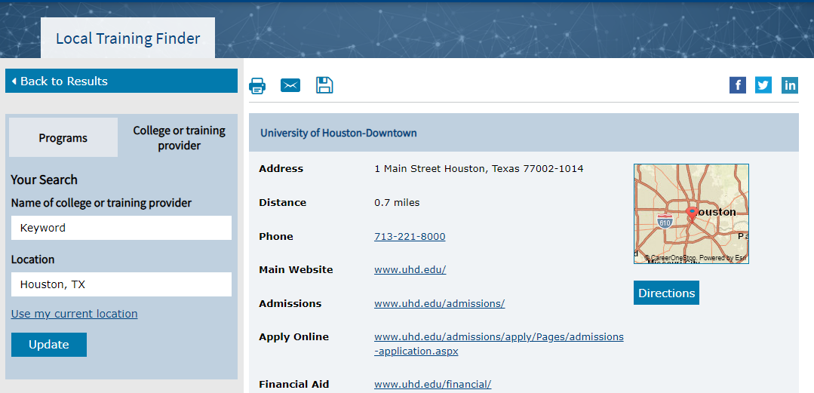
Local Training Finder – Detail Page (Provider)

Slide 13
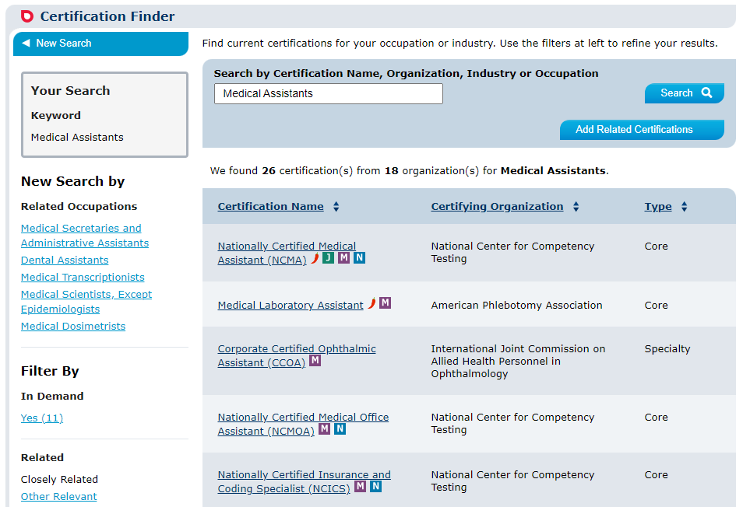
Certification Finder

Slide 14
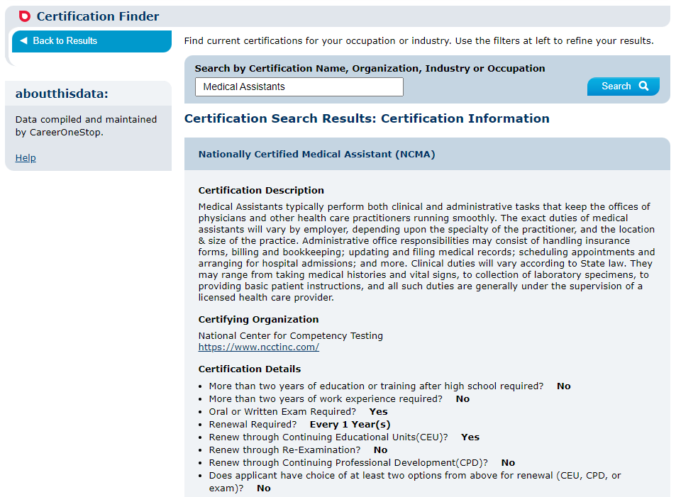
Certification Finder – Detail Page

Slide 15
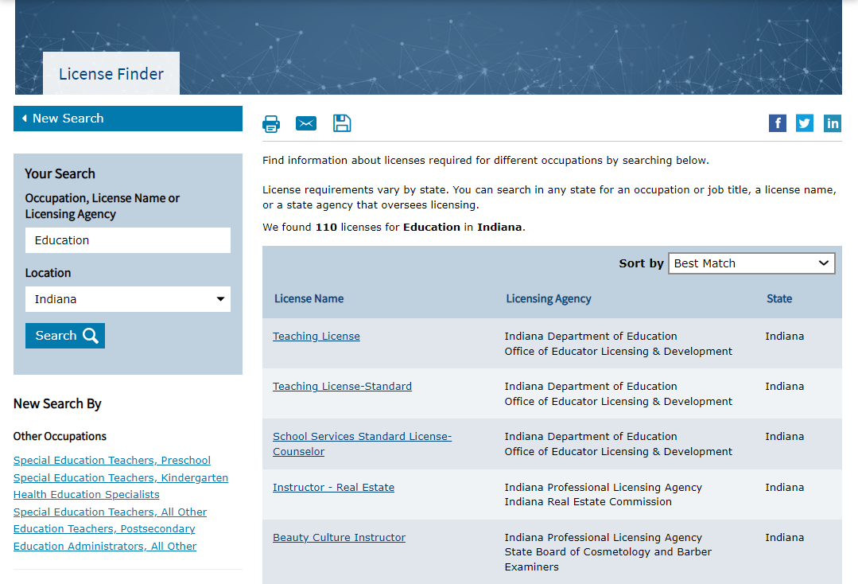
License Finder

Slide 16
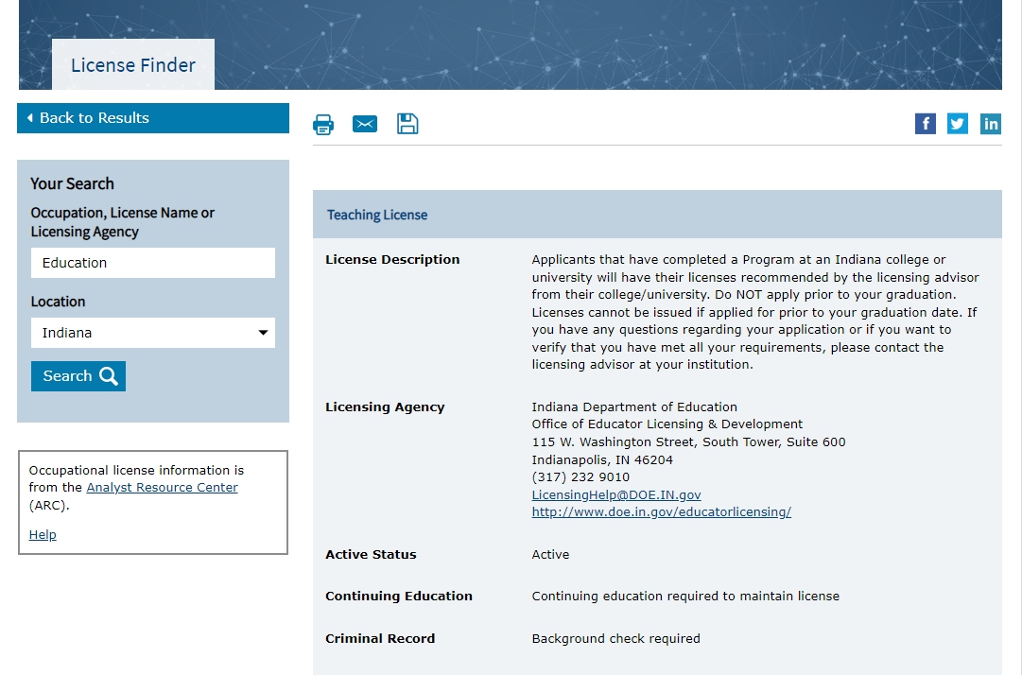
License Finder – Detail Page

Slide 17
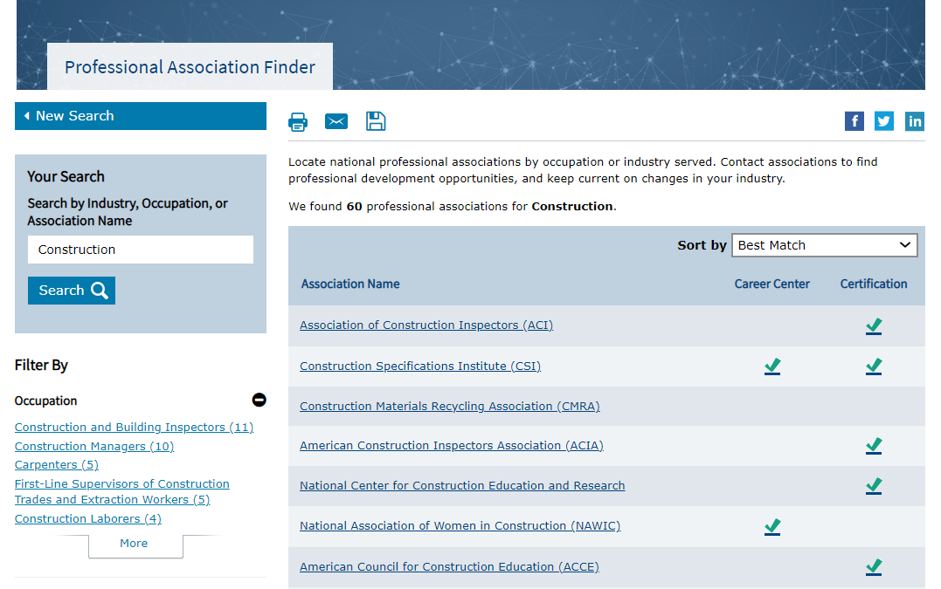
Professional Association Finder

Slide 18
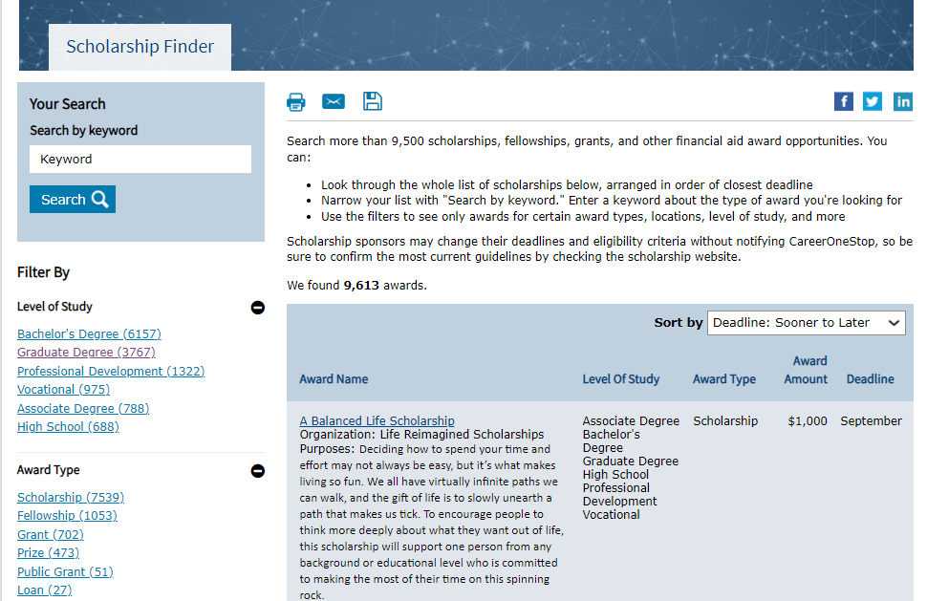
Scholarship Finder

Slide 19
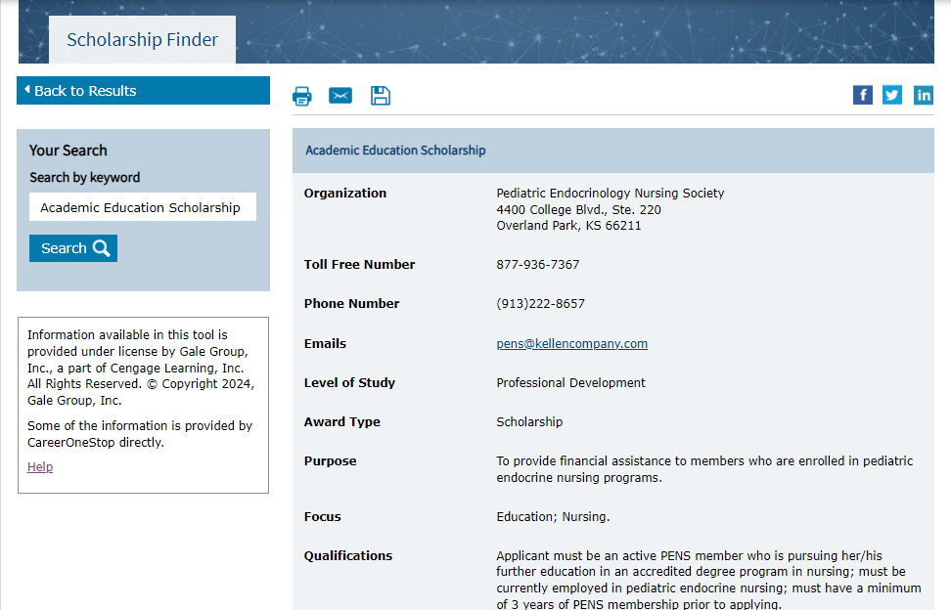
Scholarship Finder – Detail Page

Slide 20
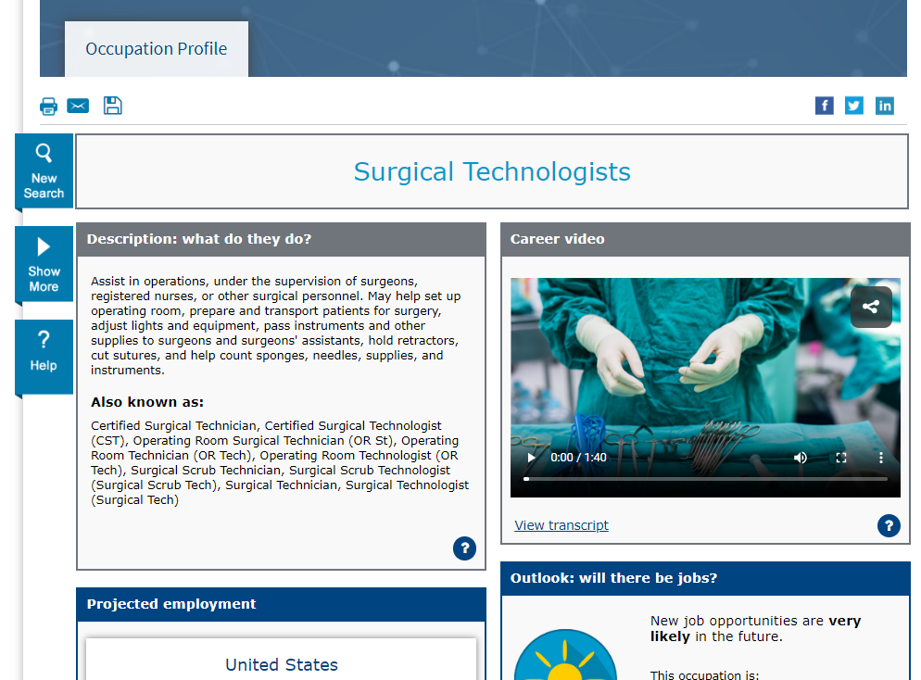
Occupation Profile

Slide 21
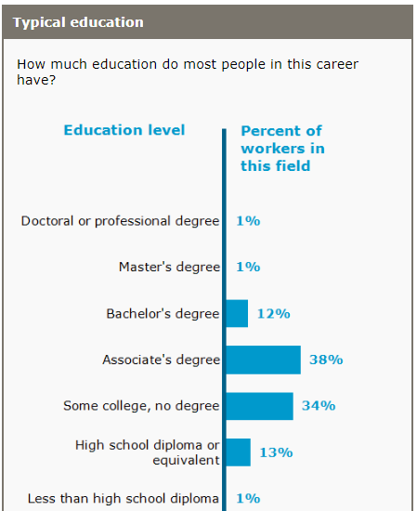
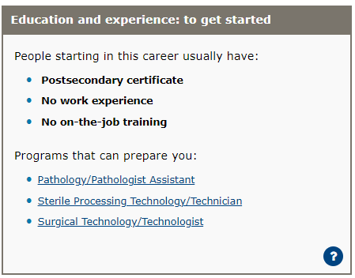
Occupation Profile – Education & Training

Slide 22
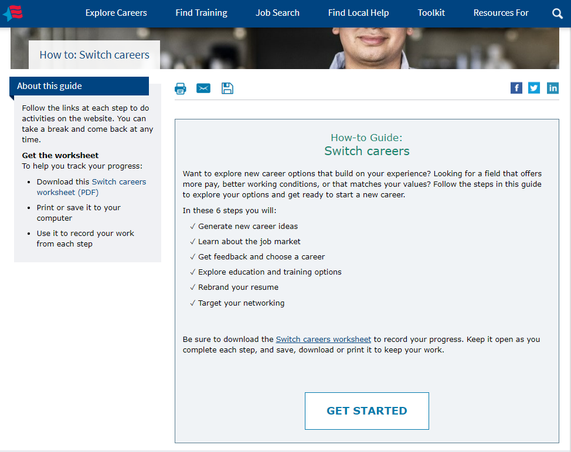
How-To Guide – Switch Careers

Slide 23
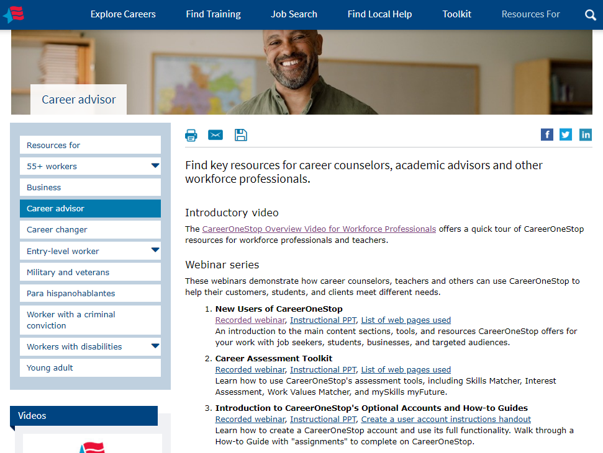
Career Advisors Page

Slide 24
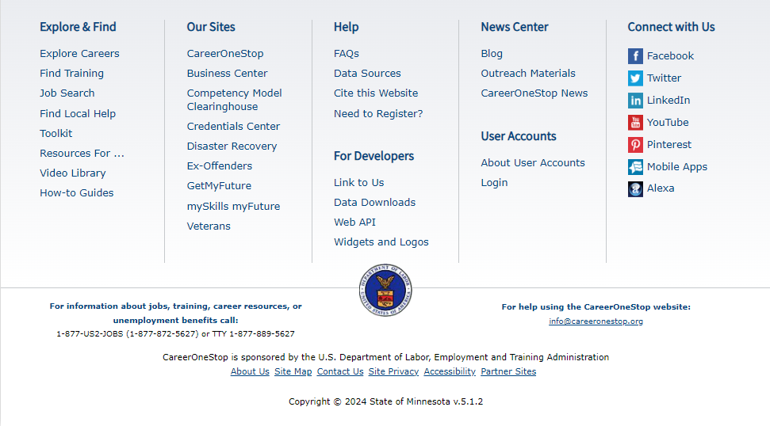
CareerOneStop Footer

