Slide 1
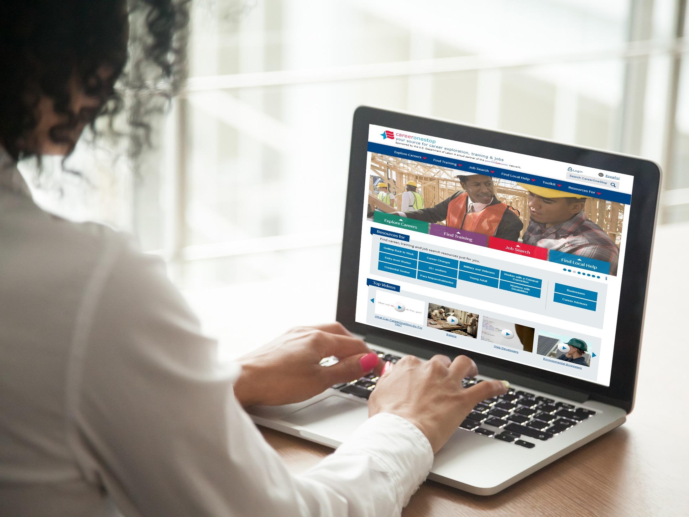
CareerOneStop User Accounts
NEW CareerOneStop User Accounts

Slide 2
Agenda
Brief CareerOneStop Overview
User Accounts
How-To Guides
Questions

Slide 3
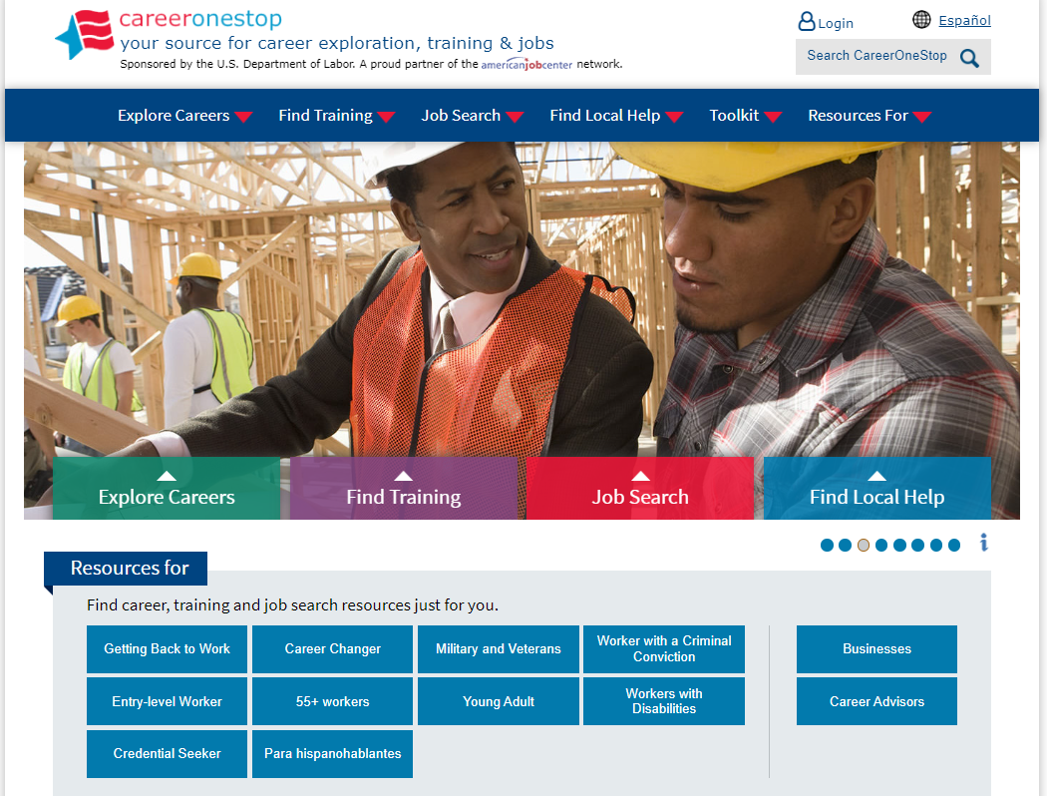
CareerOneStop
CareerOneStop is sponsored by the U.S. Department of Labor, Employment and Training Administration

Slide 4
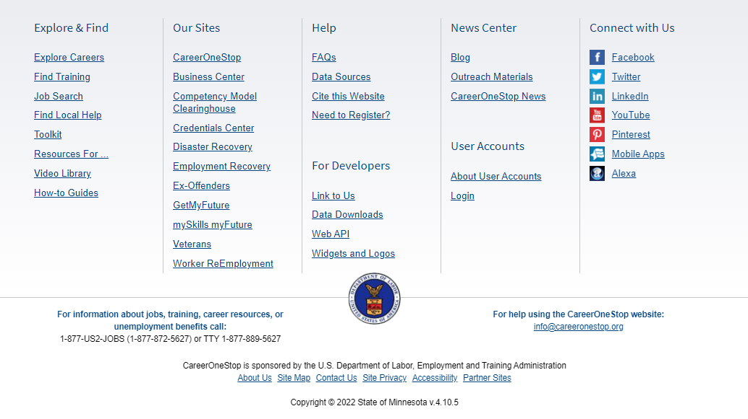
Footer
CareerOneStop is sponsored by the U.S. Department of Labor, Employment and Training Administration

Slide 5
User Accounts
Save pages, searches, assessments
Share results with teachers and counselors
Launched in November 2022
Accounts created to date

Slide 6
Account Functions
Profile includes career and location
System targets your searches
Choose personalized resources to see list of suggested resources
Subscribe to COS blog and newsletter

Slide 7
User Privacy
Personal data is not shared
Users are not required to create account
Timeout function
Notifications to engage in job search

Slide 8
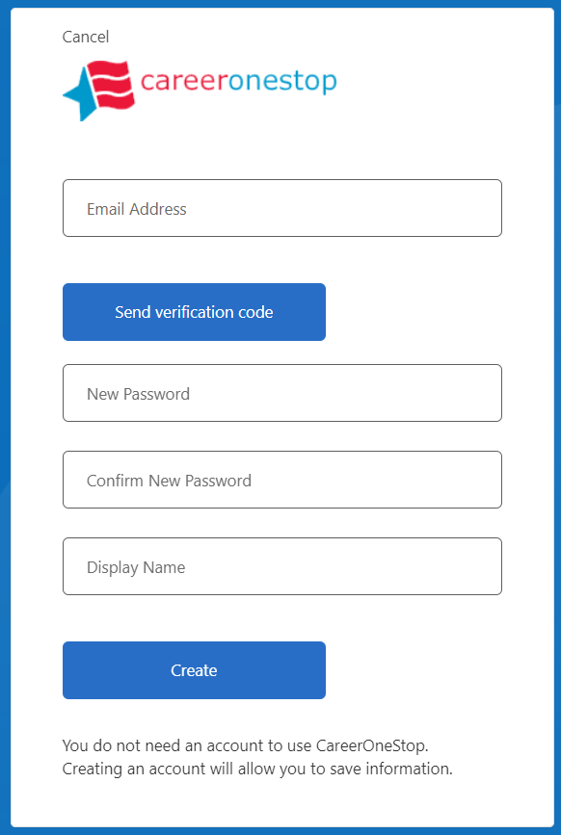
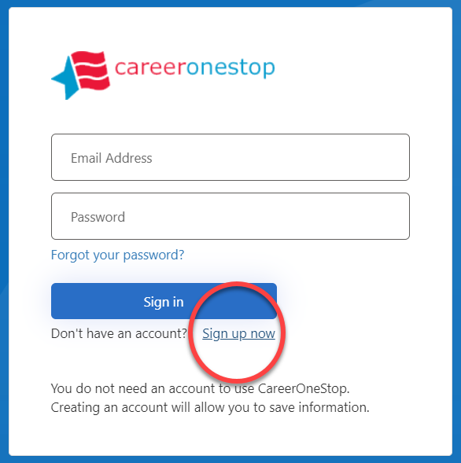
Register for a User Account

Slide 9
Screenshots

Slide 10
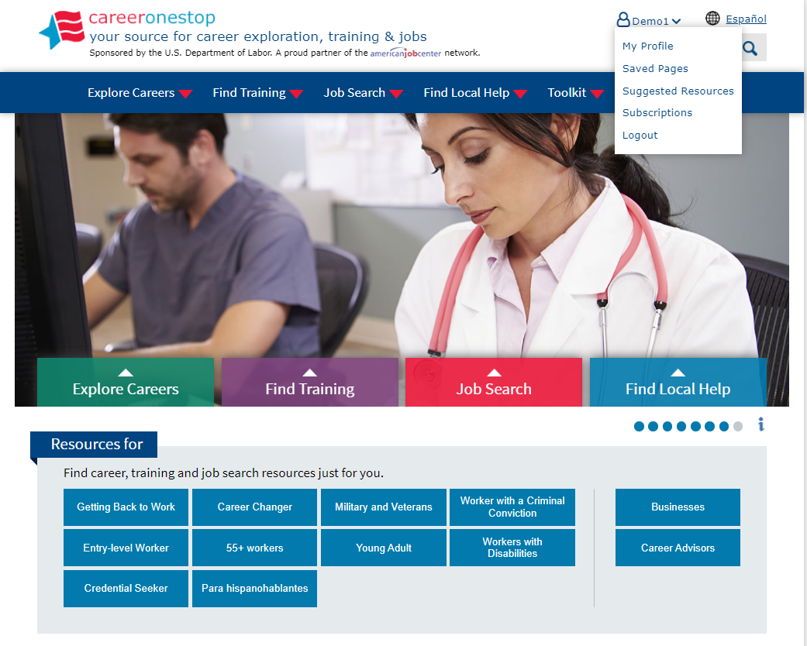
Logged In

Slide 11
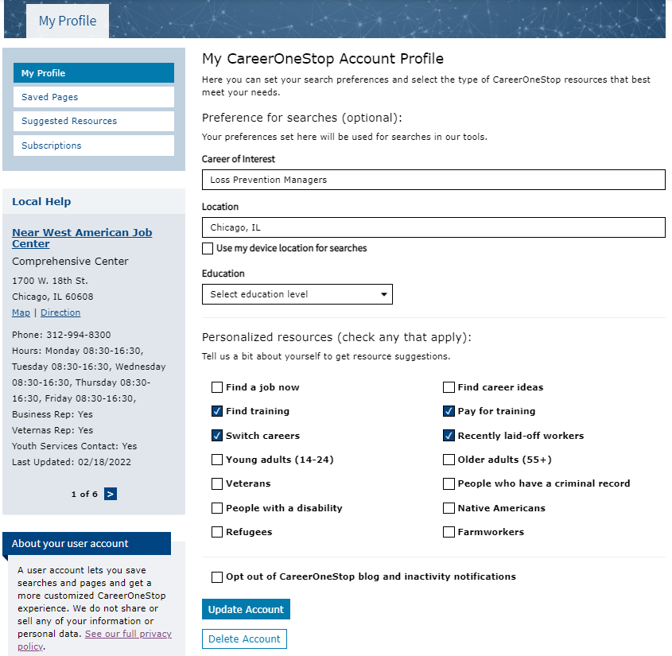
My Profile

Slide 12
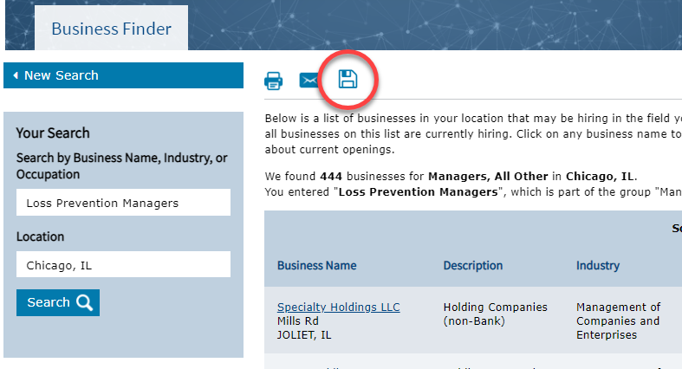
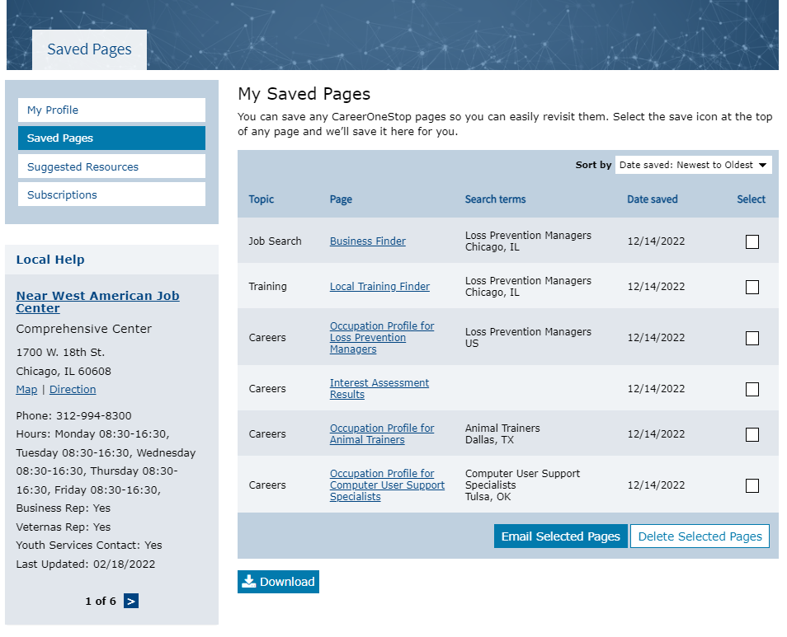
Saved Pages

Slide 13
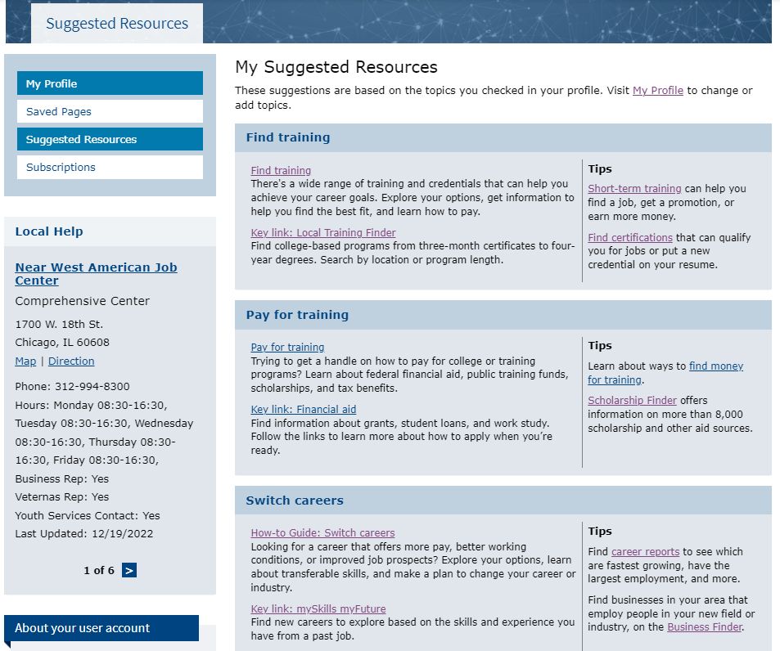
Suggested Resources

Slide 14
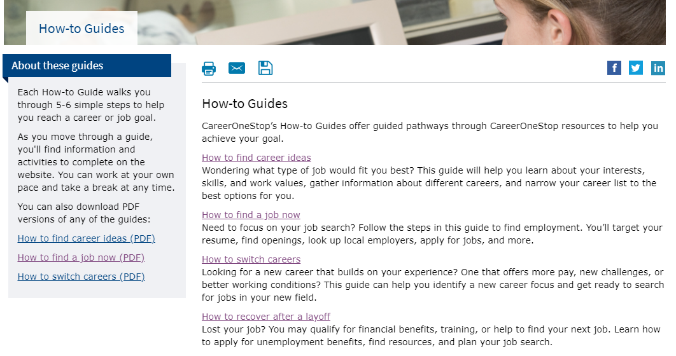
How-to Guides

Slide 15
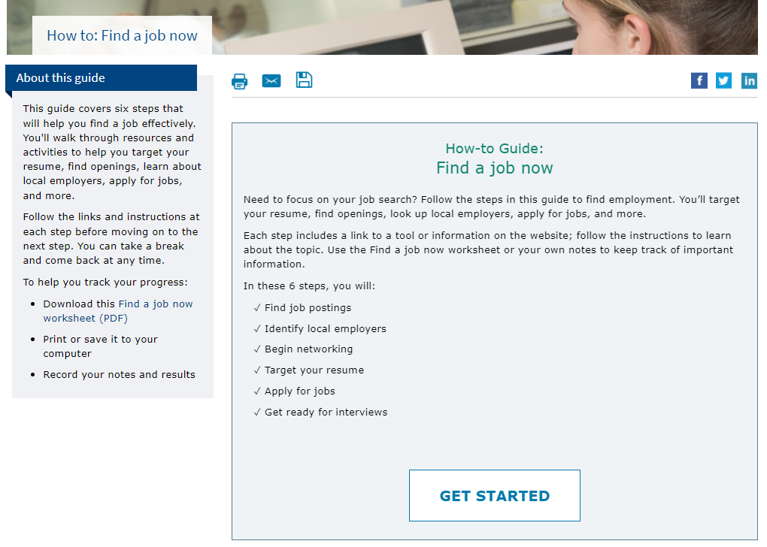
Find a Job Now

Slide 16
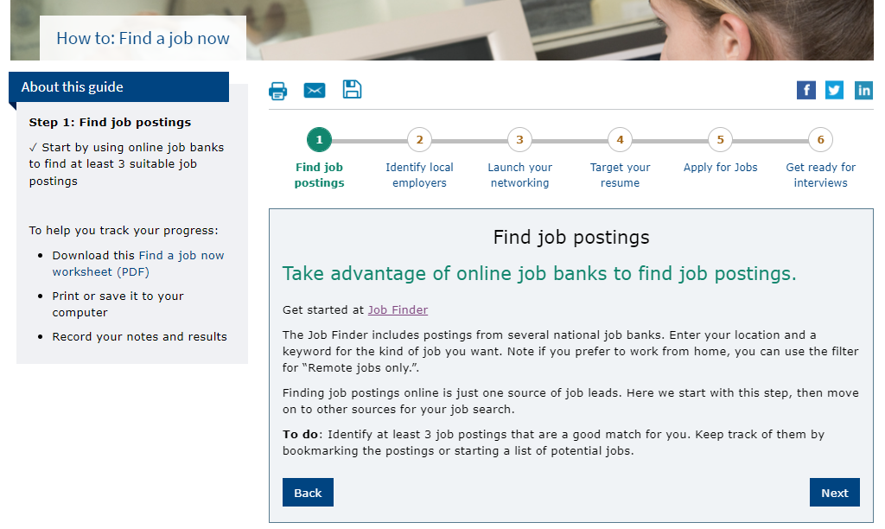
Find a Job Now2

Slide 17
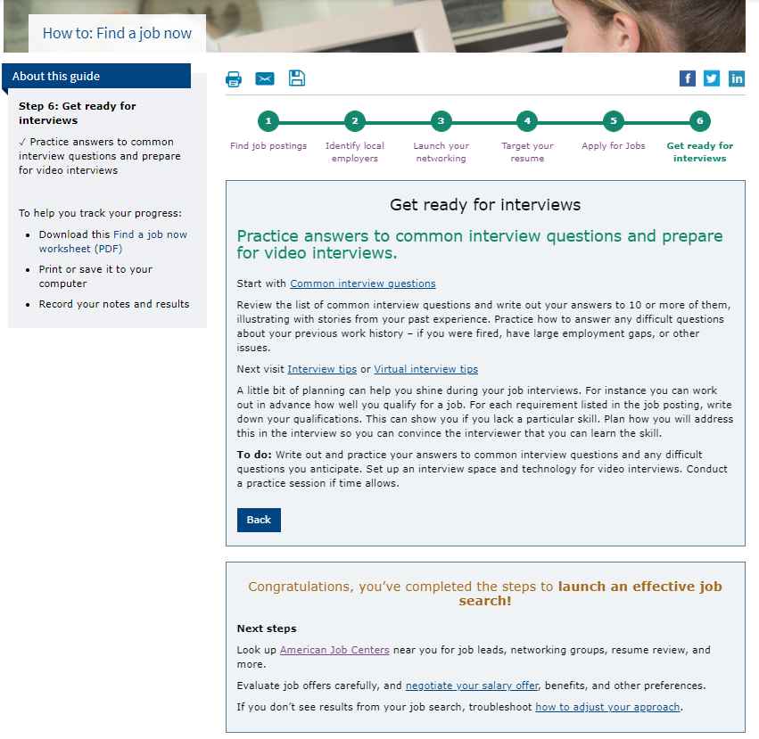
Find a Job Now3

Slide 18
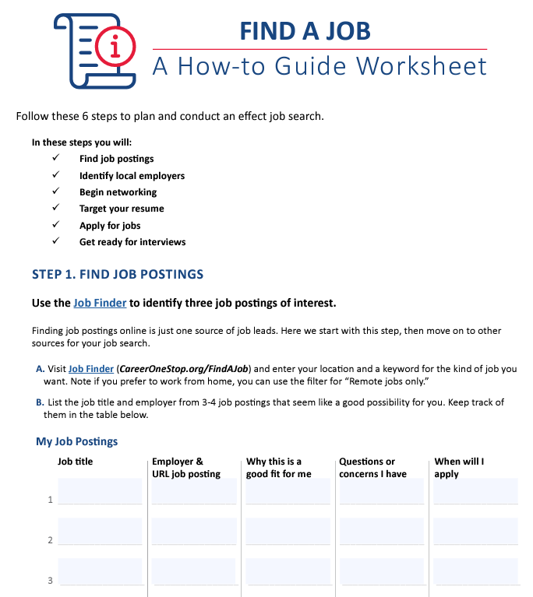
Find a Job Now Worksheet

Slide 19
Poll Question #1
What other topics should we develop as How-to Guides?

Slide 20
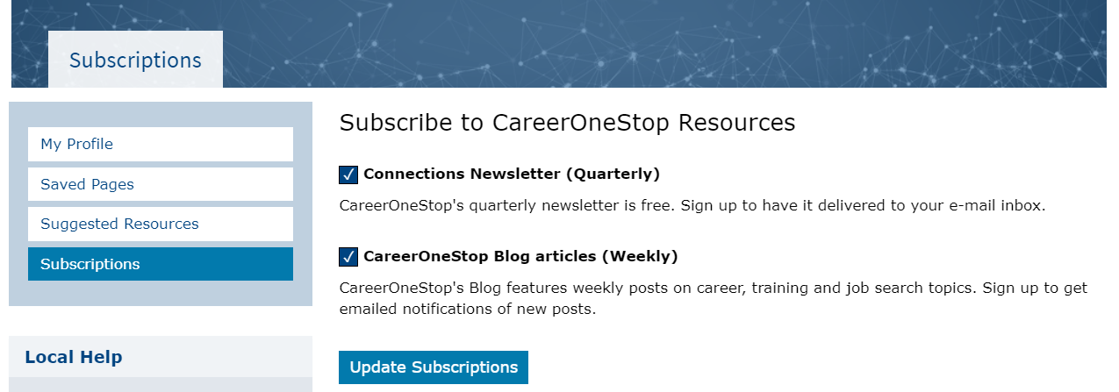
Subscriptions

Slide 21
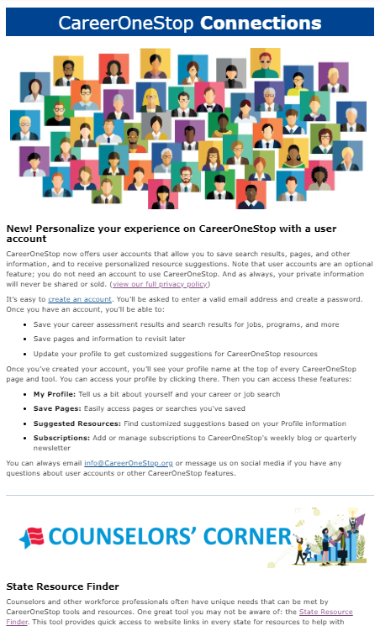
Connections Newsletter

Slide 22
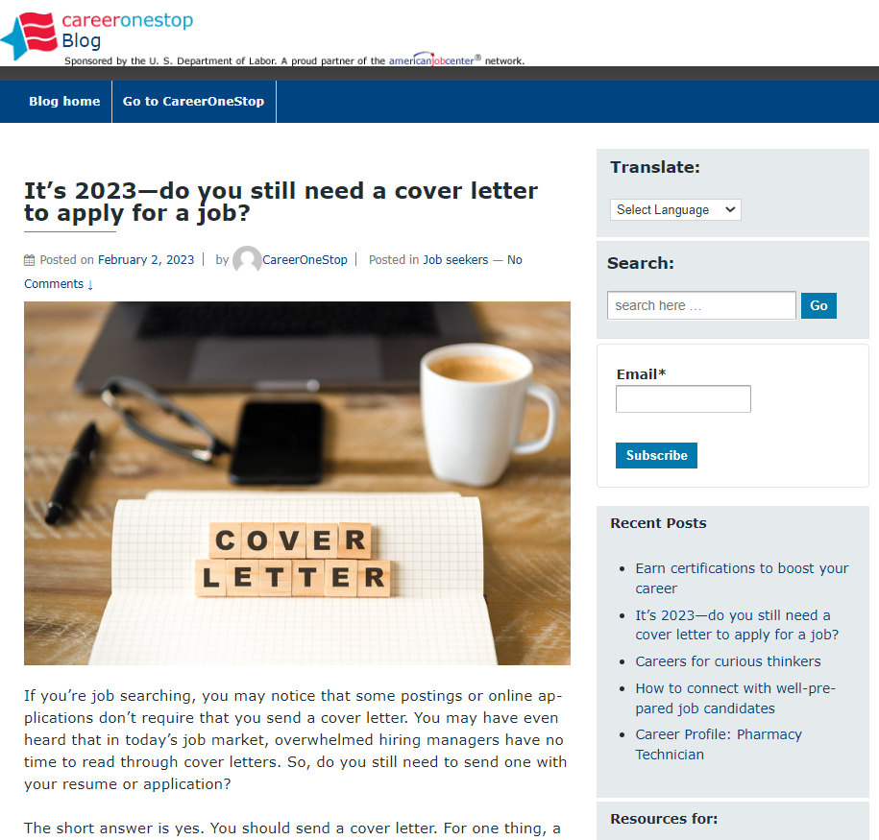
CareerOneStop Blog

Slide 23
Poll Question #2
What other user account features would you like to see for yourself or your clients?

Slide 24
Contact Information
Tricia Dahlman Operations & Outreach Manager, CareerOneStop Patricia.Dahlman@state.mn.us
Julie Remington Content Strategist, CareerOneStop Julie.Remington@state.mn.us

Slide 25
Questions

