Slide 1
Career Assessment Toolkit

Slide 2
Agenda
Brief CareerOneStop Overview
Career Assessment Toolkit
Interest Assessment
Skills Matcher
Work Values Matcher
mySkills myFuture
Questions

Slide 3
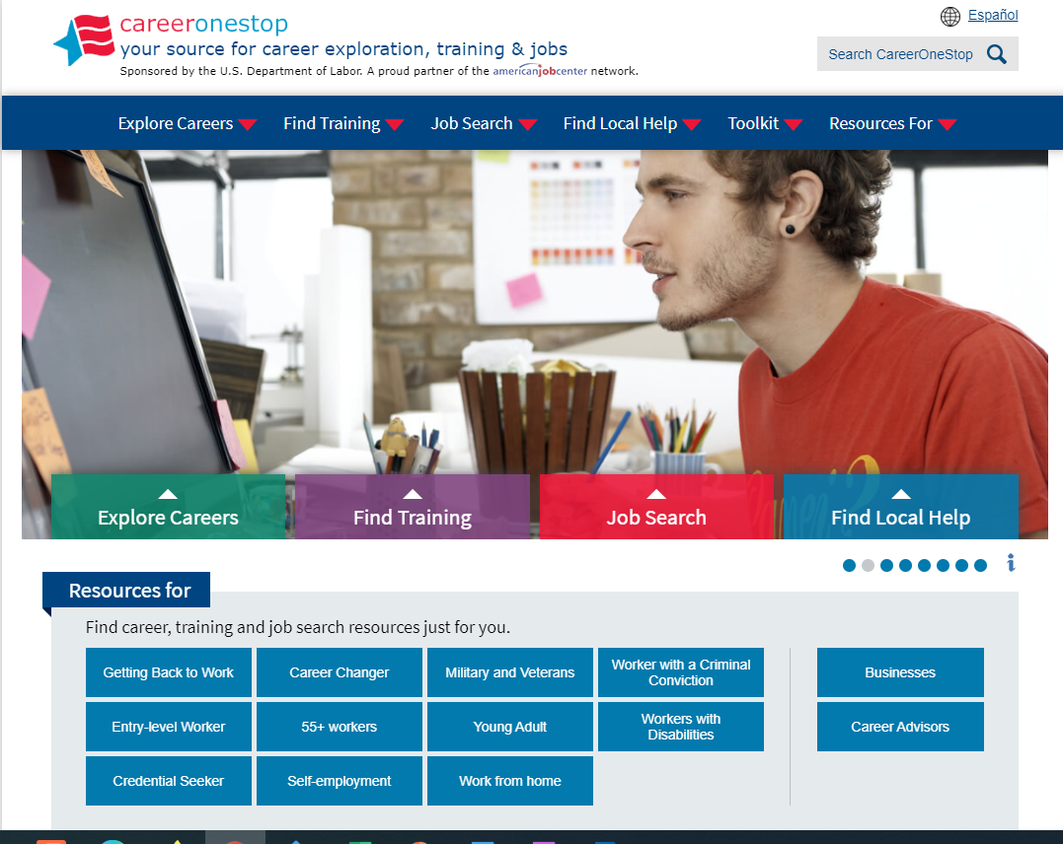
CareerOneStop
CareerOneStop is sponsored by the U.S. Department of Labor, Employment and Training Administration

Slide 4
Career Exploration Process
Take career assessments
Research career ideas
Make a reality check
Weigh priorities
Choose a career path

Slide 5
Contact Information
Tricia Dahlman Operations & Outreach Manager, CareerOneStop Patricia.Dahlman@state.mn.us
Julie Remington Content Strategist, CareerOneStop Julie.Remington@state.mn.us

Slide 6
Questions

Slide 7
Screenshots

Slide 8
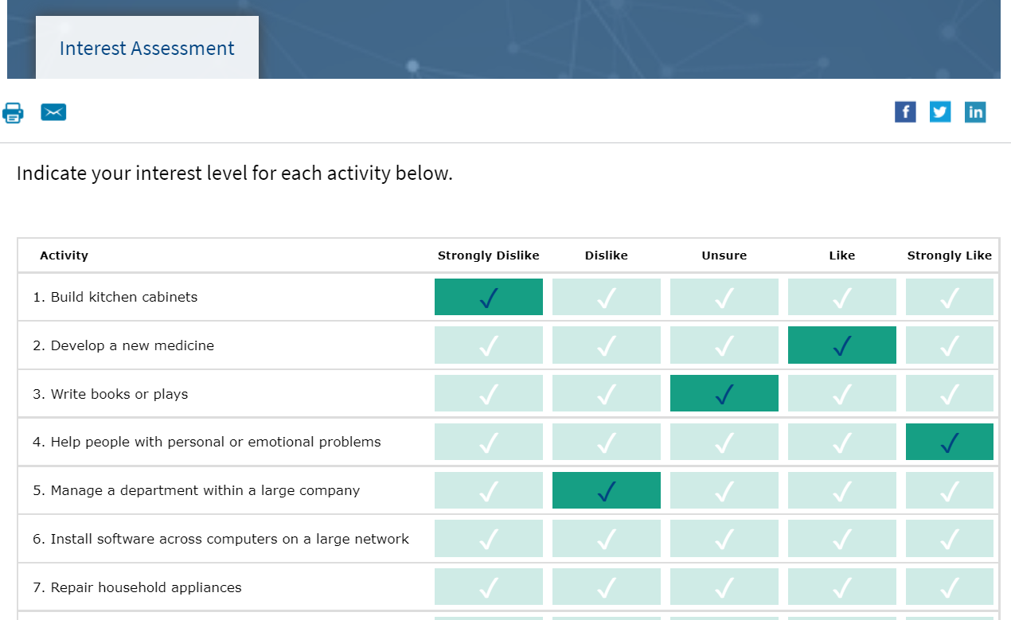
Interest Assessment

Slide 9
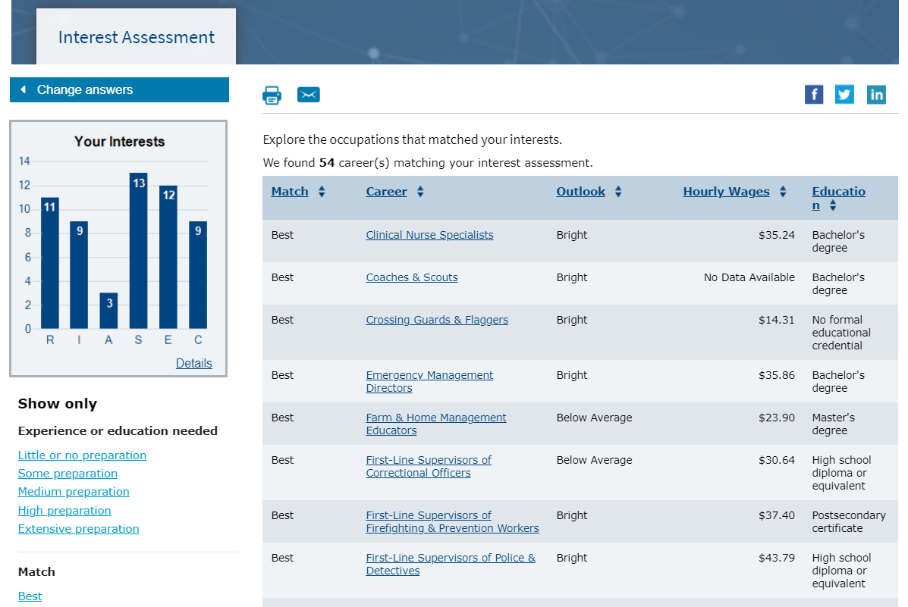
Interest Assessment Results

Slide 10
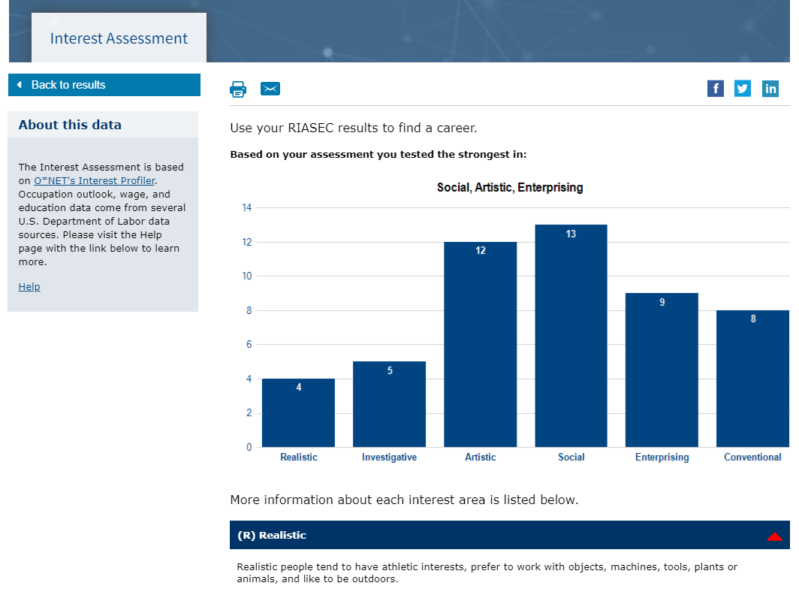
Interest Assessment Detail

Slide 11
Occupation Profile

Slide 12
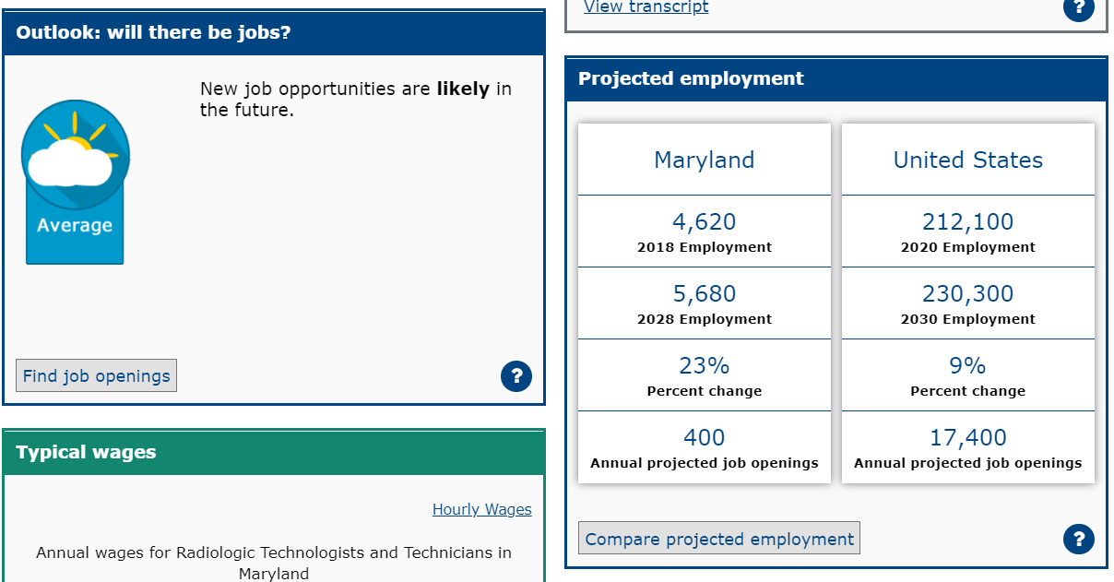
Occupation Profile

Slide 13
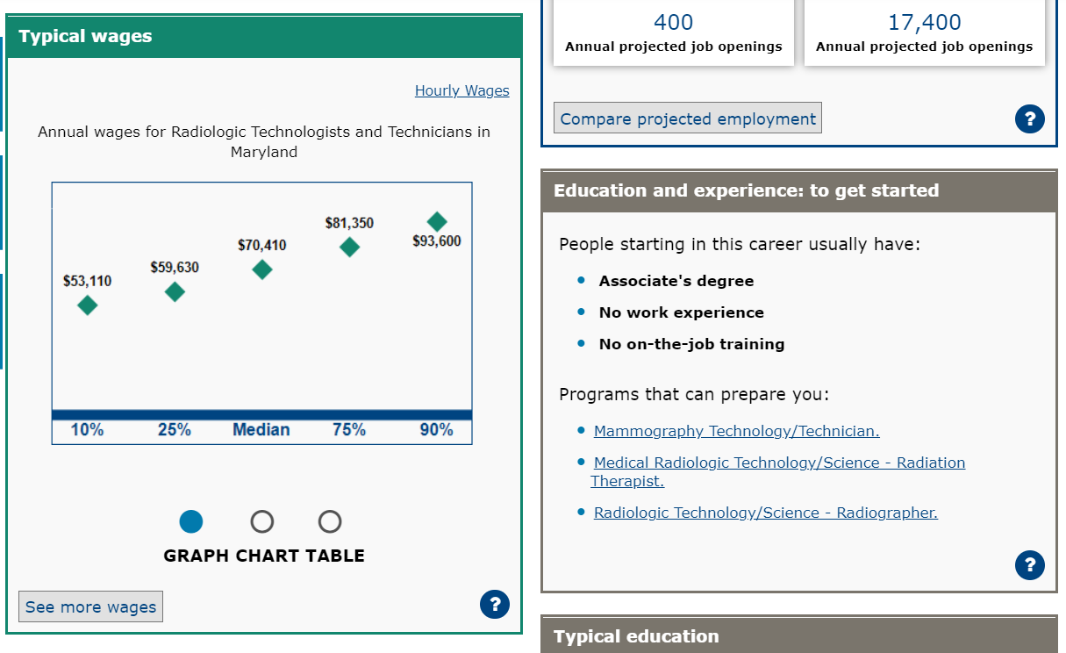
Occupation Profile

Slide 14
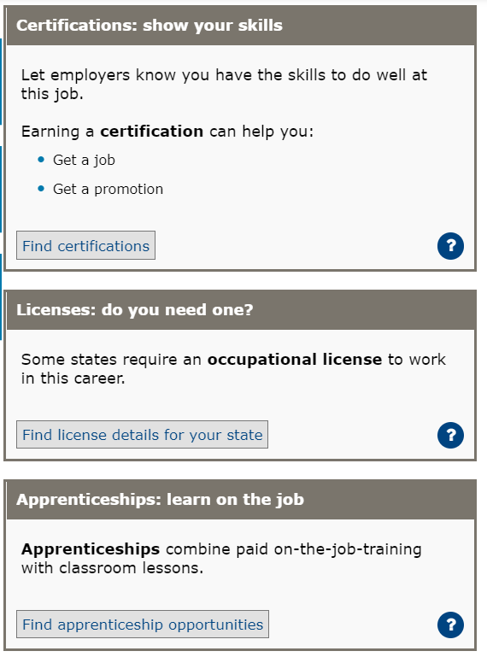
Occupation Profile

Slide 15
Occupation Profile

Slide 16
Poll Question #1
What barriers do your customers have around taking assessments?

Slide 17
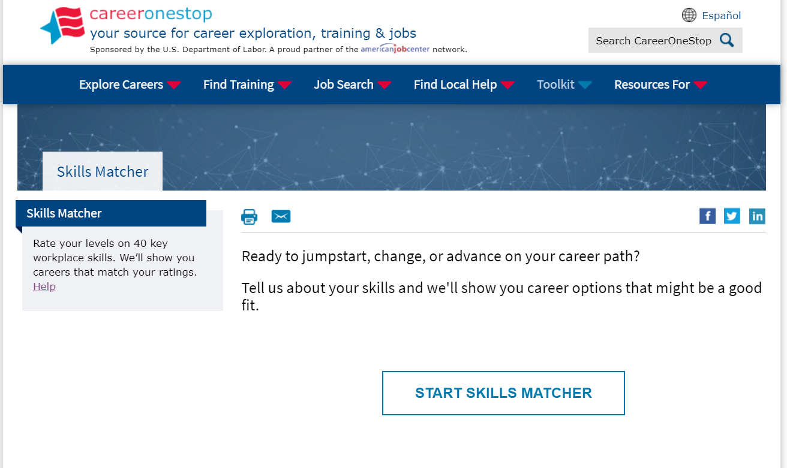
Skills Matcher

Slide 18
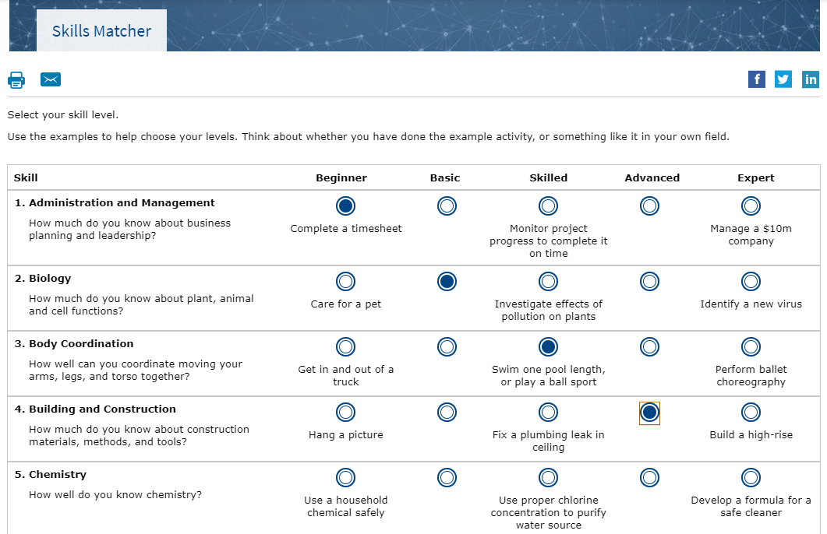
Skills Matcher

Slide 19
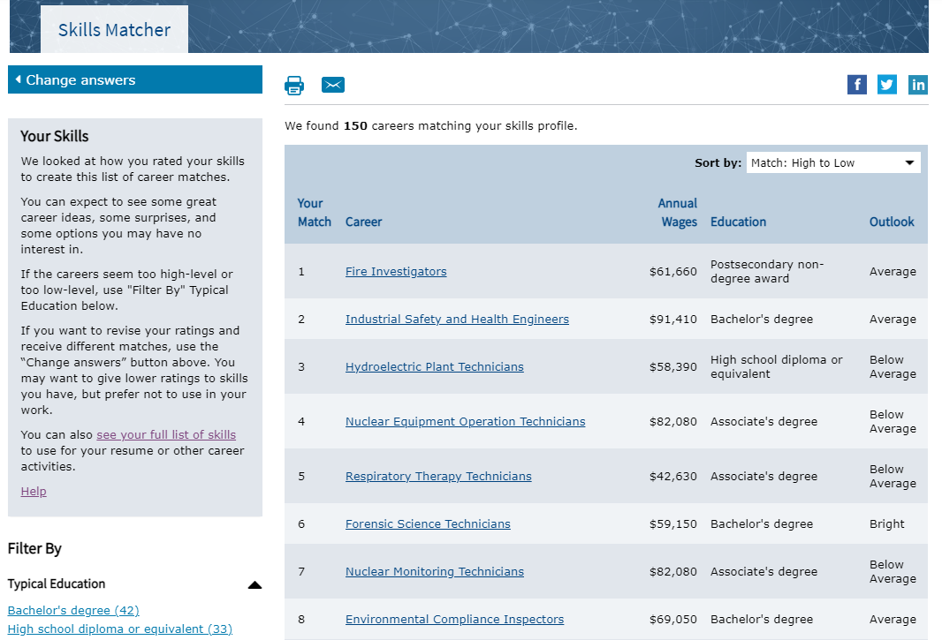
Skills Matcher Results

Slide 20
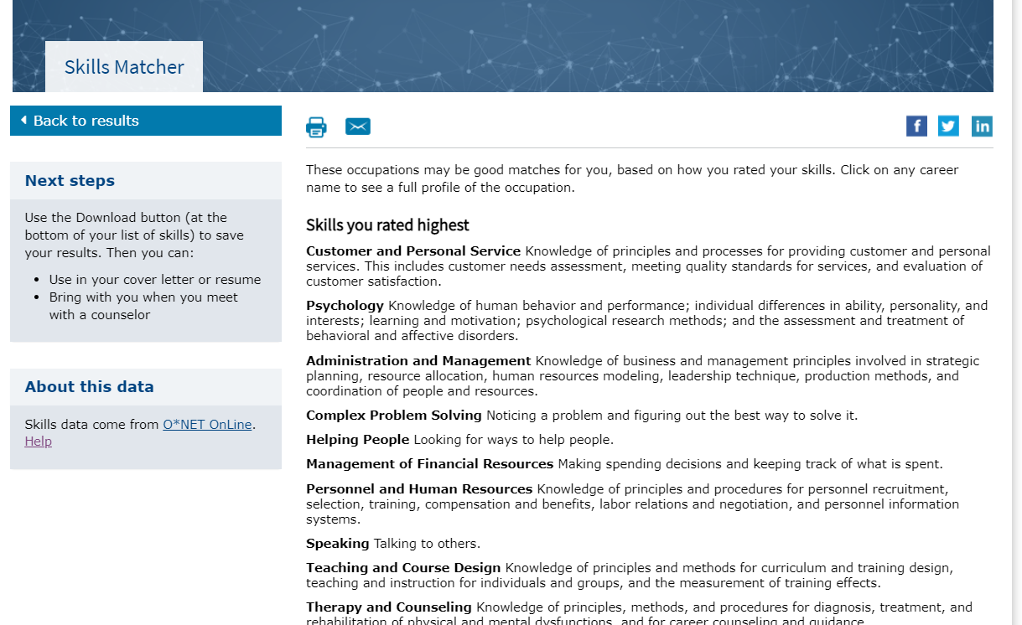
Skills Matcher Results

Slide 21
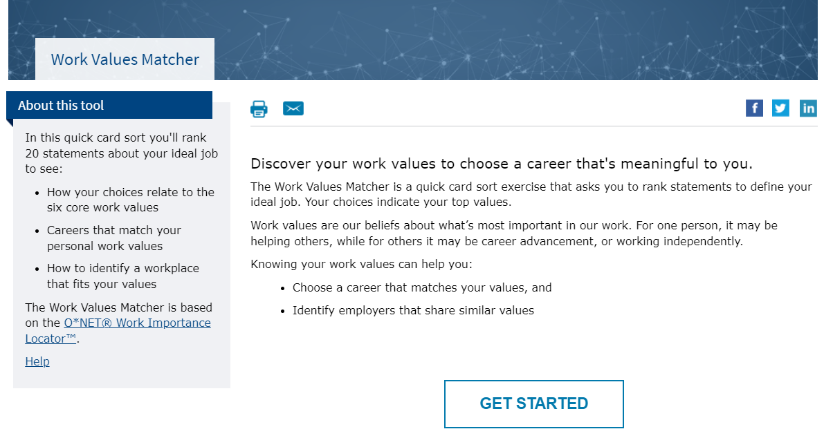
Work Values Matcher

Slide 22
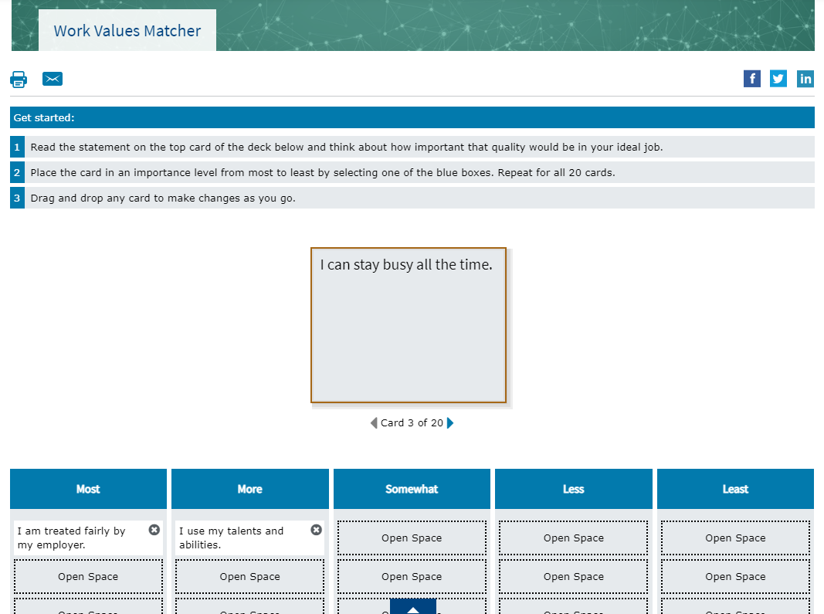
Work Values Matcher

Slide 23
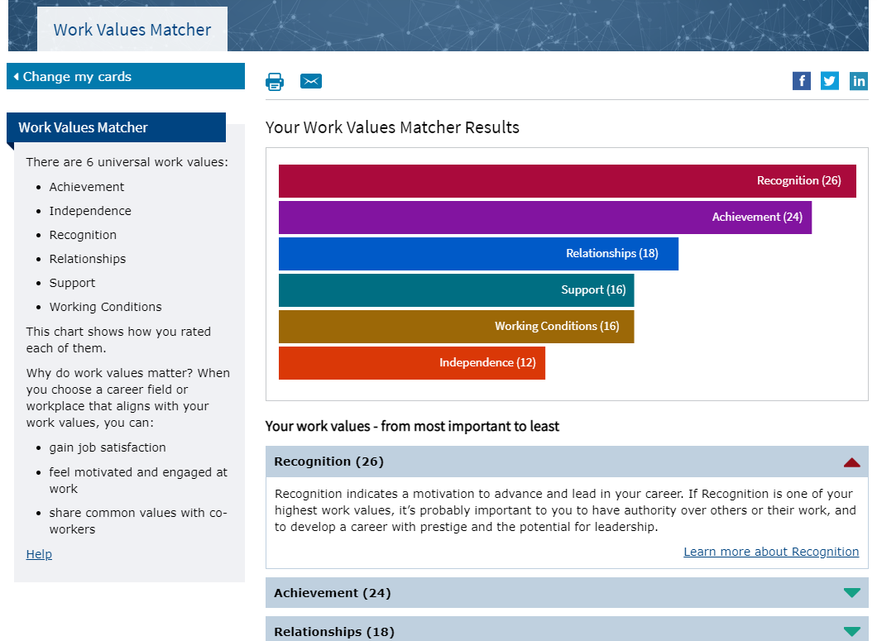
Work Values Matcher Results

Slide 24
Work Values Matcher Value Description

Slide 25
Work Values Matcher Career List

Slide 26
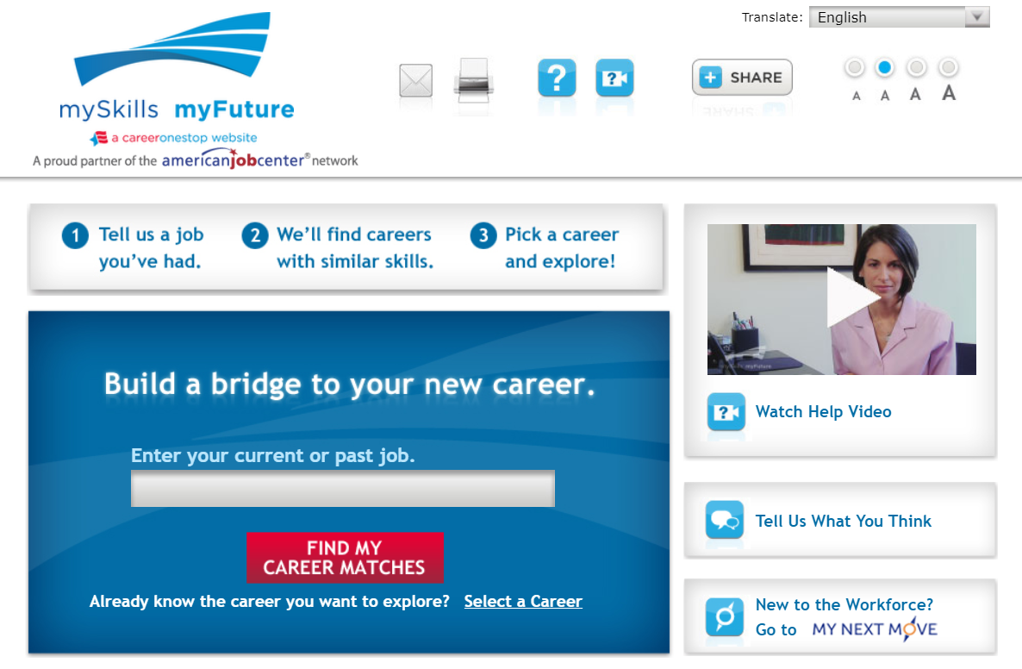
mySkills myFuture

Slide 27
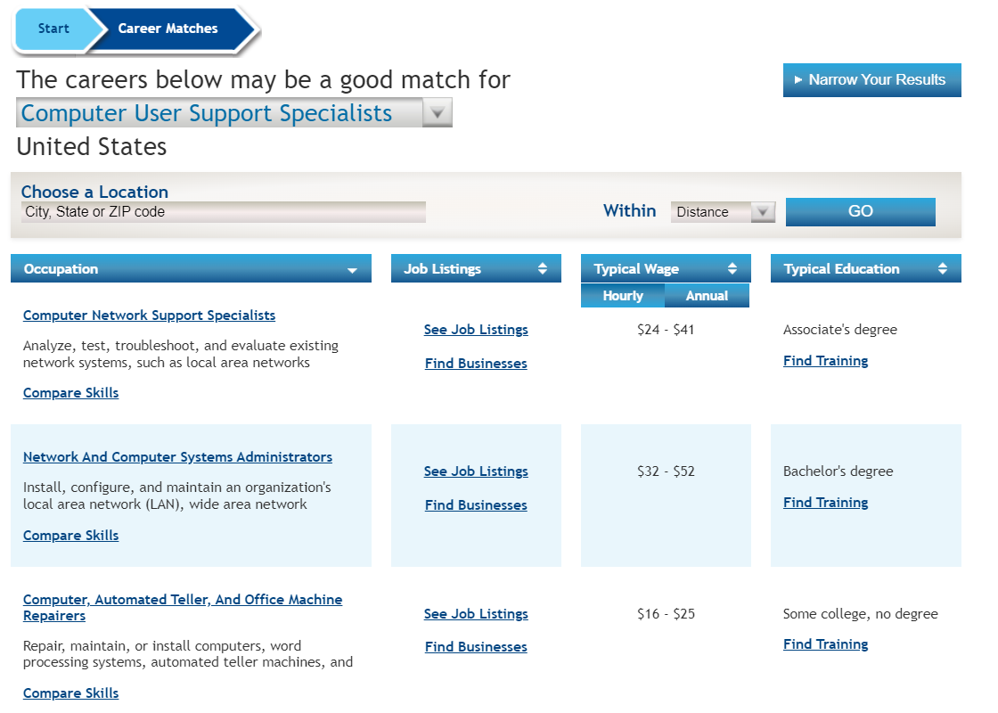
mySkills myFuture: Career Matches

Slide 28
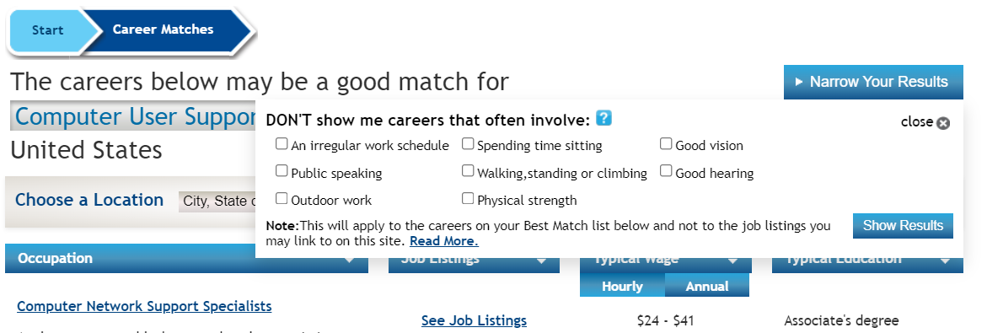
mySkills myFuture: Career Matches

Slide 29
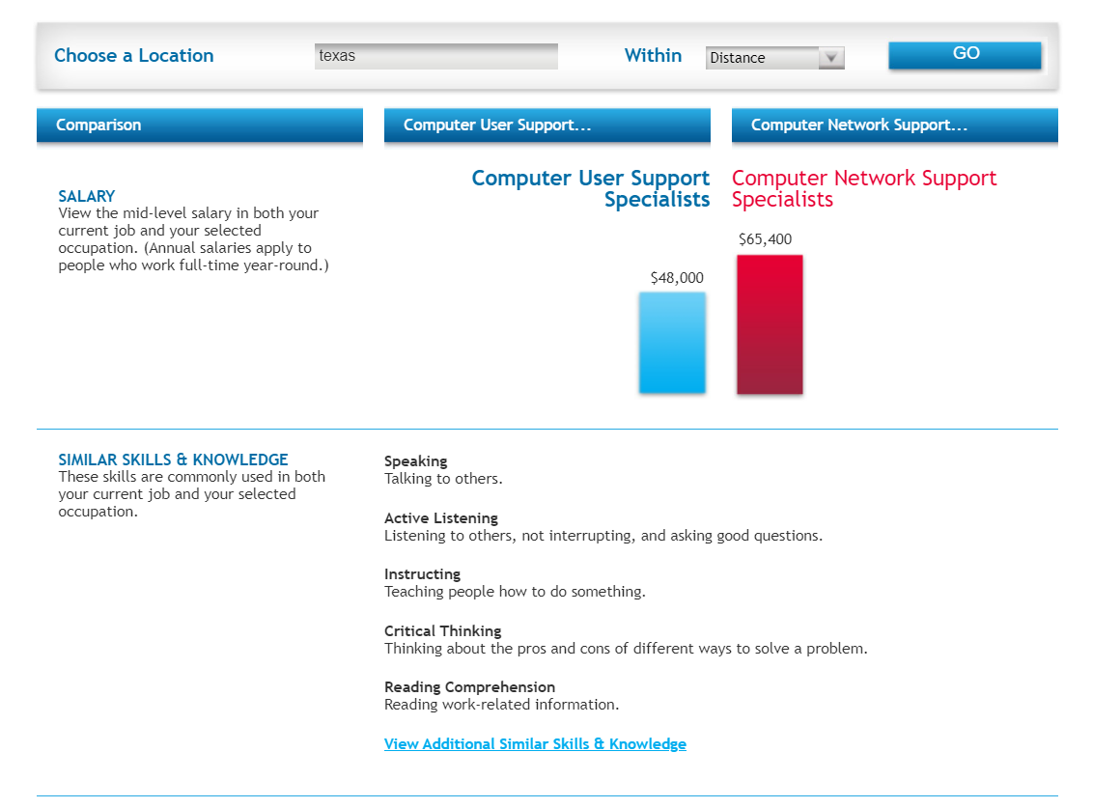
mySkills myFuture: Compare Skills

Slide 30
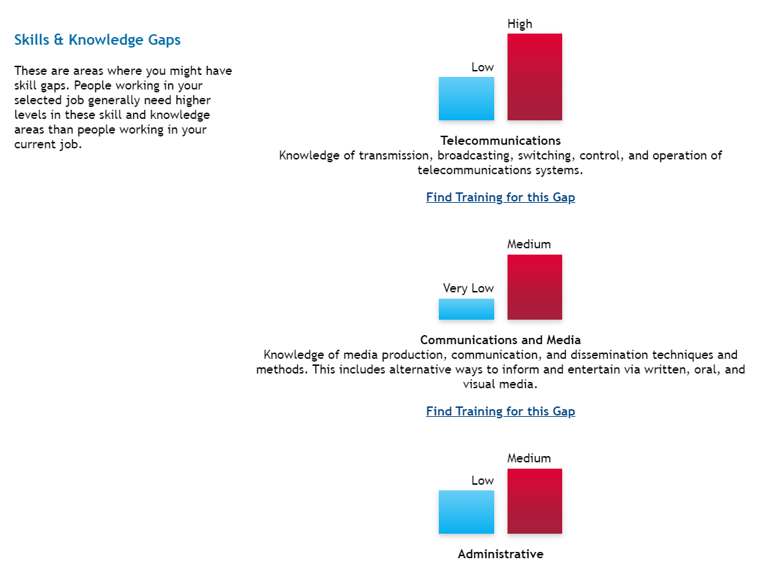
mySkills myFuture: Compare Skills

Slide 31
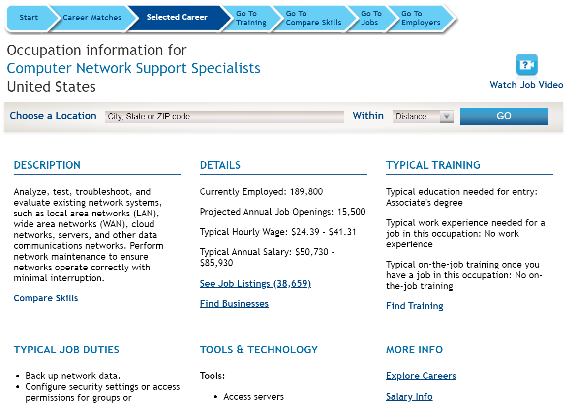
mySkills myFuture: Career Profile

Slide 32
Poll Question #2
What other types of career-related assessments would you like to see on CareerOneStop?

Slide 33
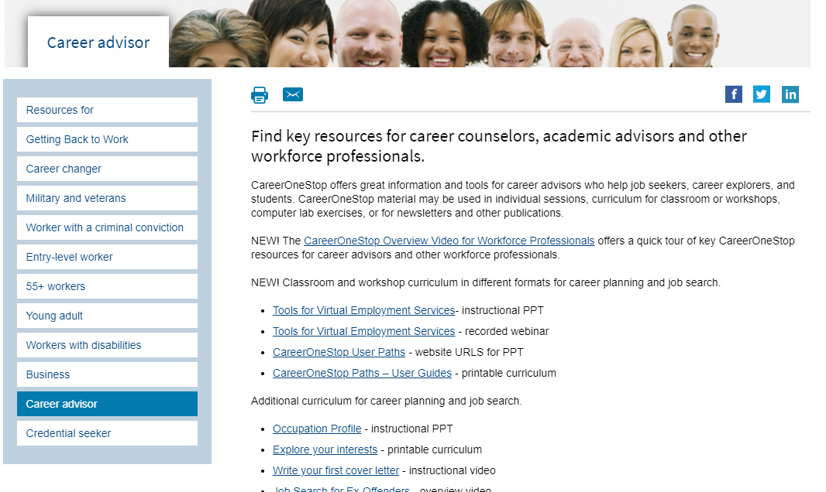
Career Advisor

