Slide 1
CareerOneStop Tools to Help Your
Customers Get Back to Work

Slide 2
Economic Recovery in Process
Large-scale pandemic-related unemployment is shifting
Growing reemployment for some
Employers need workers
Job losses persist for some
“Great reshuffle”: career changers seek better pay, conditions, and flexibility

Slide 3
Agenda
Brief CareerOneStop Overview
Top Ten Tools for Reemployment
Questions

Slide 4
Poll Question #1
How familiar are you with CareerOneStop?
Never heard of it before
Heard of the name, but I’ve never used it
Use it sometimes, but not an expert
Use it often

Slide 5
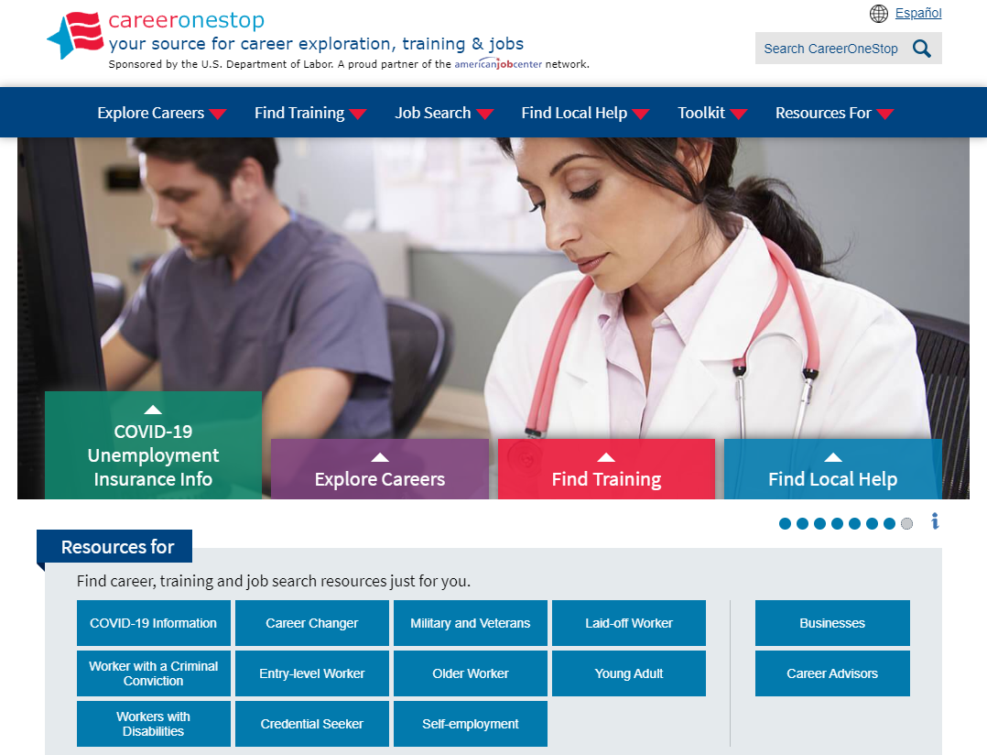
CareerOneStop
CareerOneStop is sponsored by the U.S. Department of Labor, Employment and Training Administration

Slide 6
Contact Information
Tricia Dahlman Operations & Outreach Manager, CareerOneStop Patricia.Dahlman@state.mn.us
Julie Remington Content Strategist, CareerOneStop Julie.Remington@state.mn.us

Slide 7
Poll Question #4
What topics would you like CareerOneStop to cover in future webinars?

Slide 8
Questions

Slide 9
Screenshots

Slide 10
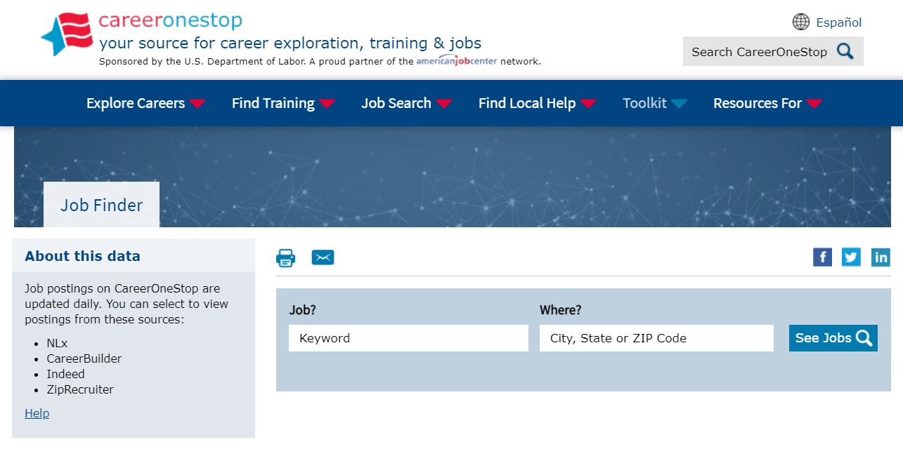
Job Finder

Slide 11
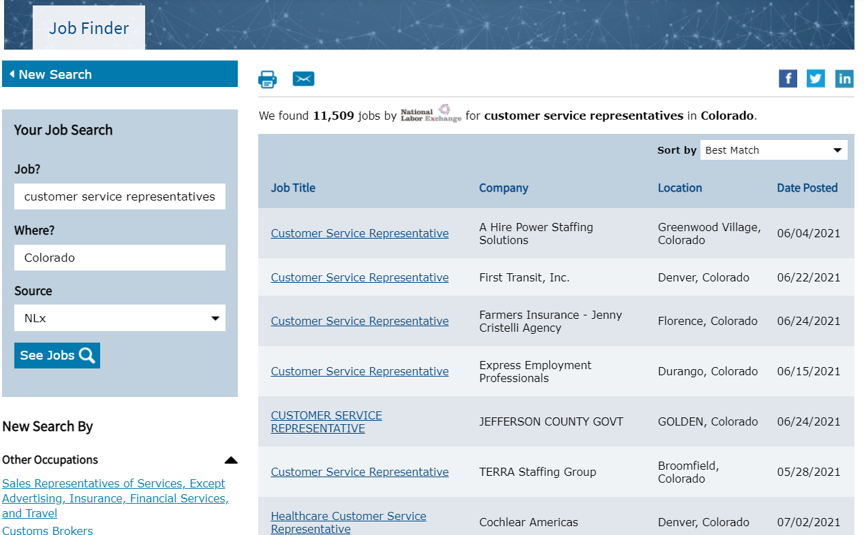
Job Finder Results Page

Slide 12
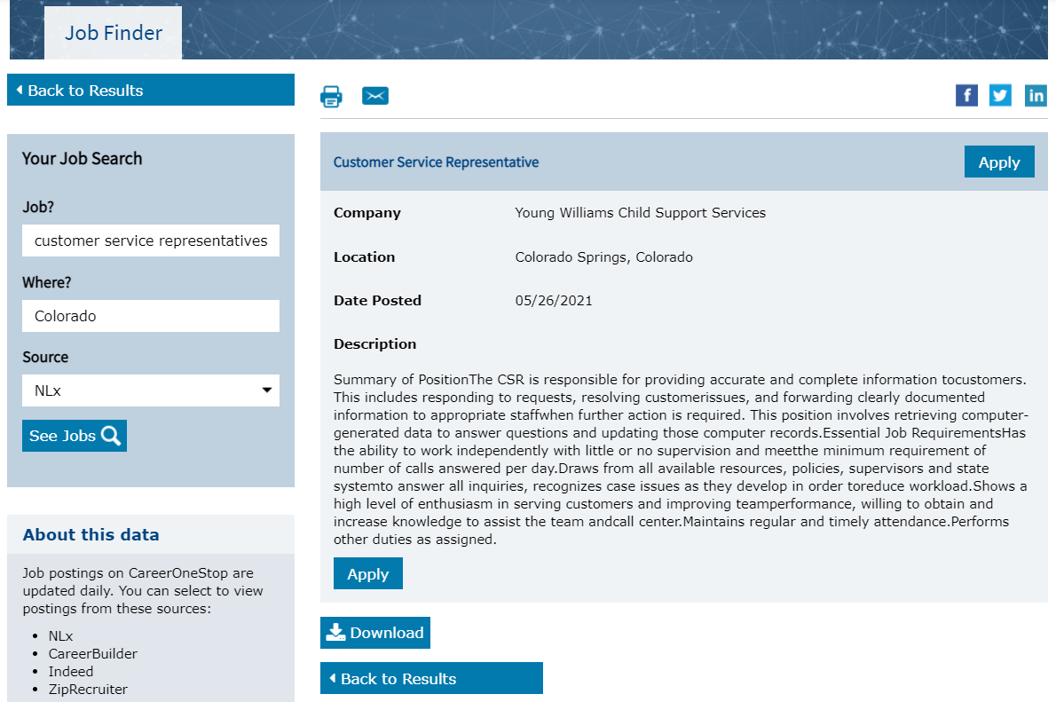
Job Finder Detail Page

Slide 13
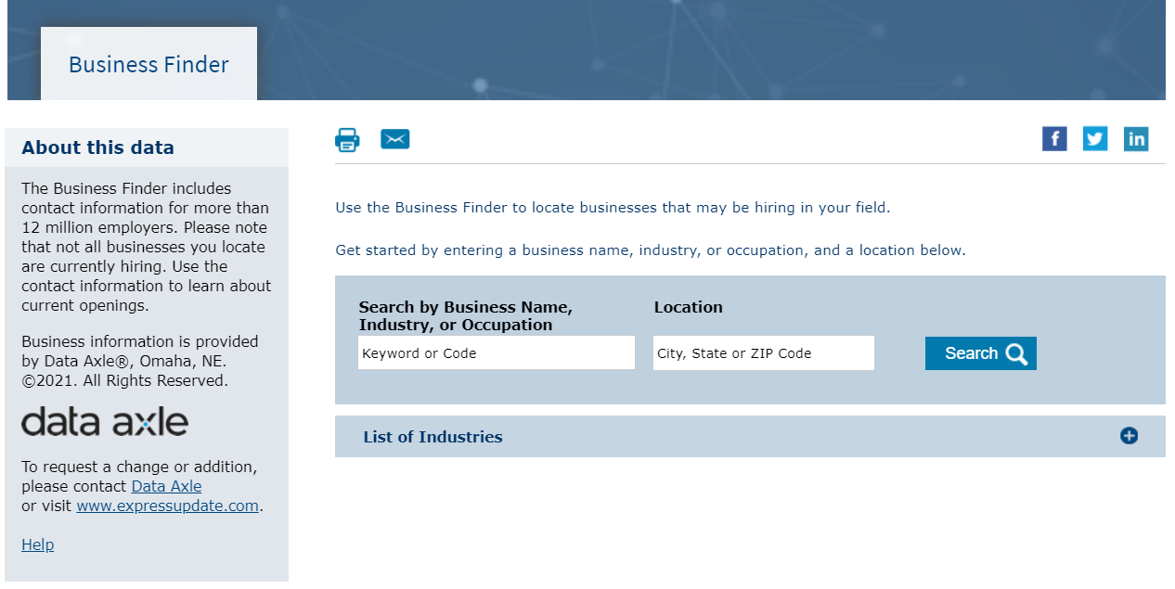
Business Finder

Slide 14
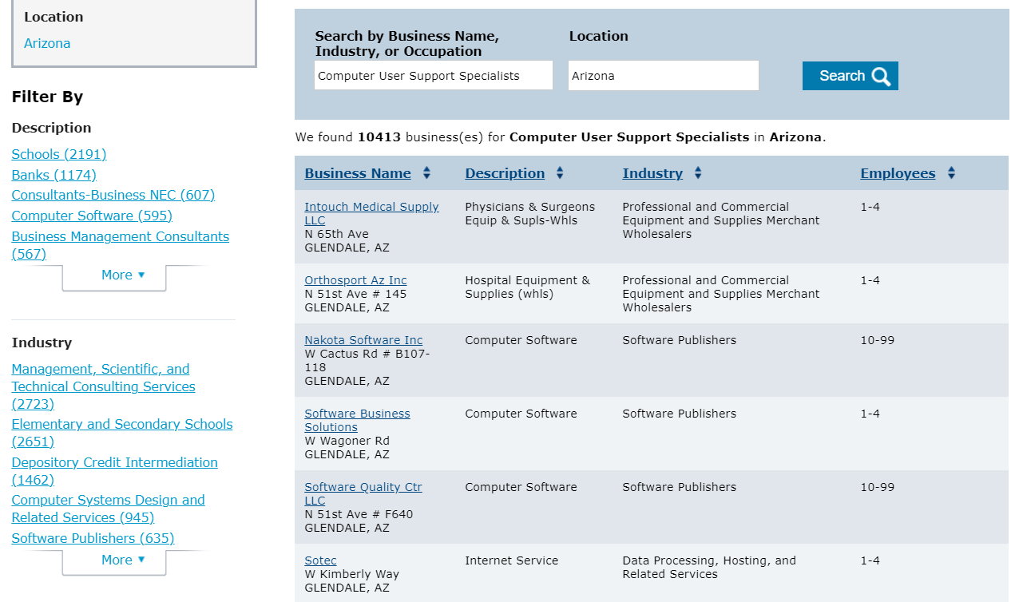
Business Finder Results Page

Slide 15
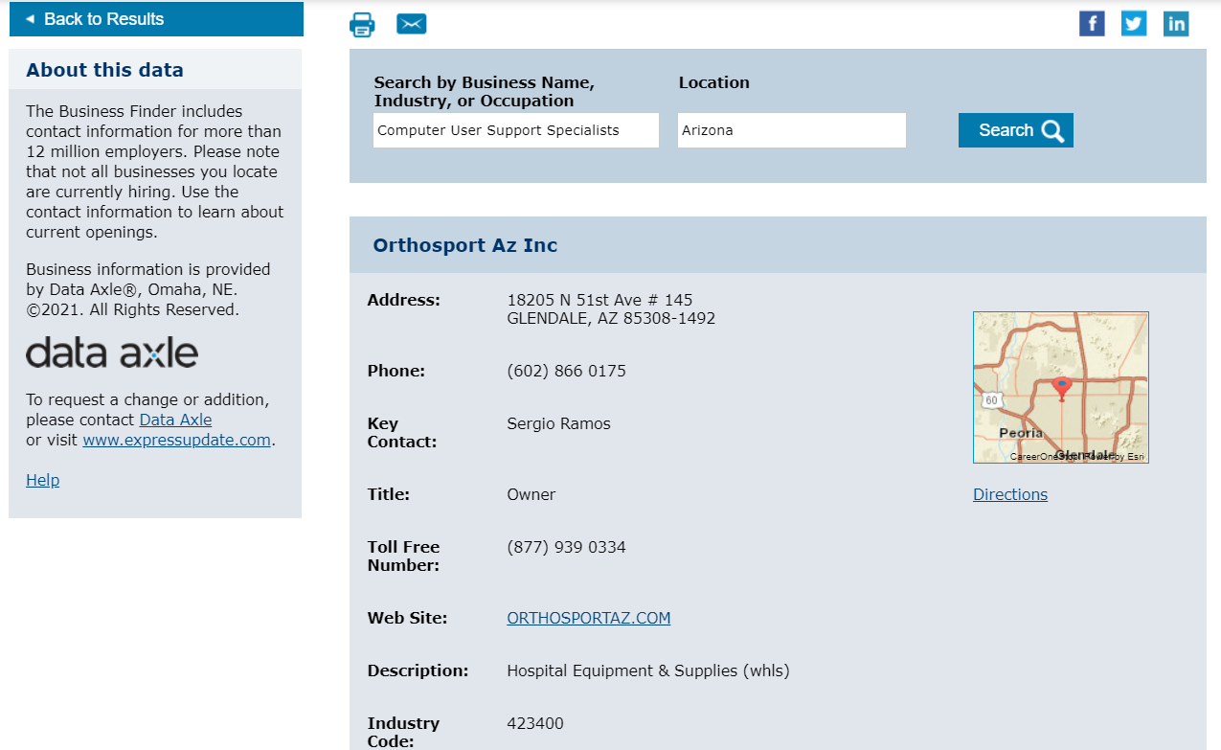
Business Finder: Detail Page

Slide 16
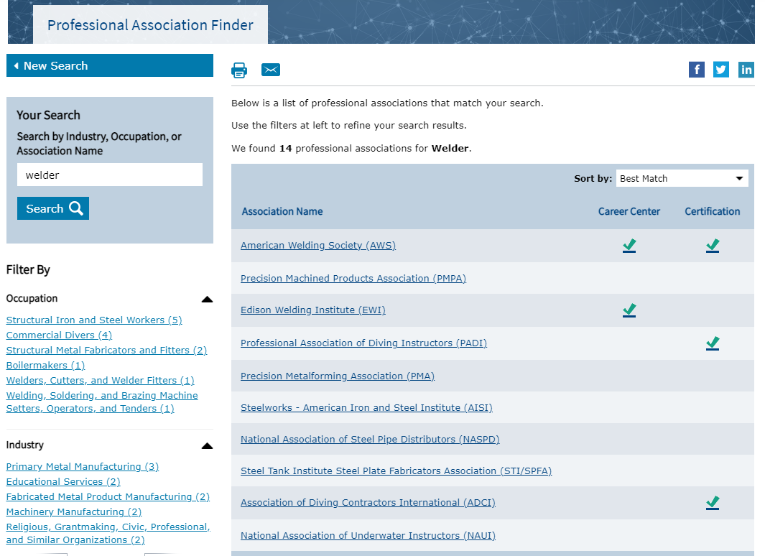
Professional Association Finder

Slide 17
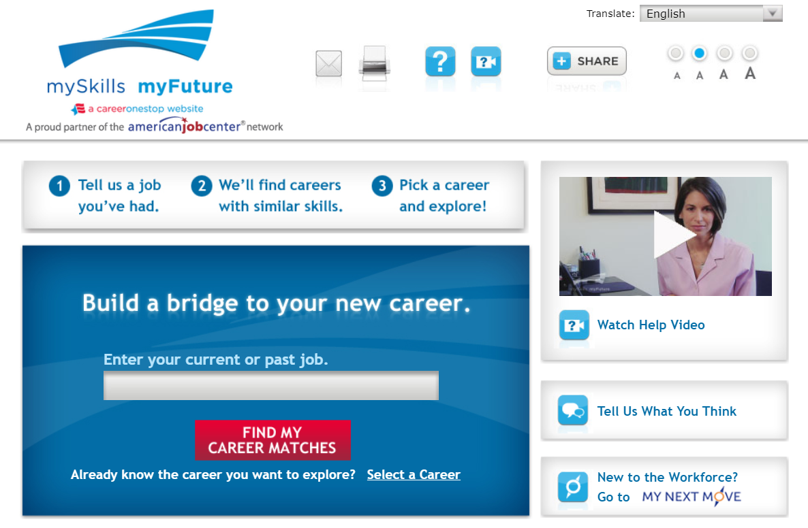
mySkills myFuture

Slide 18
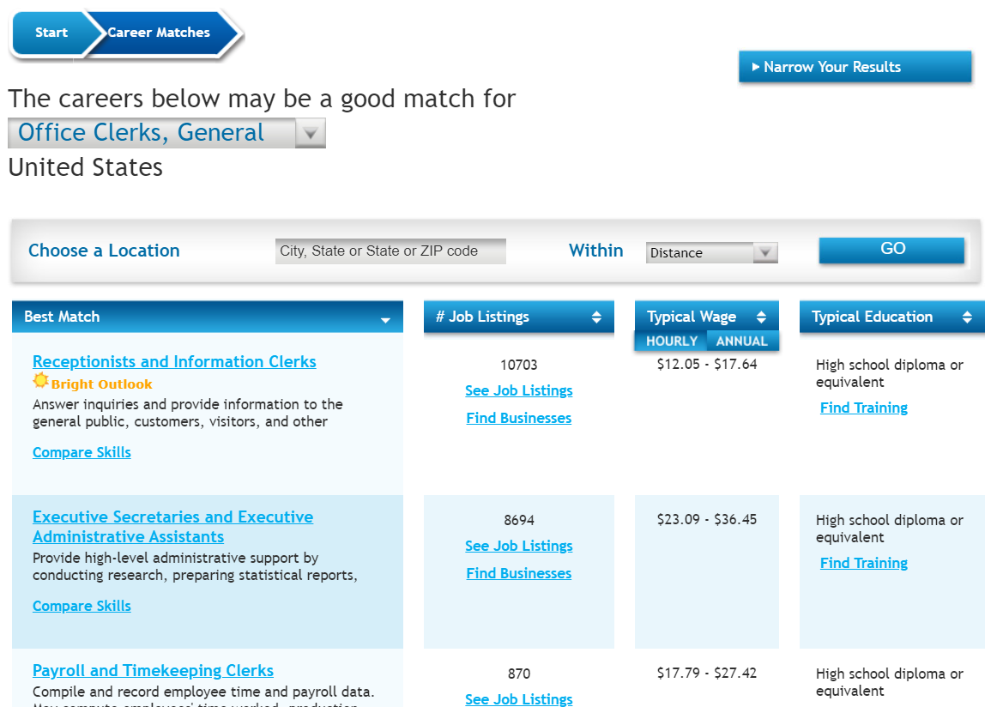
mySkills myFuture: Career Matches

Slide 19
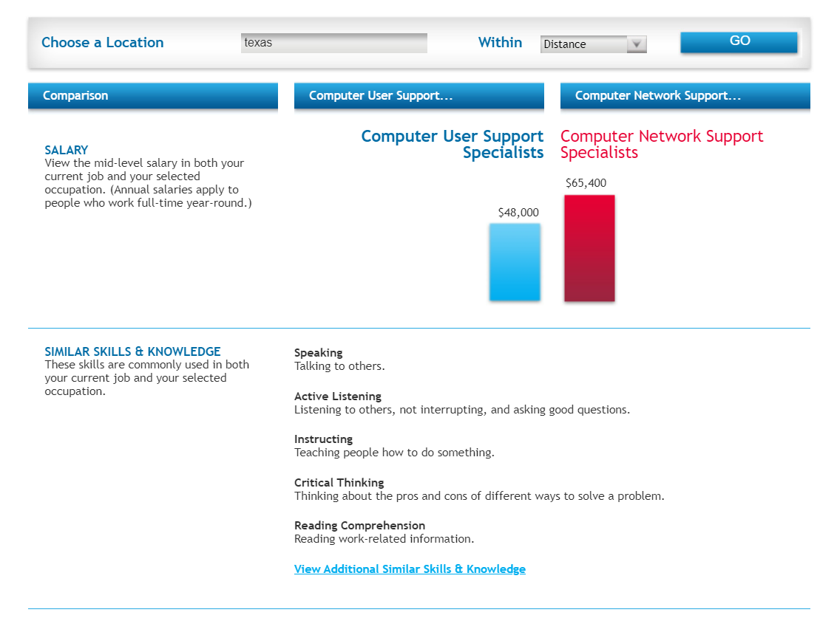
mySkills myFuture: Compare Skills

Slide 20
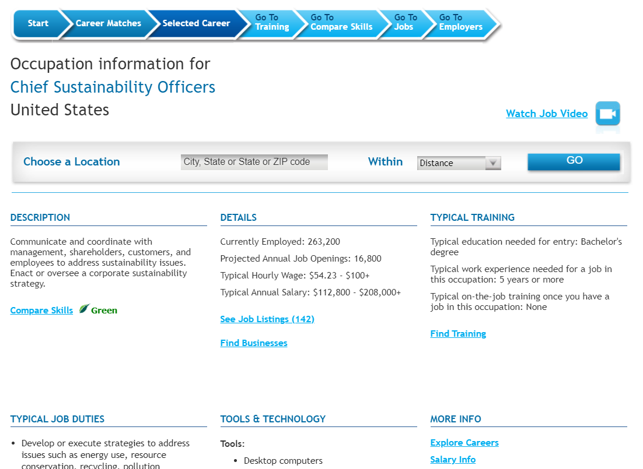
mySkills myFuture: Career Profile

Slide 21
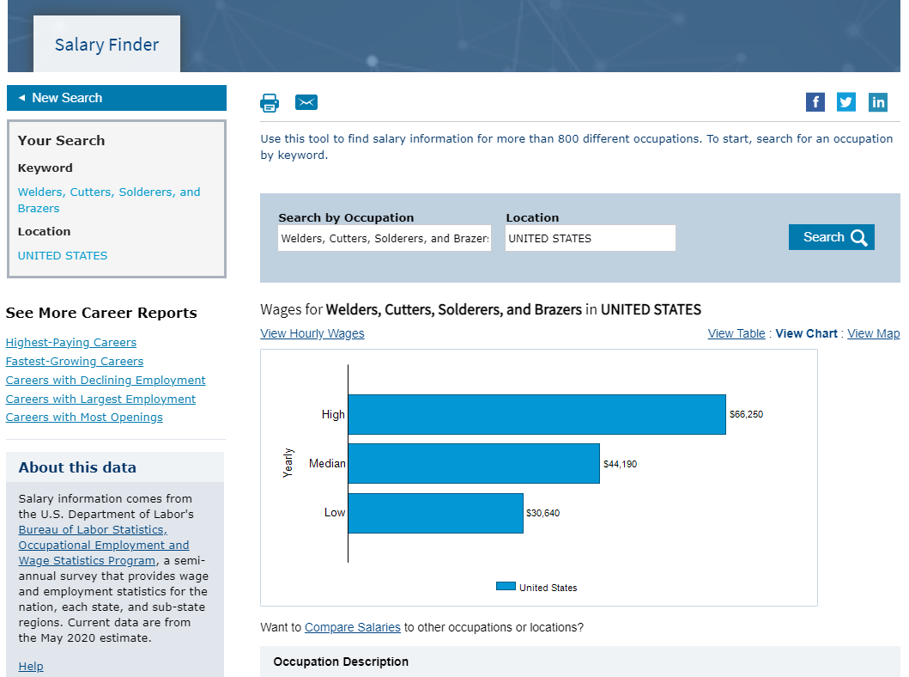
Salary Finder

Slide 22
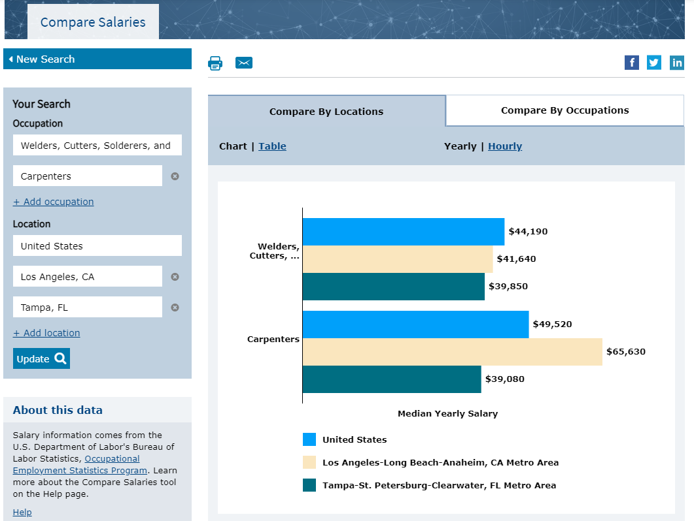
Compare Salaries

Slide 23
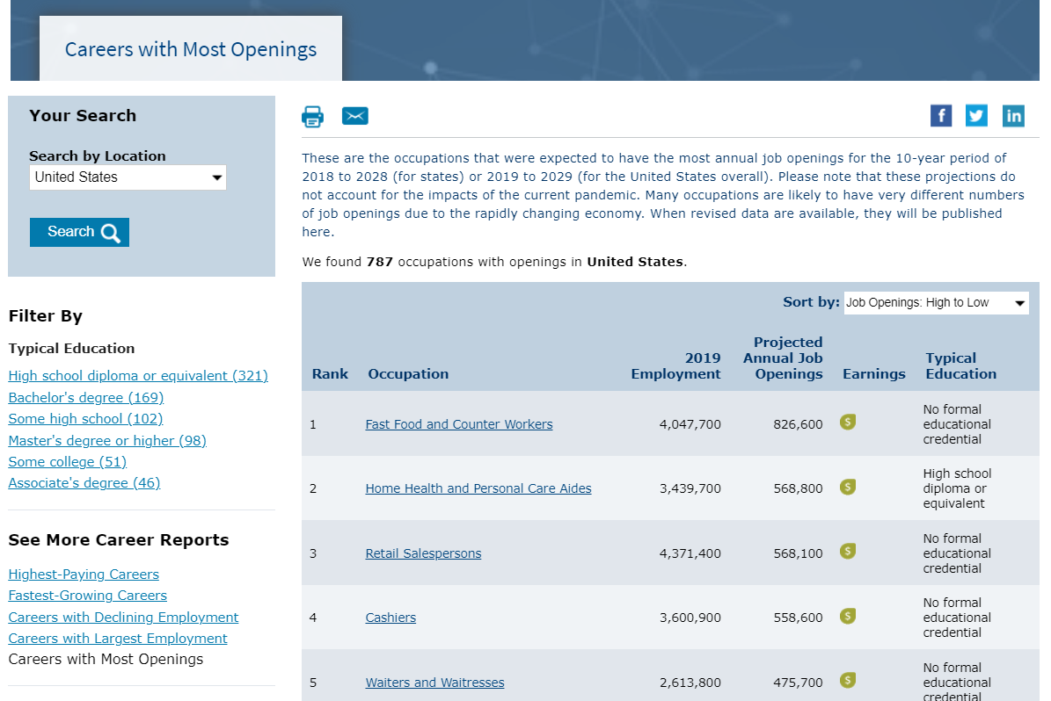
Career Reports: Most Openings

Slide 24
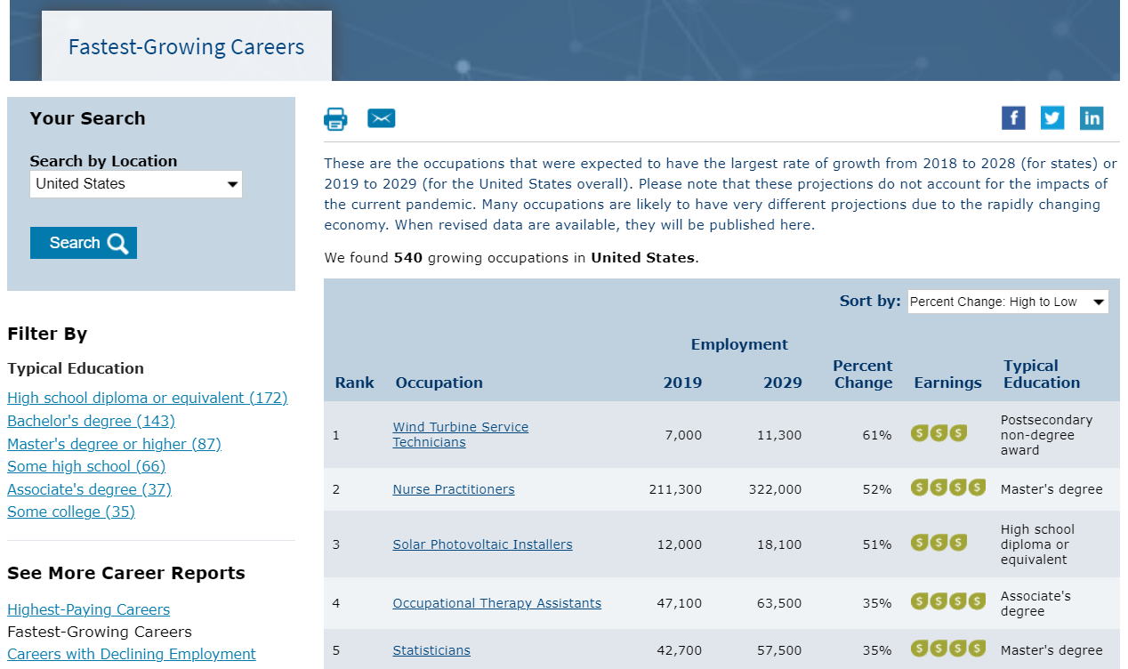
Career Reports: Fastest Growing

Slide 25
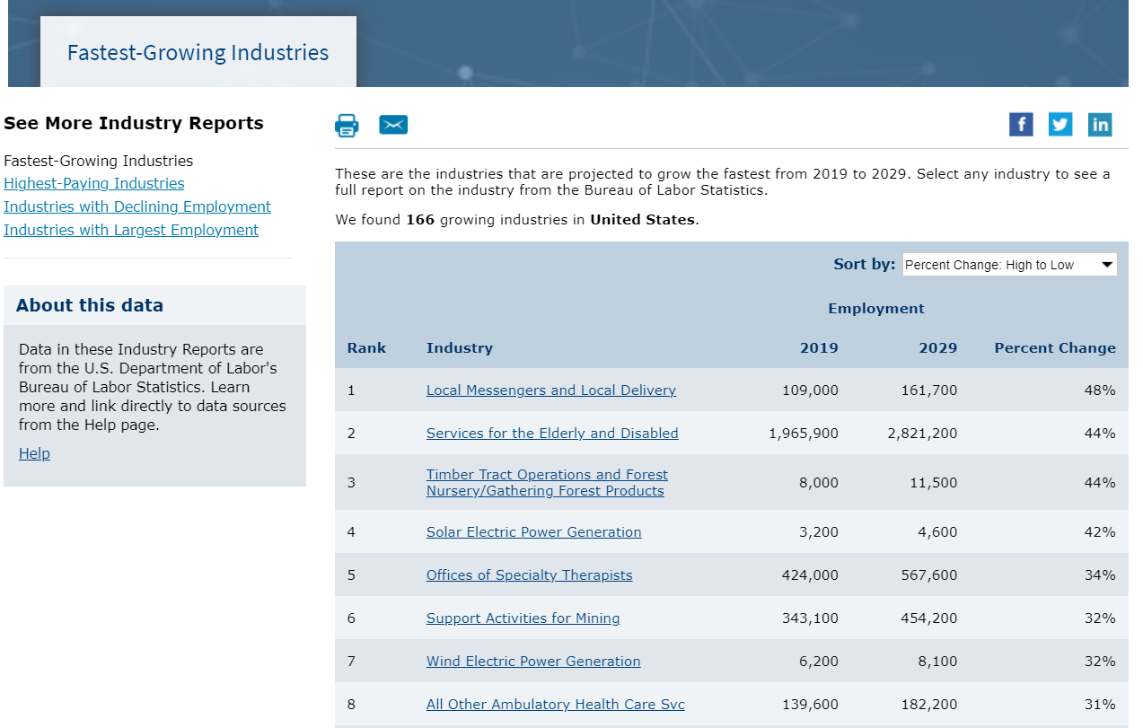
Industry Reports: Highest Paying

Slide 26
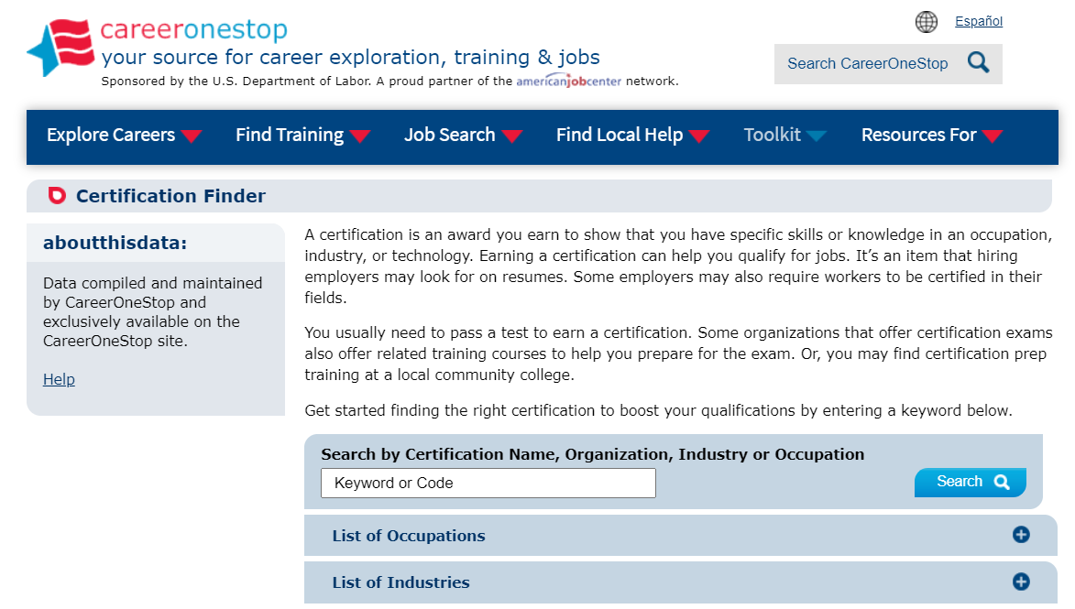
Certification Finder

Slide 27
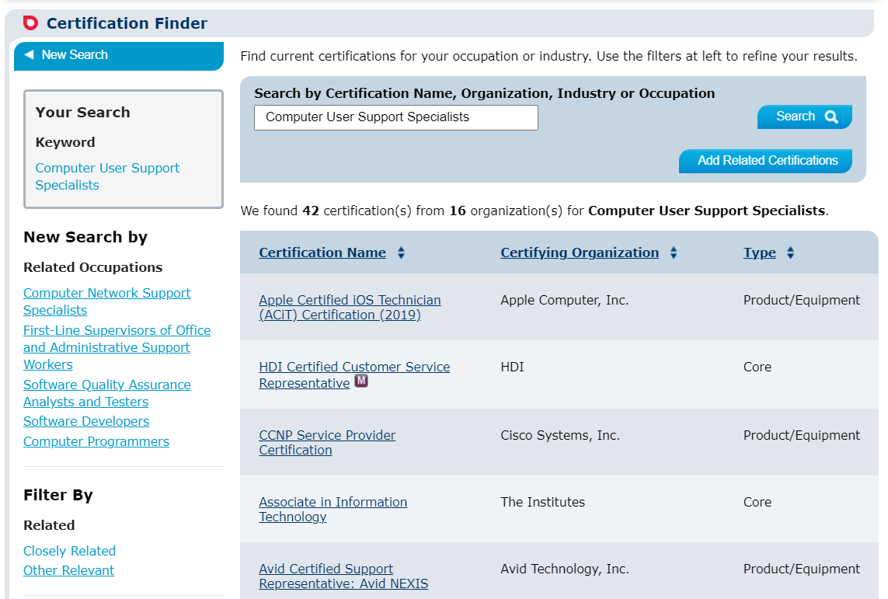
Certification Finder Results Page

Slide 28
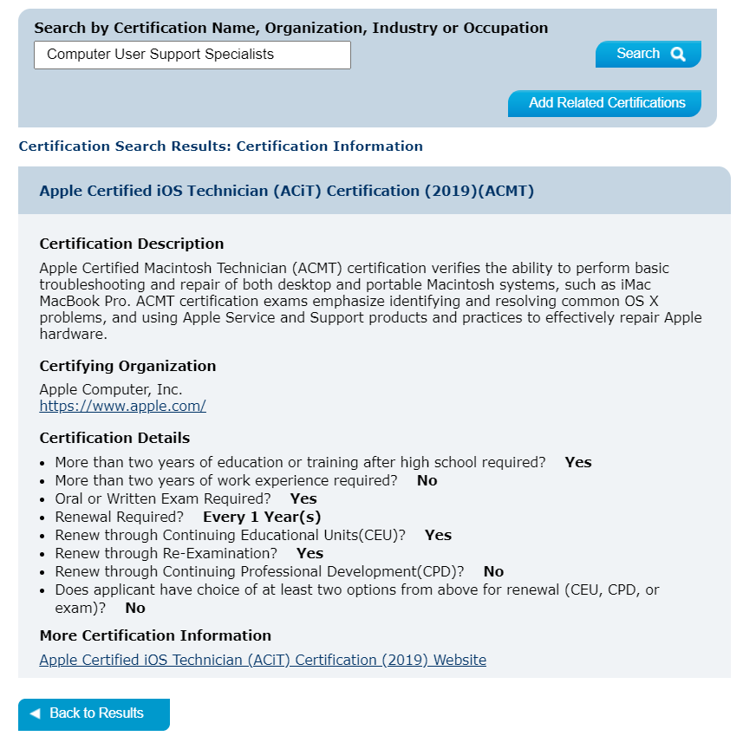
Certification Finder Detail Page

Slide 29
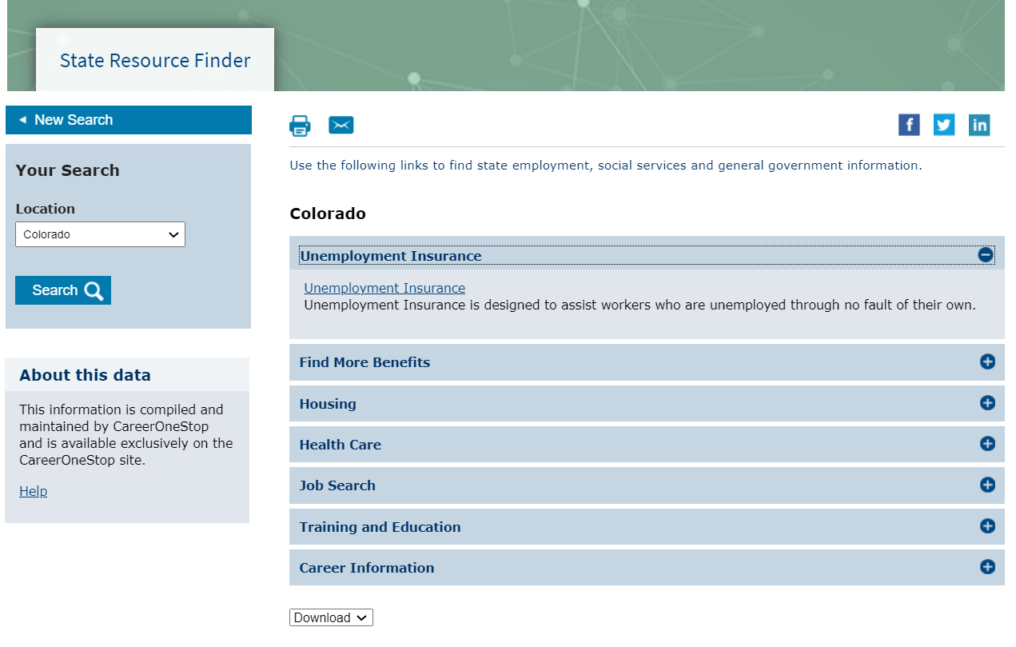
State Resource Finder

Slide 30
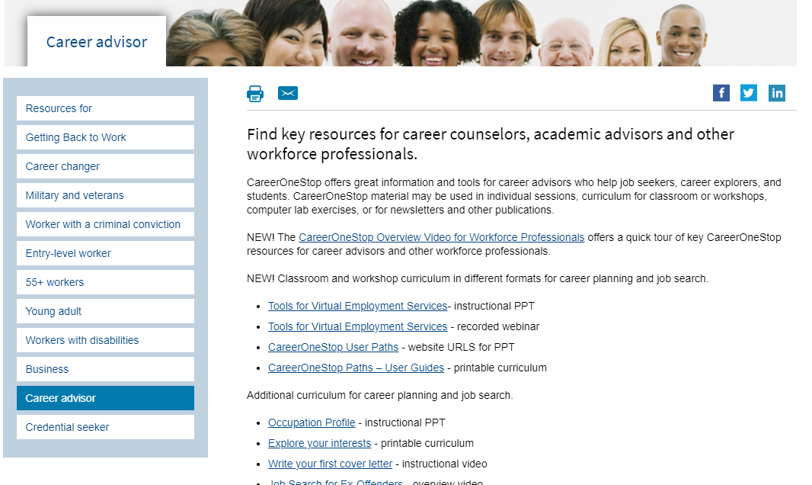
Career Advisors

Slide 31
Poll Question #2
Do you see a “reshuffle” going on with the job seekers you work with?
Yes, they want to change occupations
Yes, they want to change industries
Yes, they want to change both occupation and industry
No, they want a job in the same occupation and industry

Slide 32
Poll Question #3
How do you currently deliver employment services to job seekers?
In-person services
Virtual services
A combination of both, but mainly in-person services
A combination of both, but mainly virtual services

