Slide 1
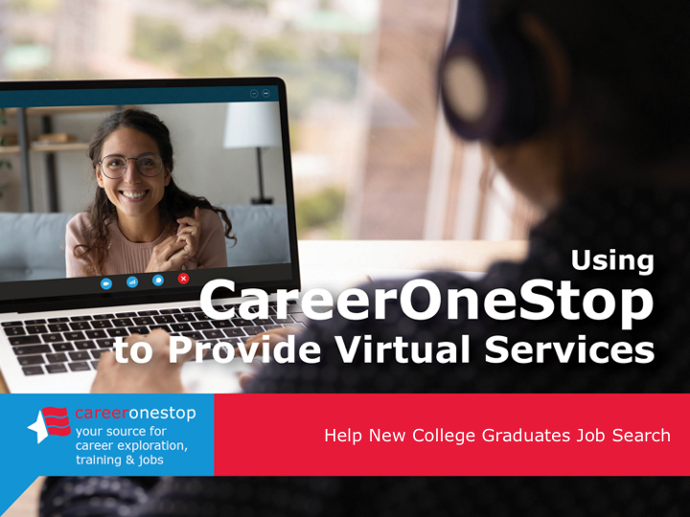

Help New College Graduates Job Search

Slide 2
Challenge
Many employment services transitioned to online formats since in-person employment counseling sites closed or reduced their hours, at the same time that demand for services has grown.

Slide 3

Agenda
Brief CareerOneStop overview
User Path:
Help new college graduates job search
Questions

Slide 4
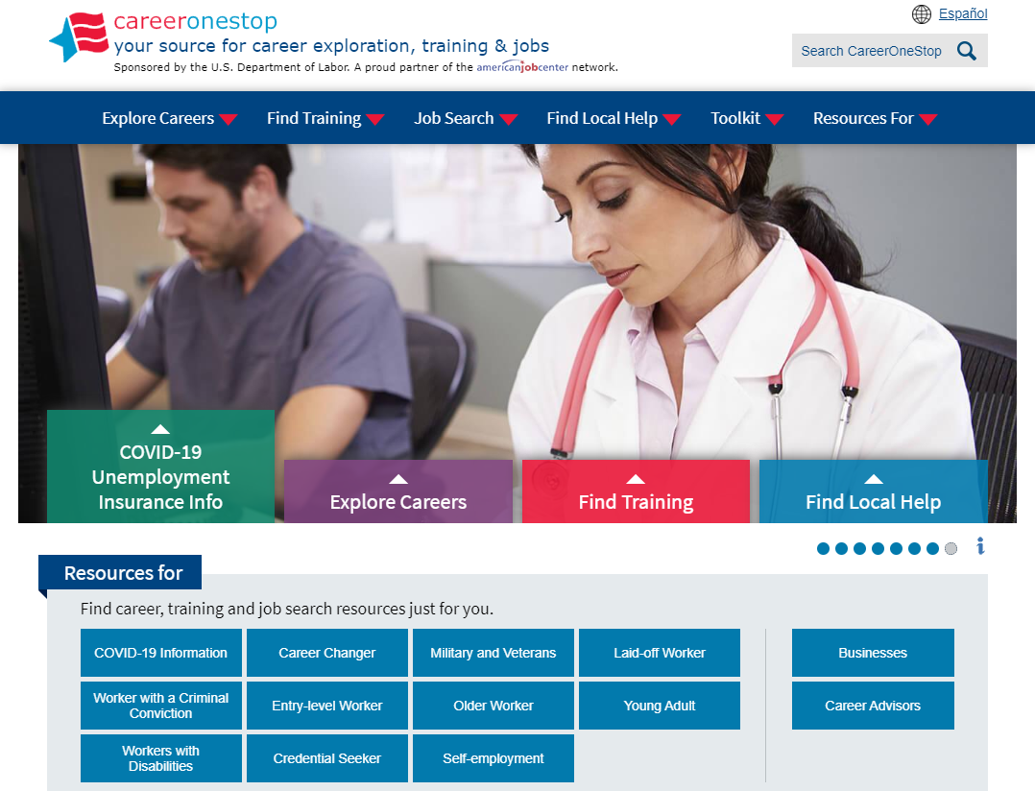

CareerOneStop
CareerOneStop is sponsored by the U.S. Department of Labor, Employment and Training Administration

Slide 5

Customer Needs
What benefits and other forms of assistance are available to me?
I need short term, immediate employment
I need a longer-term career plan
I just graduated from college, what do I do?
What options are available to develop new skills or knowledge?

Slide 6
Path: Job Search for
New College Grads
Goal
If you are a recent college graduate or anticipate graduating soon, learn methods for exploring careers, and important steps in a job search to support your career success.
Objectives
Identify your career interests using the Interest Assessment.
Prioritize your values with the Work Values Matcher.
Read about occupations from your assessment results and select 1-2 job titles to focus your search on.
Create or improve your resume.
Make a networking plan and reach out to at least 3 contacts in your field of interest.
Create or update social media profiles and activity to reflect job search goals.
Research employers in your field and local area, identify 3 to contact.
Use job banks to search for job openings in your targeted fields.
Explore a range of options to gain work experience, including
volunteer work, internships, gig work, part time, temporary jobs,
and full-time work.

Slide 7
Path: Job Search for
New College Grads
Key Resources
GetMyFuture website
www.GetMyFuture.org
    Interest Assessment
    Work Values Matcher
    Occupation Profile
    Resume Guide
    Find Job Openings
    Job Finder
    Get Work Experience
    User Guide
_

Slide 8
Contact Information
Tricia Dahlman
Business Technology Manager, CareerOneStop
Patricia.Dahlman@state.mn.us
Julie Remington
Content Strategist, CareerOneStop
Julie.Remington@state.mn.us
_
_

Slide 9
Questions

Slide 10
Screenshots

Slide 11
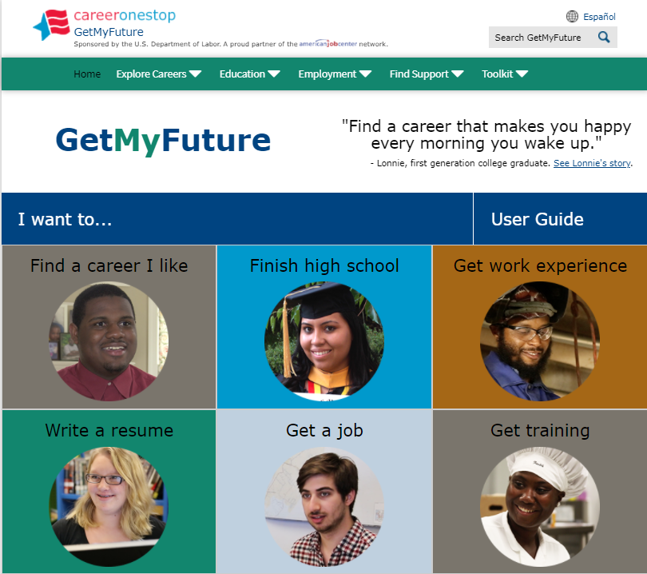
GetMyFuture

Slide 12
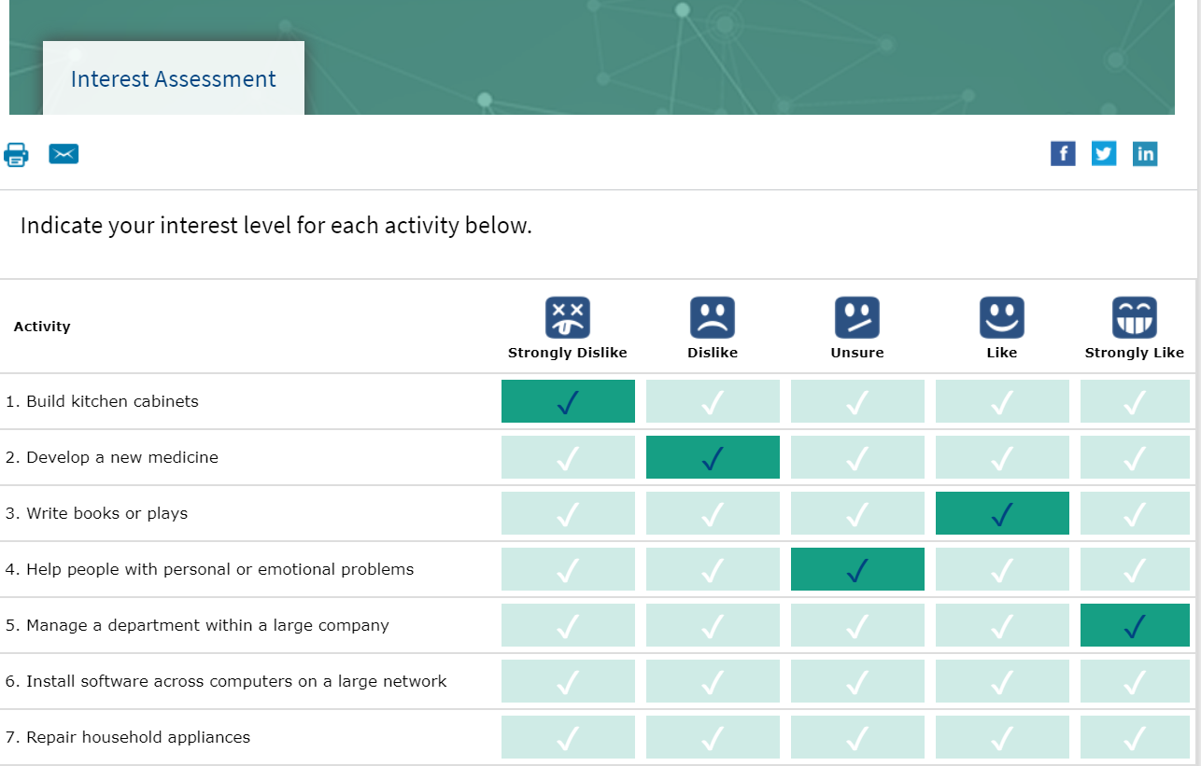
Interest Assessment

Slide 13
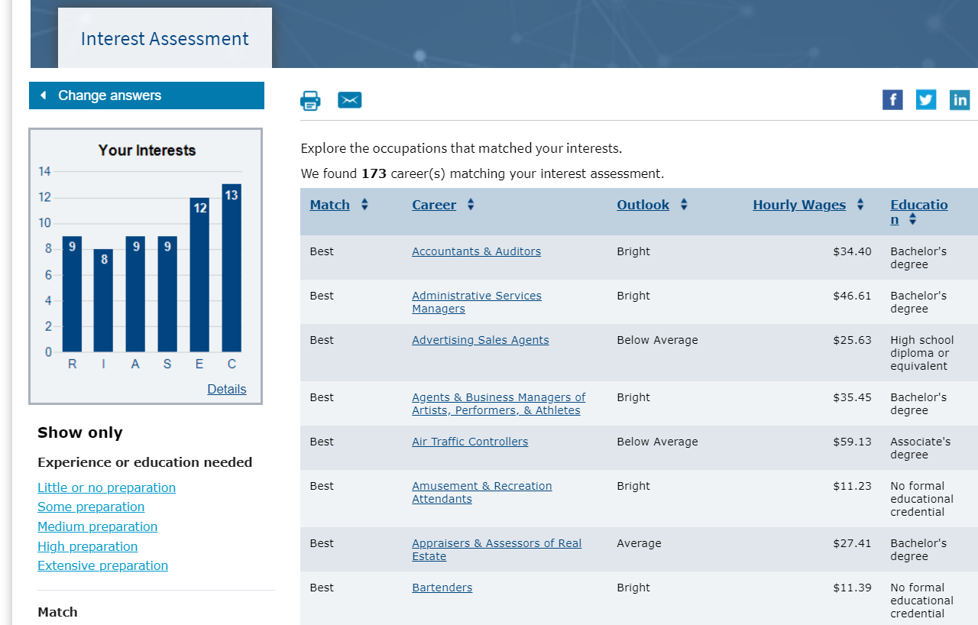
Interest Assessment Results

Slide 14
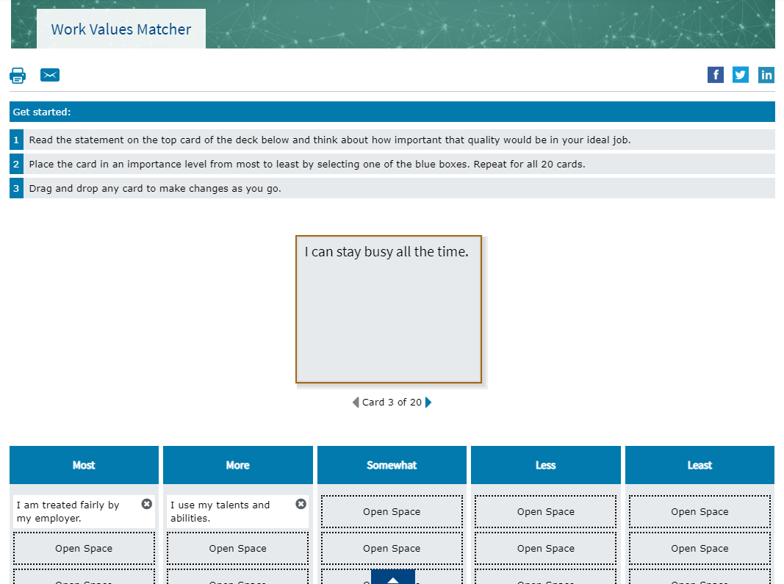
Work Values Matcher

Slide 15
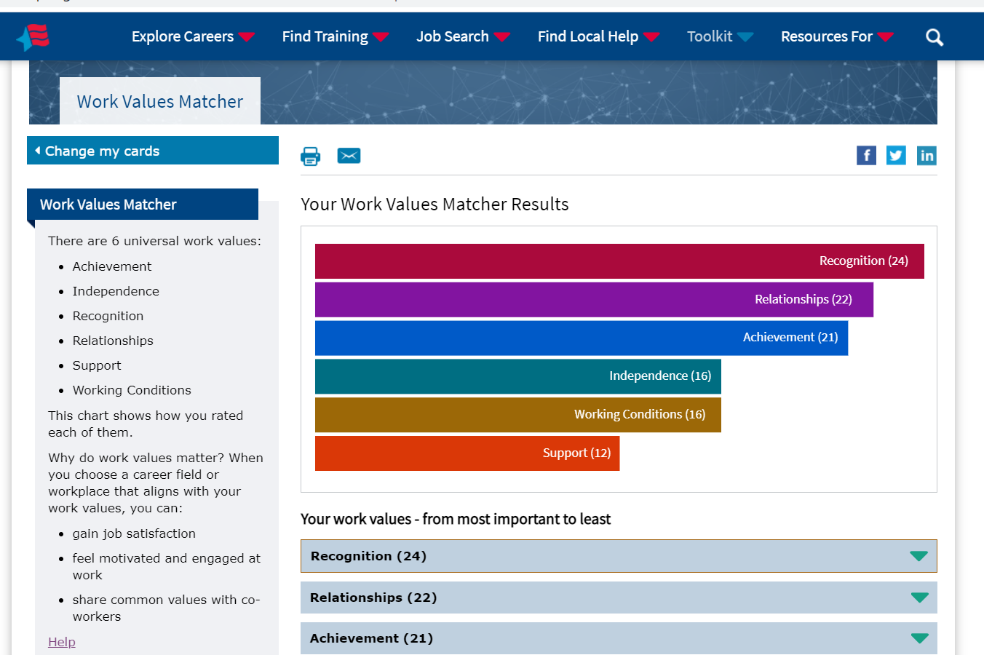
Work Values Matcher Results

Slide 16
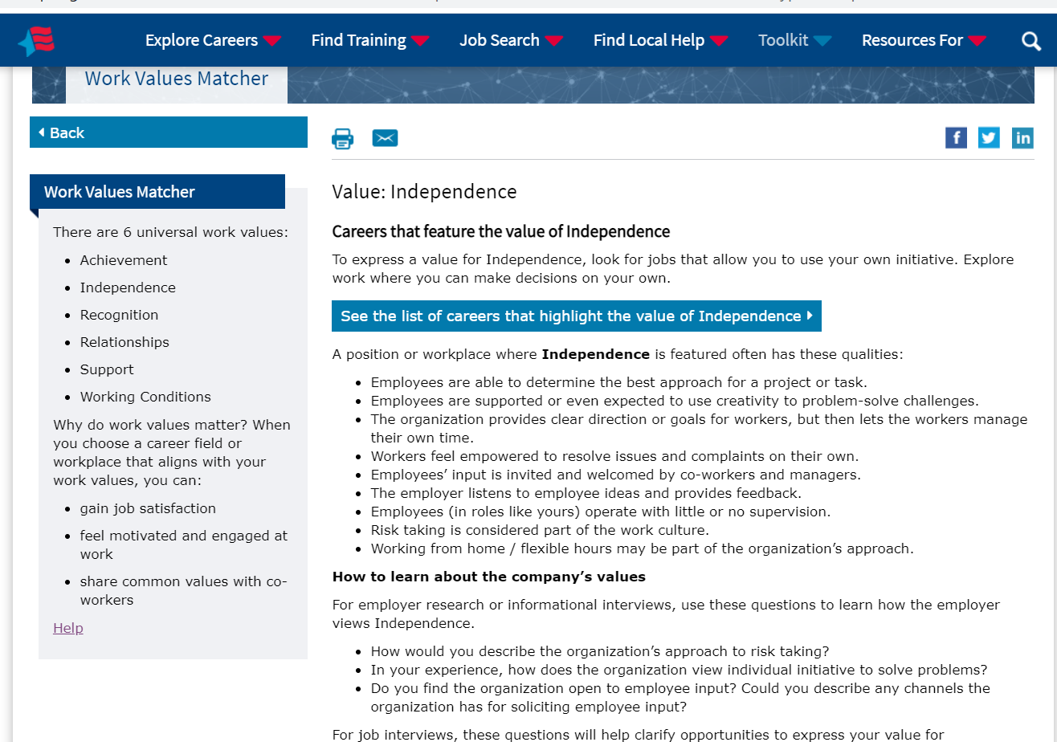
Work Values Matcher Value Description

Slide 17
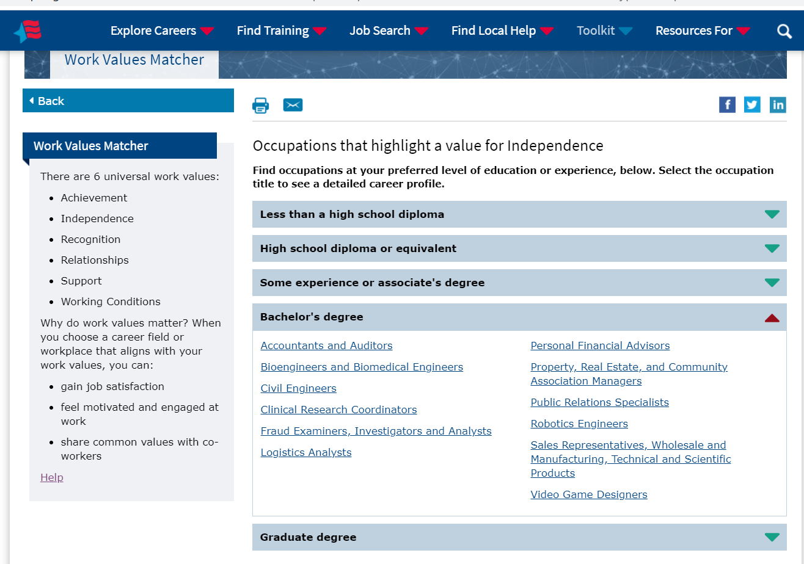
Work Values Matcher Career List

Slide 18
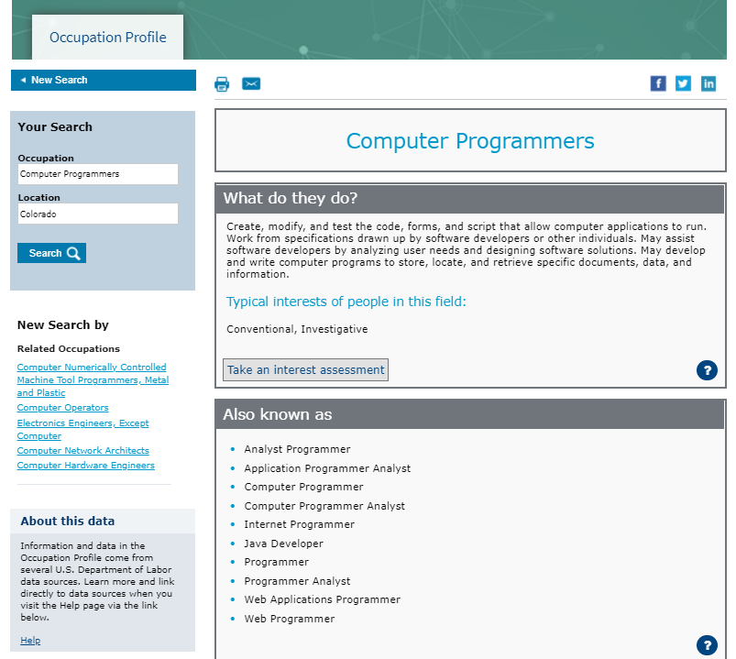
Occupation Profile

Slide 19
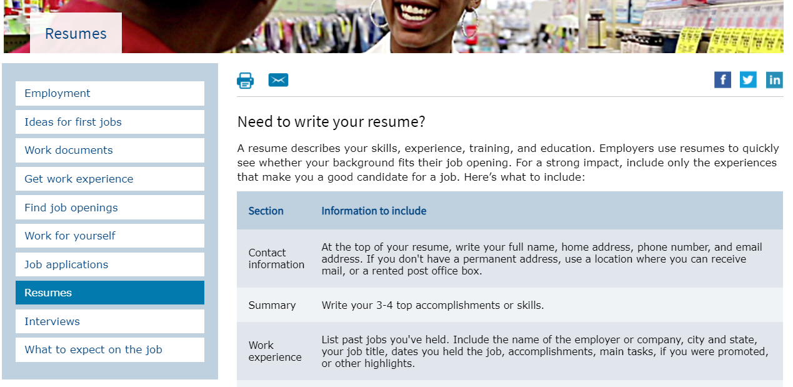
Resumes

Slide 20
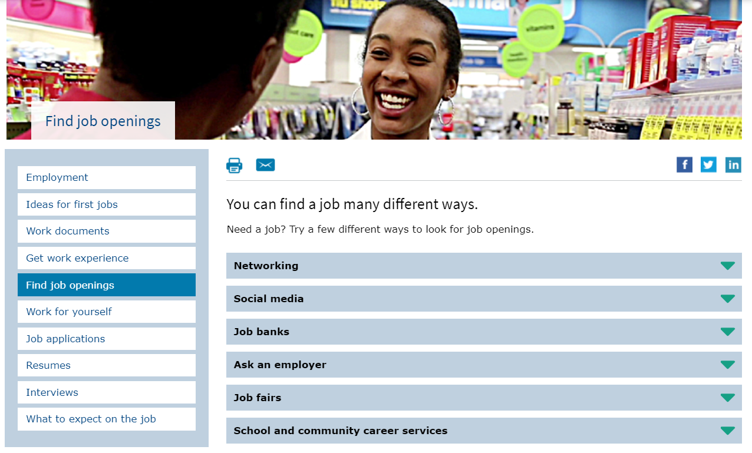
Find Job Openings

Slide 21
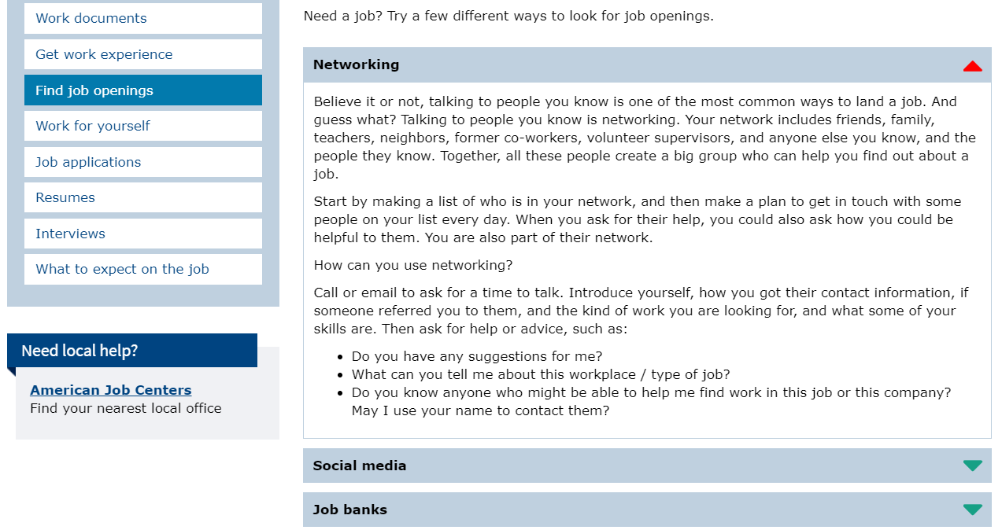
Find Job Openings: Networking

Slide 22
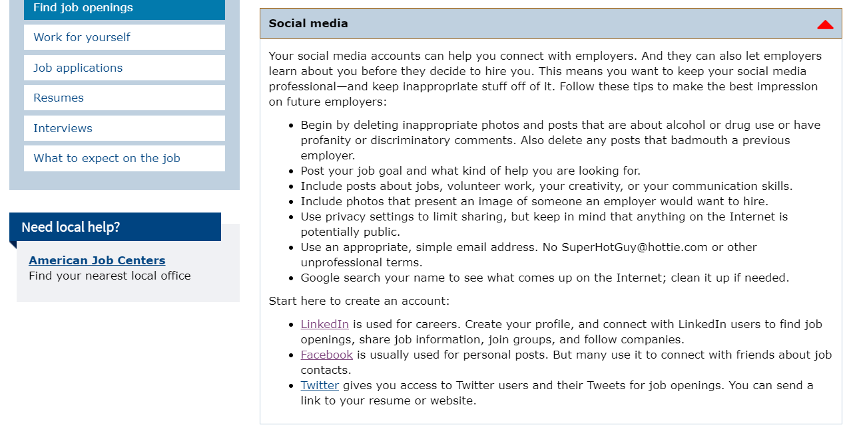
Find Job Openings: Social Media

Slide 23
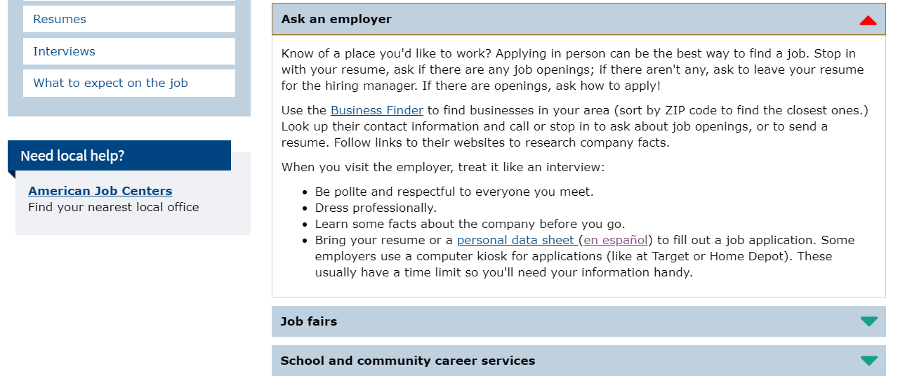
Find Job Openings: Ask an Employer

Slide 24
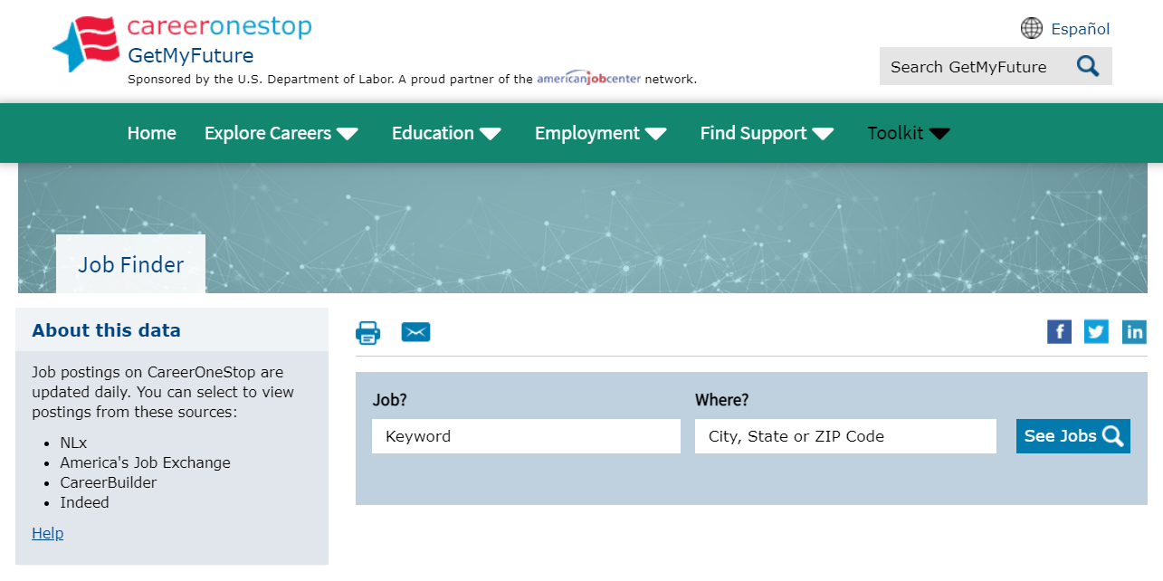
Job Finder

Slide 25
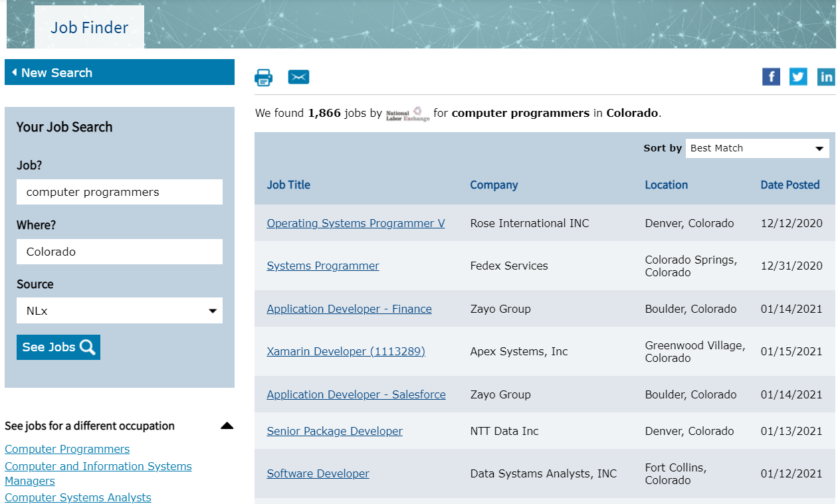
Job Finder Results

Slide 26
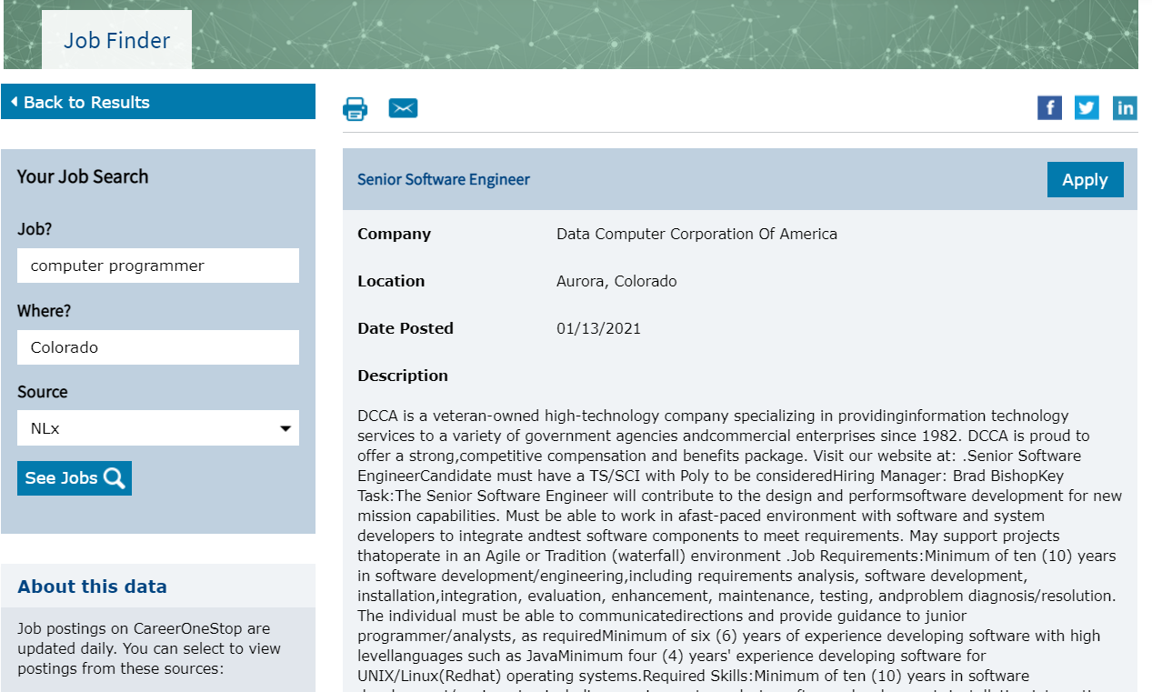
Job Finder Detail

Slide 27
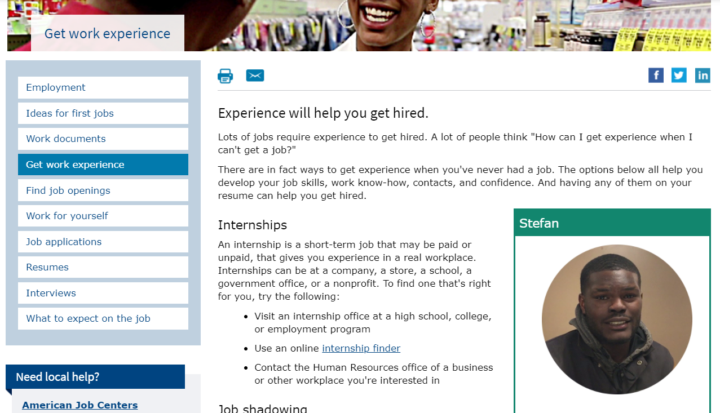
Get Work Experience

Slide 28
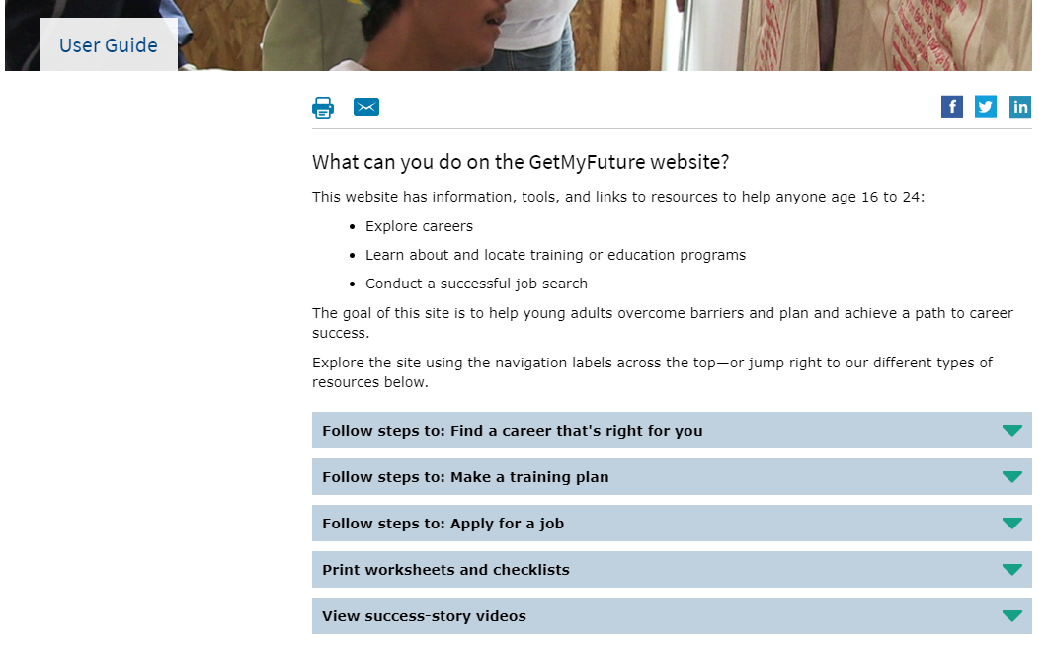
User Guide

