Slide 1
Develop New Skills and Knowledge

Slide 2
Challenge
Many employment services transitioned to online formats since in-person employment counseling sites closed or reduced their hours, at the same time that demand for services has grown.

Slide 3
Agenda
Brief CareerOneStop overview
User Path 4: Develop new skills and knowledge
Questions

Slide 4
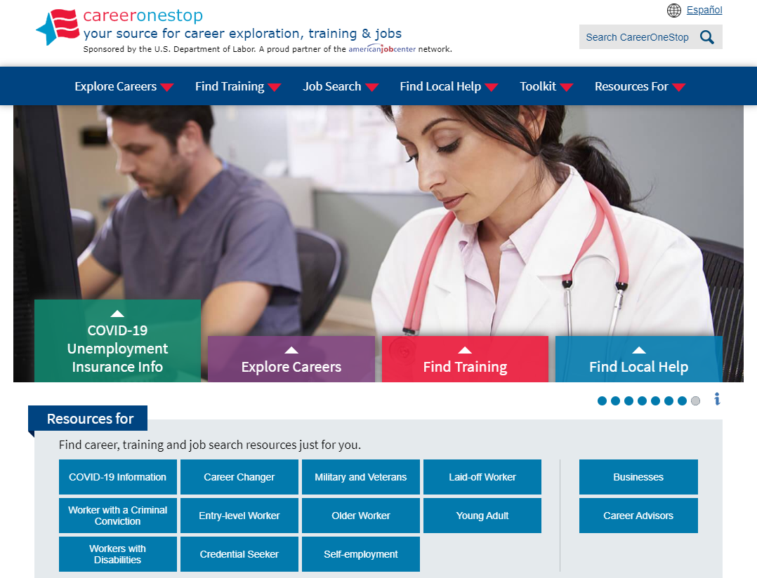
CareerOneStop
CareerOneStop is sponsored by the U.S. Department of Labor, Employment and Training Administration

Slide 5
Customer Needs
What benefits and other forms of assistance are available to me?
I need short term, immediate employment
I need a longer-term career plan
I just graduated from college, what do I do?
What options are available to develop new skills or knowledge?

Slide 6
Path 4: New Skills and Knowledge
Goal Make a plan to develop new skills and knowledge, to better position yourself to find a career job. Learn about different types of training to meet your training goals. Research ways to pay for your training.
Objectives
Use the Occupation Profile to find out what training is required for your career goal.
Review the types of training available to help you reach your career goal. Write down the next 1-2 training steps to move from where you are now toward your goal.
Research the options from this list to learn which will be most helpful now. Note details about how to enroll or set up your next training steps:
Learn about free and low-cost online training and education opportunities.
Explore college-based programs in your local area and compare location, program length, cost, and outcomes.
Find federally-funded training opportunities for in-demand jobs for eligible youth and adults.
Identify 2-3 certifications using the Certification Finder.
Find 1-3 apprenticeship sponsors in your local area to contact about opportunities.
Find 2 professional associations on Professional Association Finder to contact and join.
Research options to pay for training.
Use the Scholarship Finder to find 3-4 scholarships that you are qualified to apply for.

Slide 7
Path 4: New Skills and Knowledge
Key Resources
CareerOneStop website www.careeronestop.org
What’s right for me?
Occupation Profile
Short-term training
Local Training Finder
Certification Finder
Professional Association Finder
Find money for training
Financial aid
Scholarship Finder
_

Slide 8
Objective 3: Research Options
Research Options Research the options from this list to learn which will be most helpful now. Note details about how to enroll or set up your next training steps.
Learn about free and low-cost online training and education opportunities.
Explore college-based programs in your local area and compare location, program length, cost, and outcomes.
Find federally-funded training opportunities for in-demand jobs for eligible youth and adults.
Identify 2-3 certifications using the Certification Finder.
Find 1-3 apprenticeship sponsors in your local area to contact about opportunities.

Slide 9
Contact Information
Tricia Dahlman Business Technology Manager, CareerOneStop Patricia.Dahlman@state.mn.us
Julie Remington Content Strategist, CareerOneStop Julie.Remington@state.mn.us
_
_

Slide 10
Questions

Slide 11
Screenshots

Slide 12
Occupation Profile

Slide 13
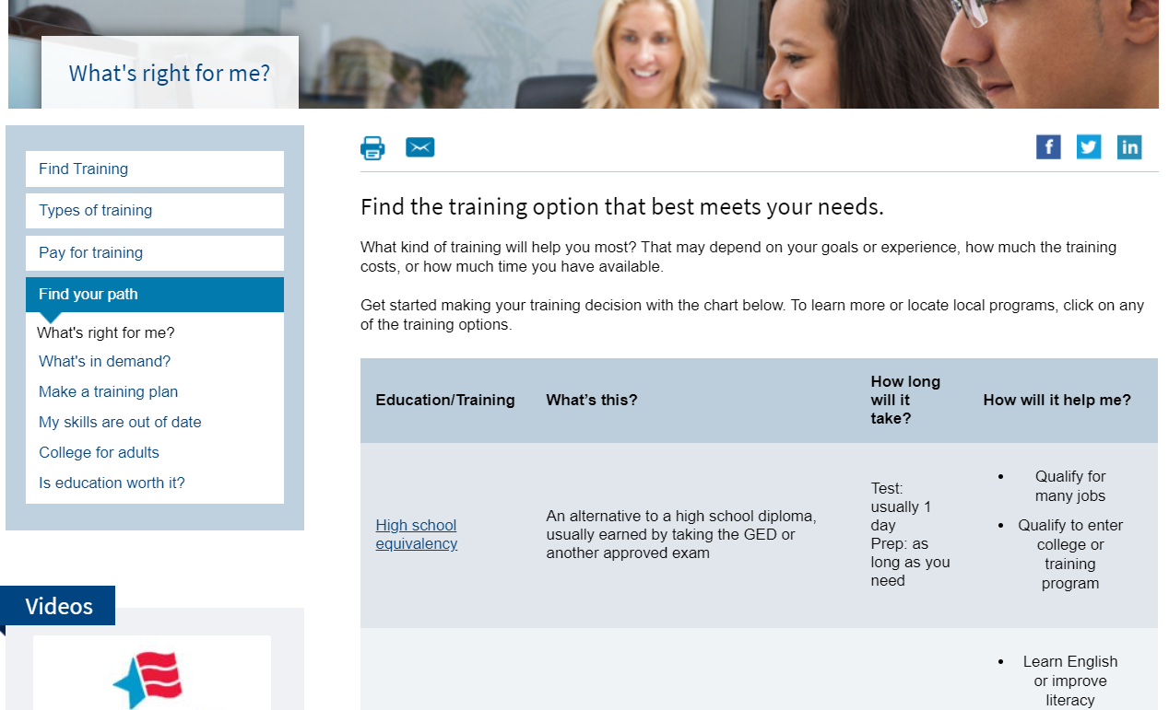
What’s Right for Me?

Slide 14
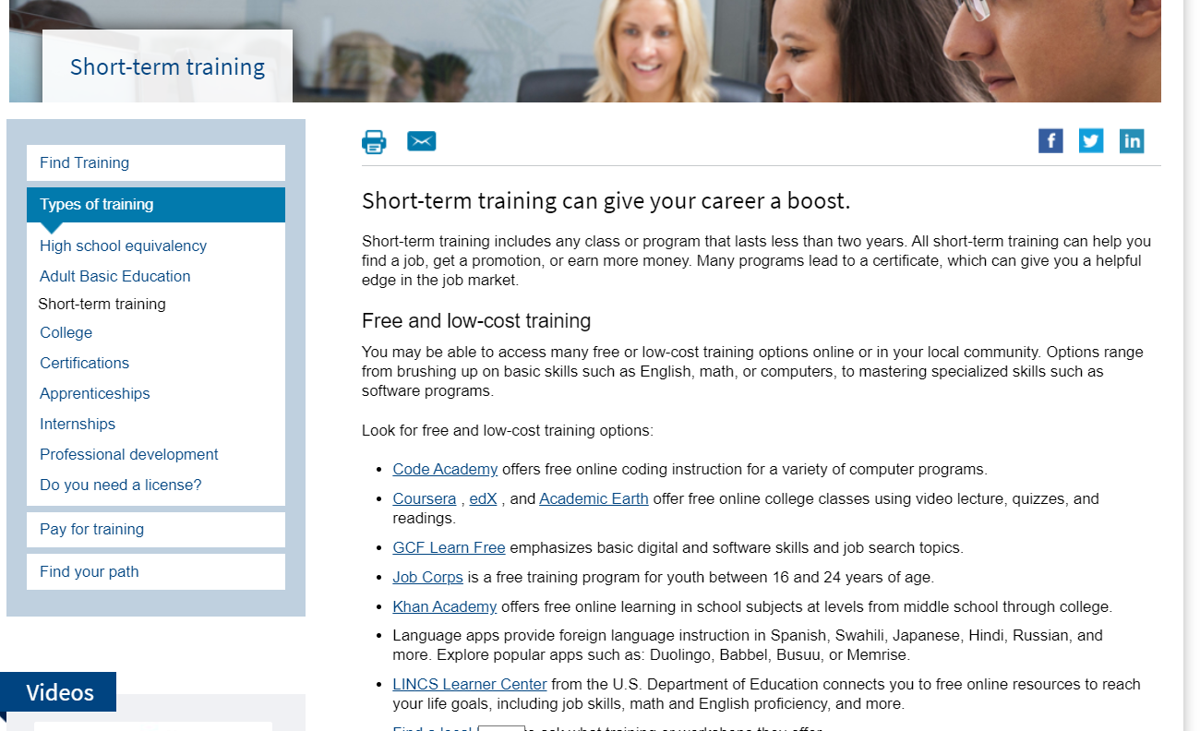
Short-Term Training

Slide 15
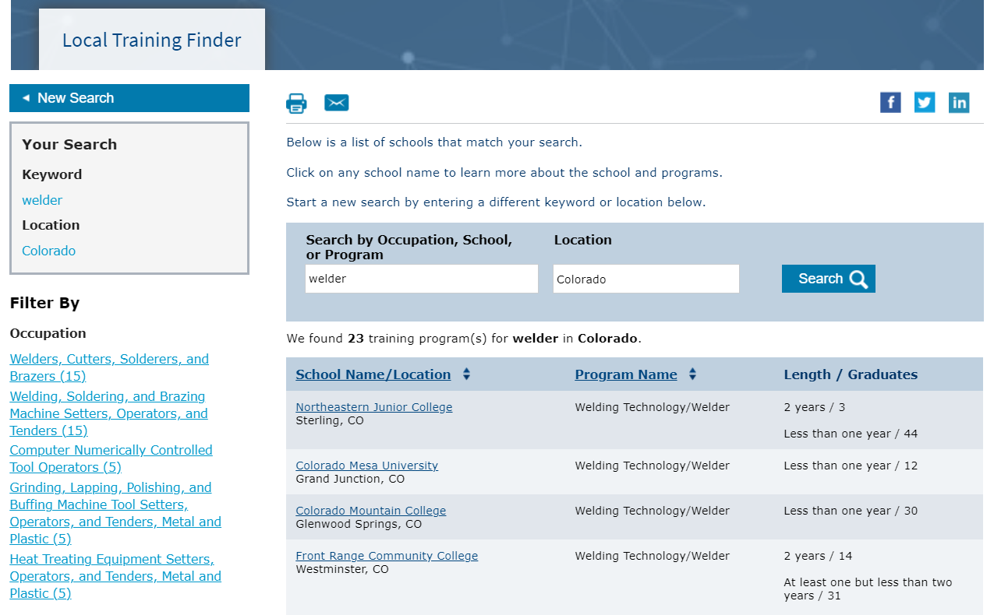
Local Training Finder

Slide 16
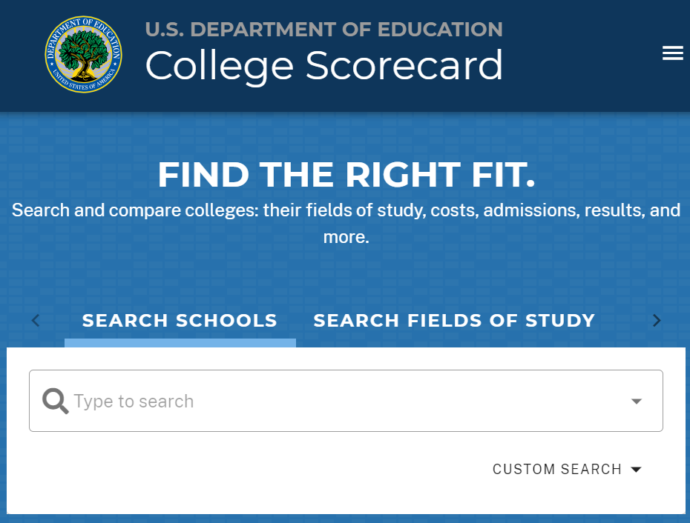
College Scorecard Website

Slide 17
Training Provider Results Website

Slide 18
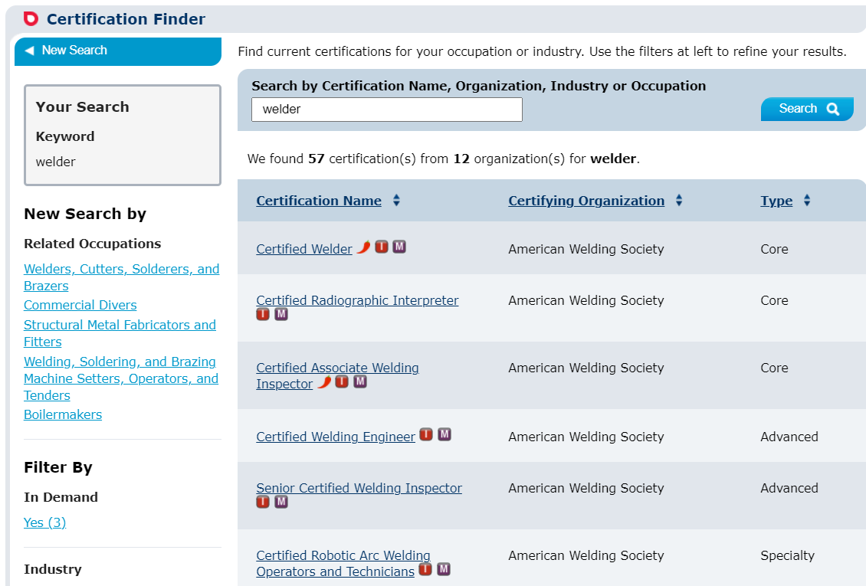
Certification Finder

Slide 19
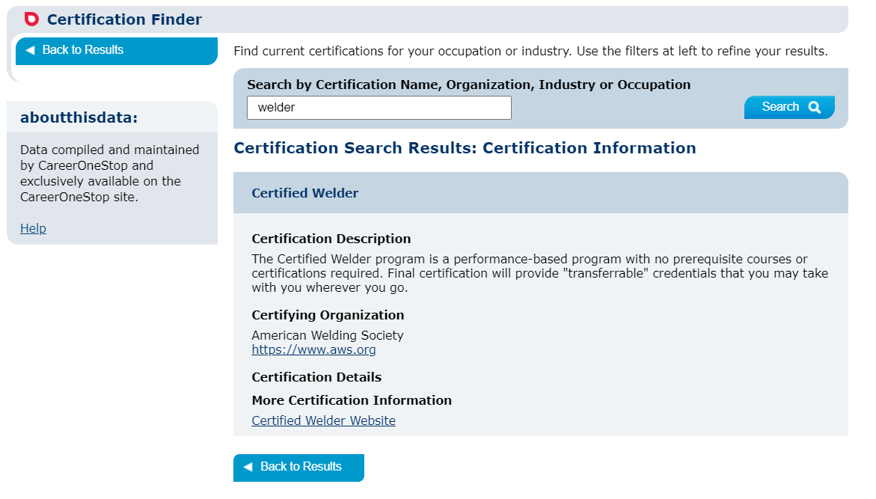
Certification Detail

Slide 20
Apprenticeship.gov Website

Slide 21
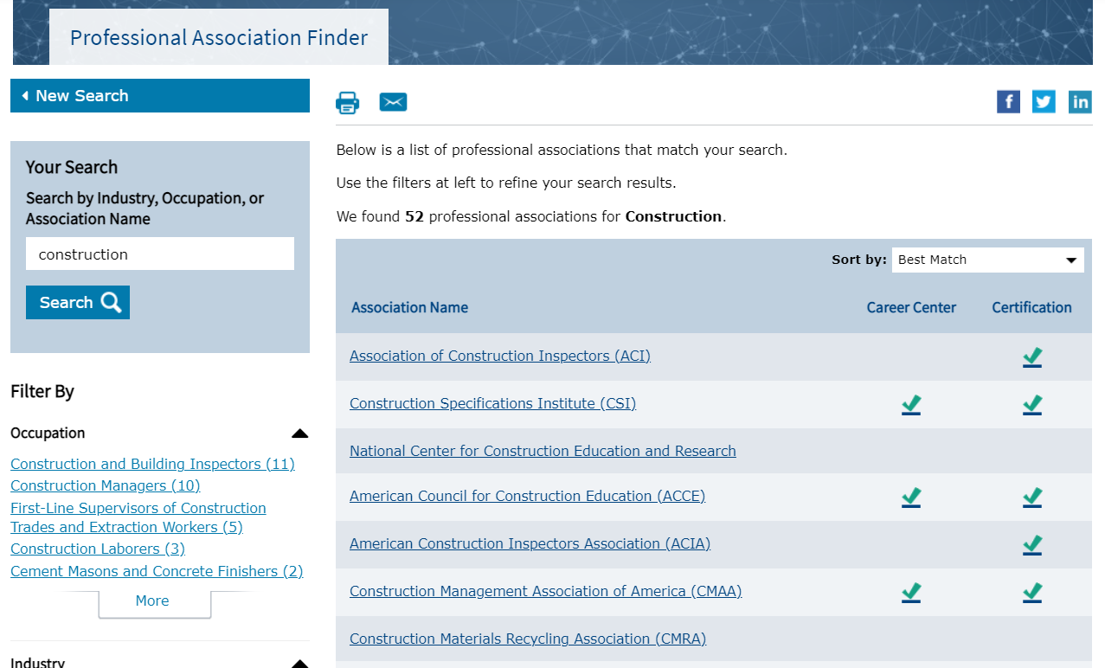
Professional Associations Finder

Slide 22
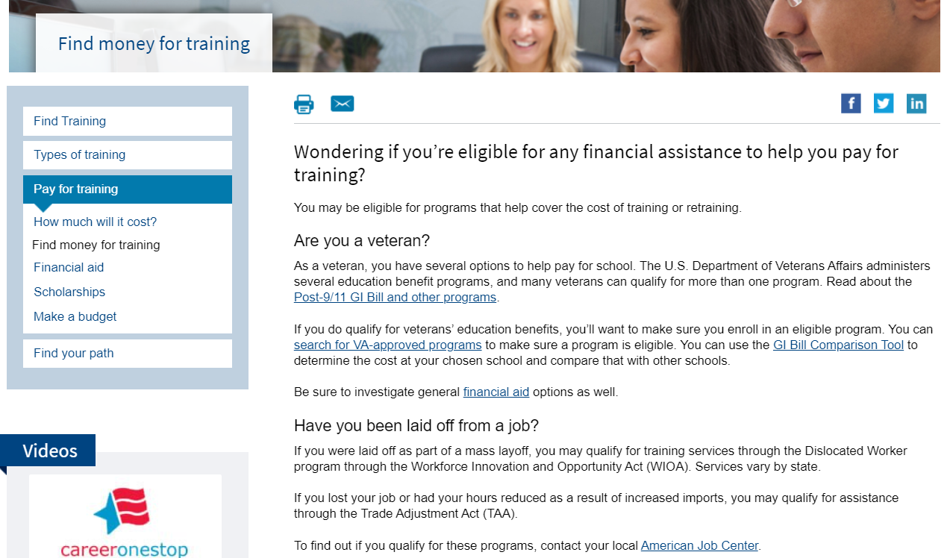
Find Money for Training

Slide 23
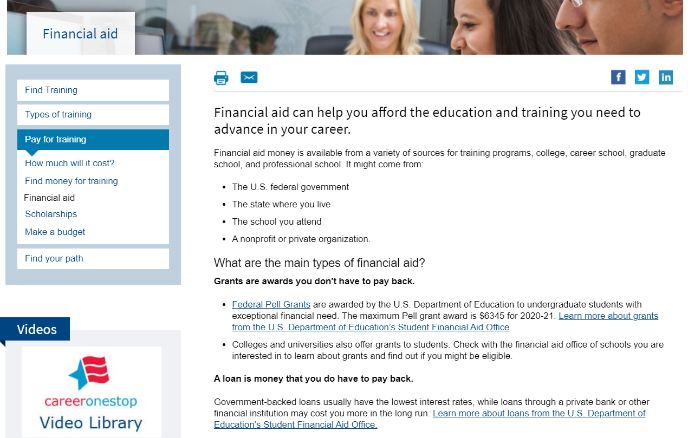
Financial Aid

Slide 24
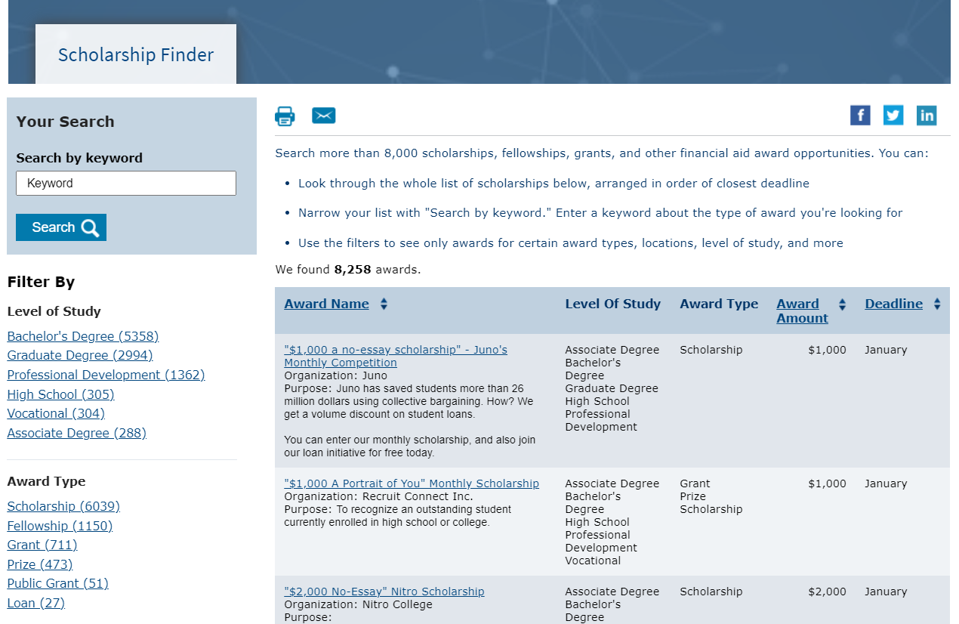
Scholarship Finder

Slide 25
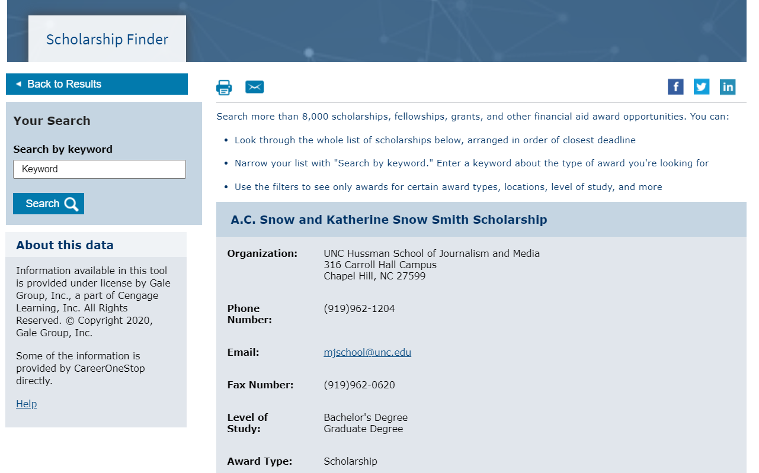
Scholarship Detail

Slide 26
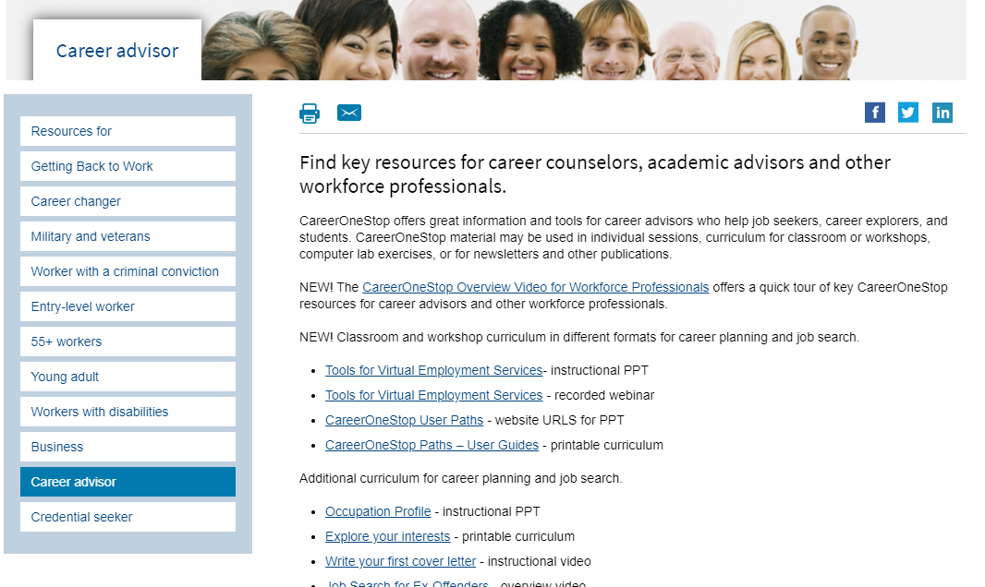
Career Advisors

