Slide 1
Find Immediate Employment and Apply for Unemployment Benefits

Slide 2
Challenge
Many employment services transitioned to online formats since in-person employment counseling sites closed or reduced their hours, at the same time that demand for services has grown.

Slide 3
Agenda
Brief CareerOneStop overview
User Path 1: Find immediate employment
User Path 2: Apply for unemployment benefits
Questions

Slide 4
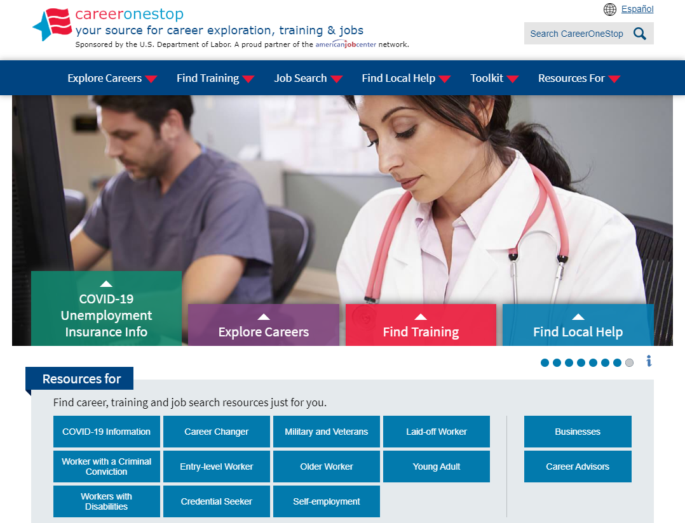
CareerOneStop
CareerOneStop is sponsored by the U.S. Department of Labor, Employment and Training Administration

Slide 5
Customer Needs
What benefits and other forms of assistance are available to me?
I need short term, immediate employment
I need a longer-term career plan
I just graduated from college, what do I do?
What options are available to develop new skills or knowledge?

Slide 6
Path 1: Immediate Employment
Goal
Help customers find short term, immediate employment. Provide steps and tools to focus their search, refresh their resume, and look for job postings and ideas on which kinds of organizations or jobs may be open to them during the COVID-19 pandemic.
Objectives
Learn about industries in the local area that are hiring
Identify 2-3 job titles to focus their search on
Refresh their resume or get tools to write one that targets their job search goal
Use online job search resources to find at least 3 viable job postings
Use Business Finder to identify 3 local businesses that hire workers in their field
Make a networking plan to reach out to at least 3 contacts about job openings in their identified fields
Practice answers to common interview questions and prepare to participate in video interviews

Slide 7
Path 1: Immediate Employment
Key Resources
Employment Recovery website
www.careeronestop.org/EmploymentRecovery/
Who’s Hiring?
Occupation Profile
Remote Jobs Finder
Update your resume
Job Finder
Business Finder
Networking Now
Virtual Interviews

Slide 8
Path 2: Unemployment Benefits and Assistance
Goal Help customers find and apply for unemployment benefits and other assistance to meet their essential needs during the COVID-19 pandemic.
Objectives
Identify state resources for general and pandemic-related unemployment insurance
Learn about their key state or local resources for housing, mental health, food assistance, and more
Learn how the local American Job Center can support their job search and local resource connections now and in the future

Slide 9
Path 2: Unemployment Benefits and Assistance
Key Resources
Employment Recovery website www.careeronestop.org/EmploymentRecovery/
Unemployment Benefits Finder
Unemployment FAQs
State Resource Finder
American Job Center Finder

Slide 10
Contact Information
Tricia Dahlman Business Technology Manager, CareerOneStop Patricia.Dahlman@state.mn.us
Julie Remington Content Strategist, CareerOneStop Julie.Remington@state.mn.us

Slide 11
Questions

Slide 12
Screenshots

Slide 13
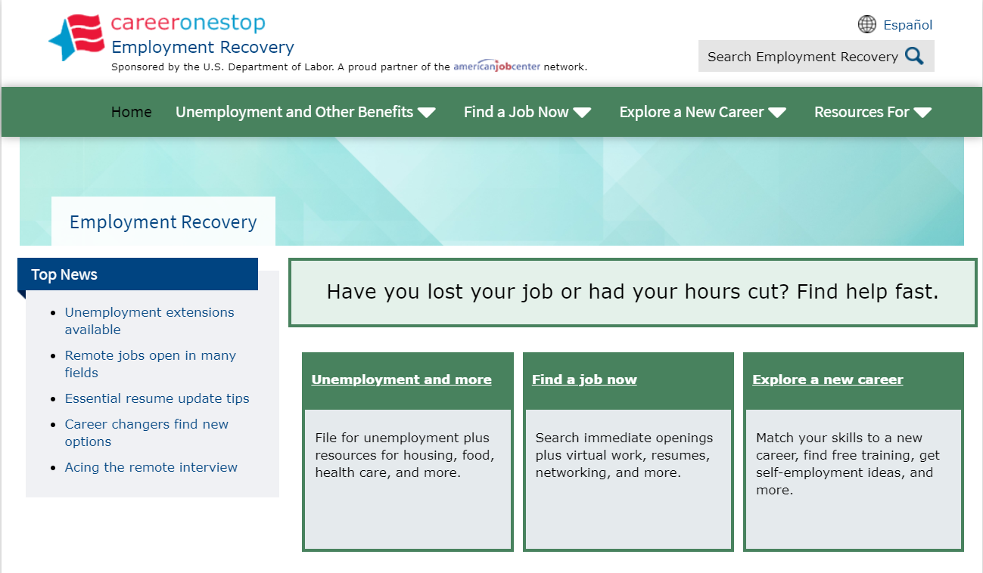
Employment Recovery

Slide 14
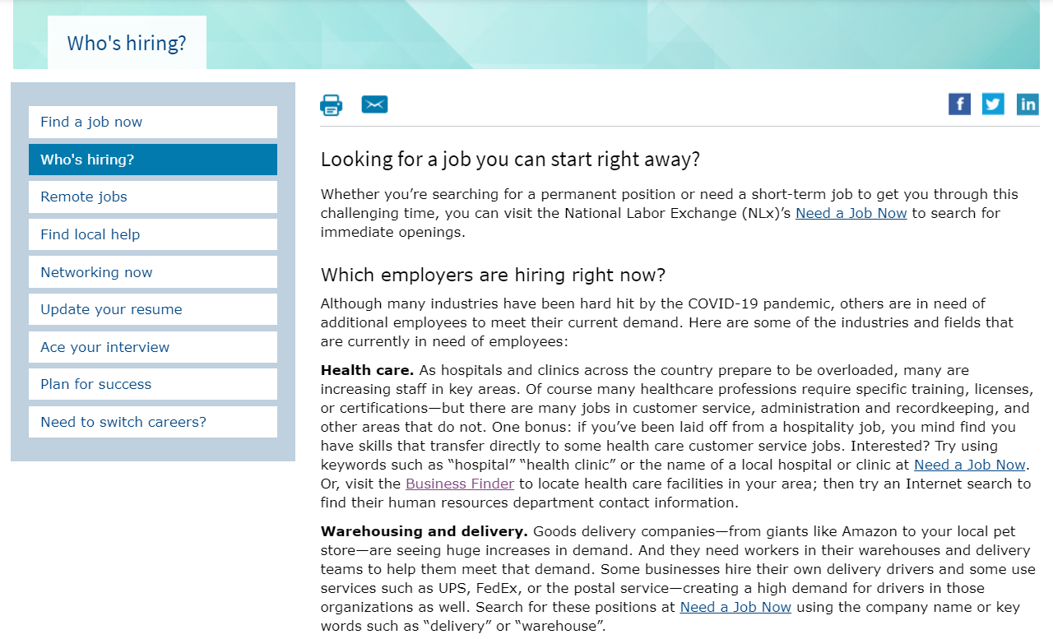
Who’s Hiring

Slide 15
Occupation Profile

Slide 16
Update Your Resume

Slide 17
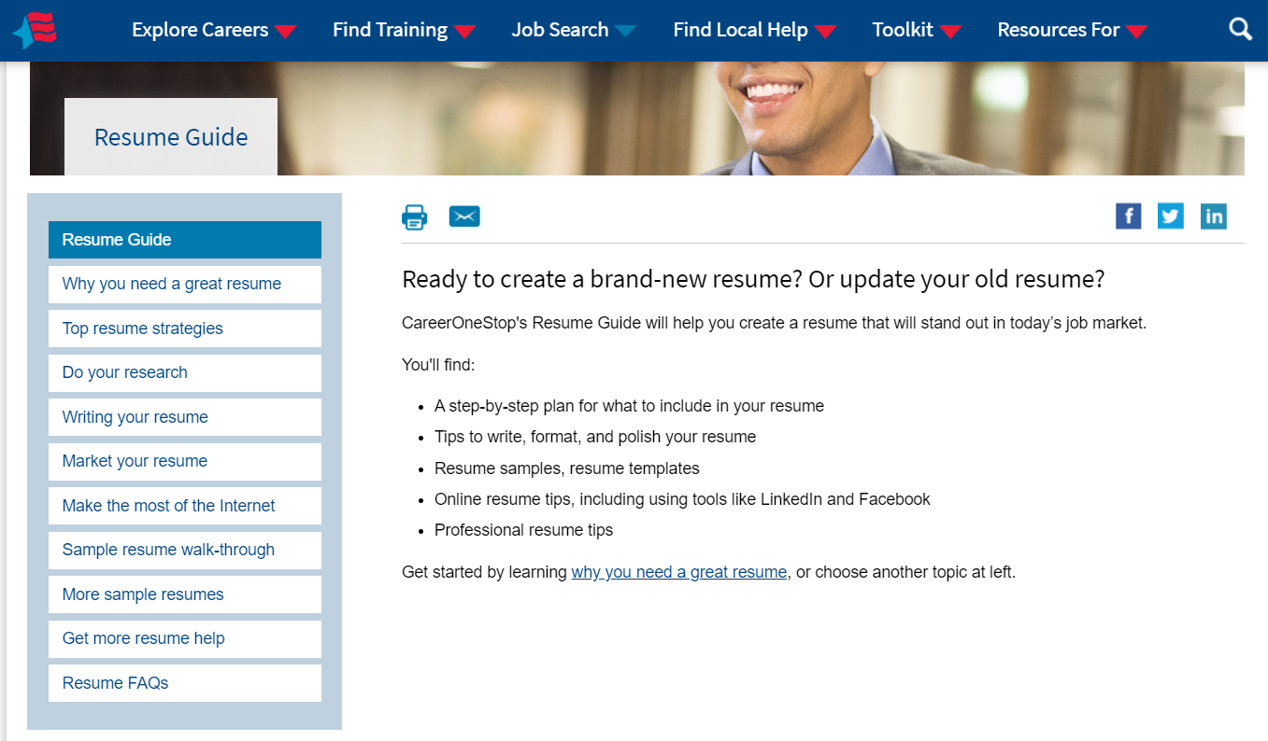
Resume Guide

Slide 18
Job Finder

Slide 19
Job Finder Results

Slide 20
Find a Remote Job

Slide 21
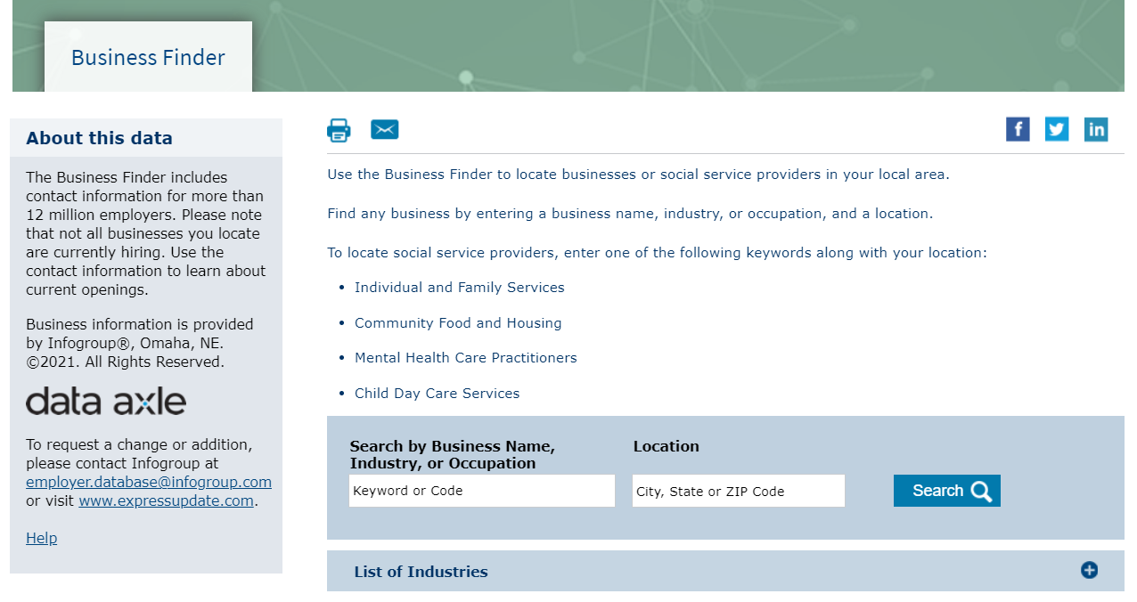
Business Finder

Slide 22
Networking Now

Slide 23
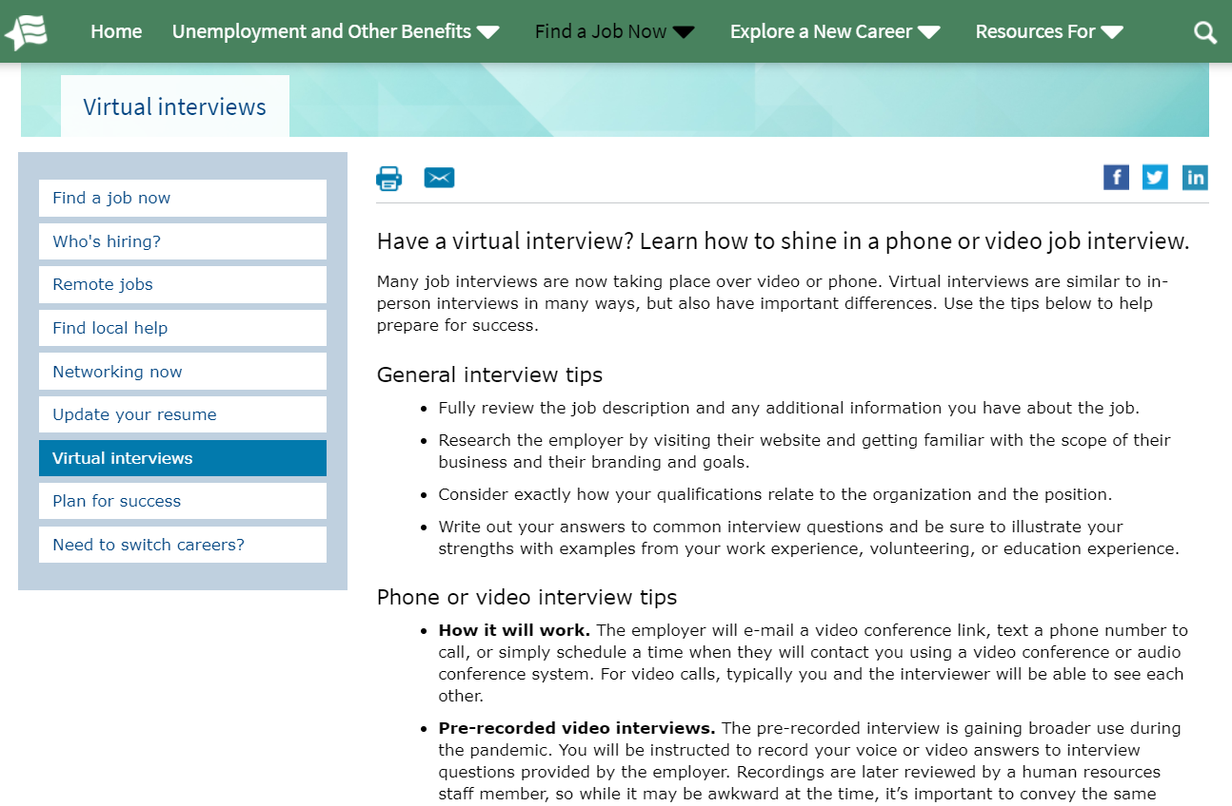
Virtual Interviews

Slide 24
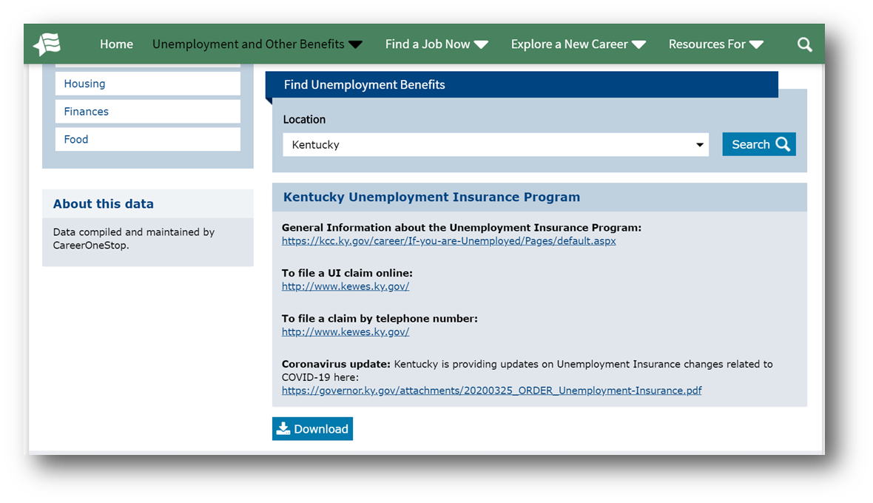
Unemployment Benefits Finder

Slide 25
FAQs About Unemployment

Slide 26
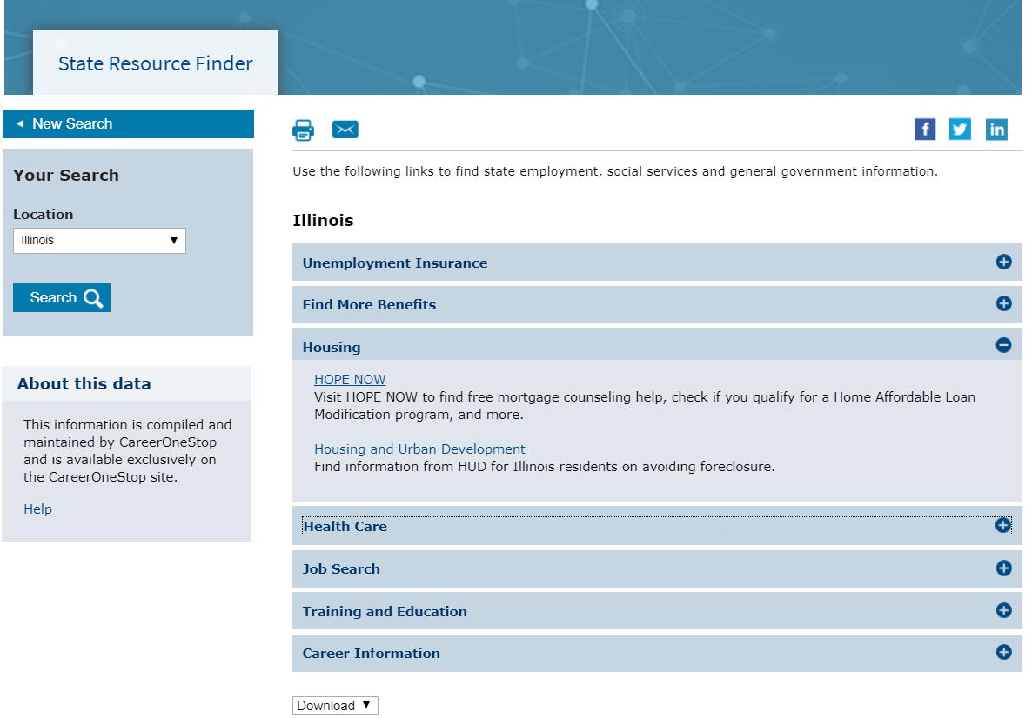
State Resources Finder

Slide 27
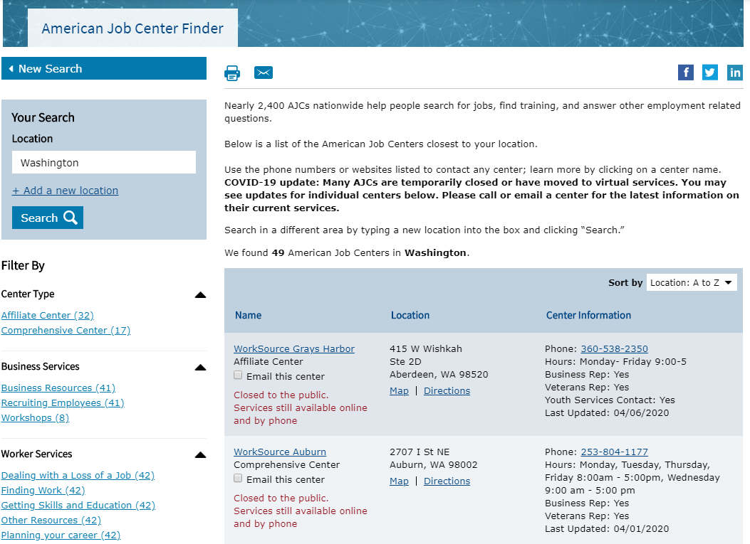
American Job Center Finder

Slide 28
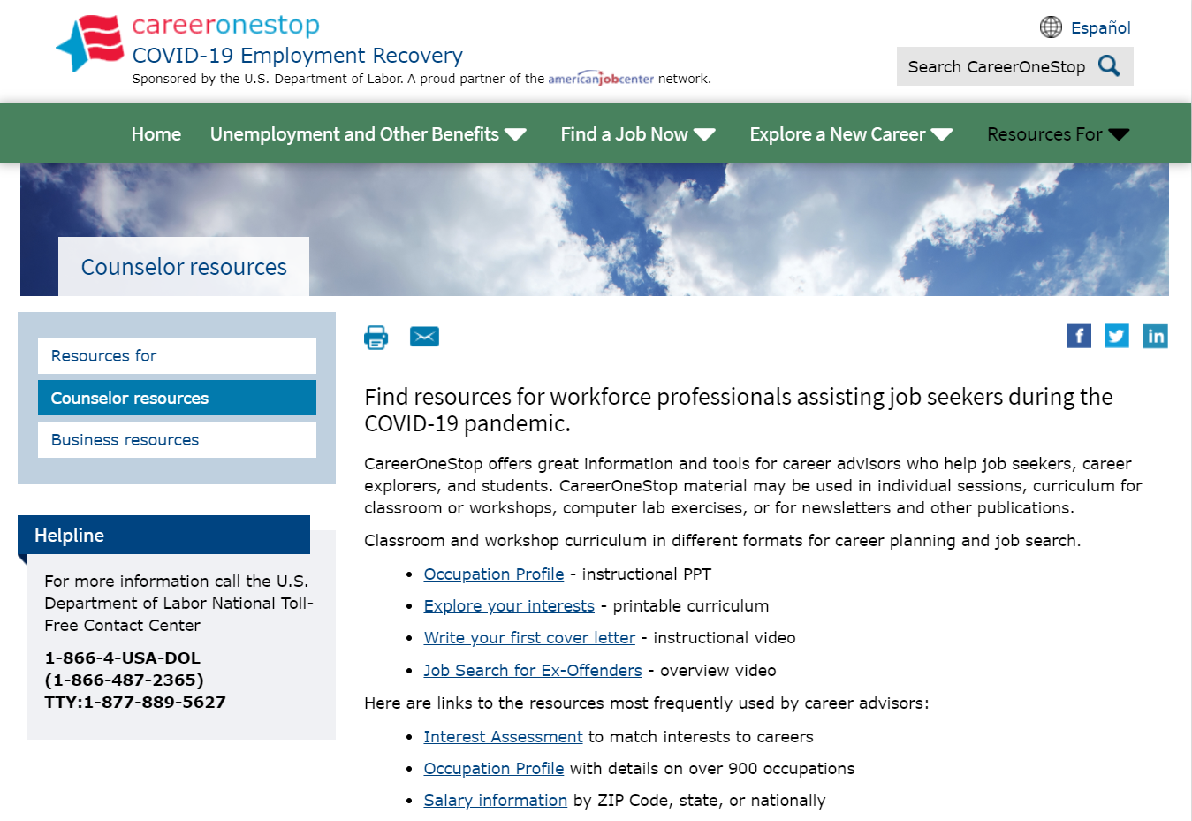
Counselor Resources

