Slide 1
Tools for Virtual Employment Services
DOL sponsors several online career tools providing solutions for job seekers, unemployed workers, career counselors, economic developers, educators, parents, students, businesses, and workforce professionals.

Slide 2
My Next Move
An interactive tool based on O*NET data for job seekers and students to learn more about their career options.
Dedicated portals for veterans and Spanish-speakers
www.mynextmove.org
www.mynextmove.org/vets/
www.miproximopaso.org

Slide 3
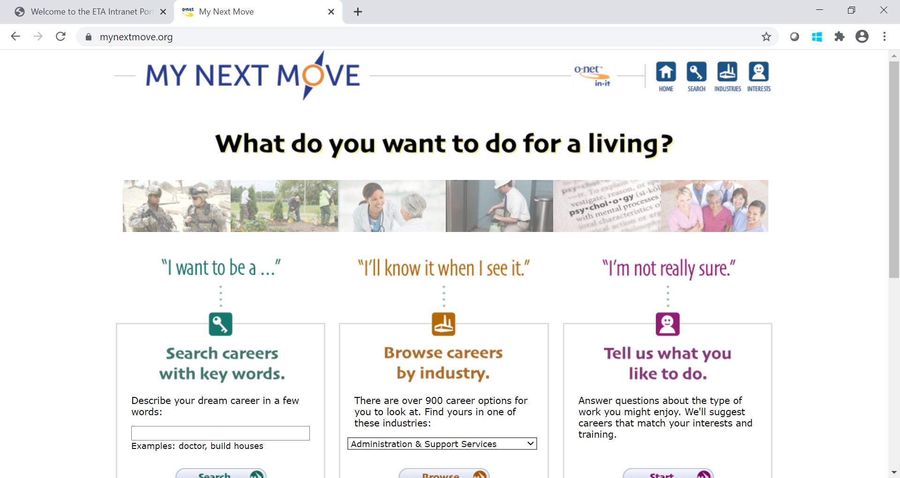

Slide 4
My Next Move
For over 900 careers:
Knowledge
Skills
Abilities
Personality
Technology
Education Requirements
Job Outlook

Slide 5
Using CareerOneStop to Provide Virtual Career and Job Services

Slide 6
Current Challenges
Many employment services transitioned to online formats when in-person employment counseling sites closed or reduced their hours, at the same time that demand for services has grown.

Slide 7
Agenda
Brief CareerOneStop overview
What are the current needs of customers?
CareerOneStop paths to address key needs
Questions

Slide 8
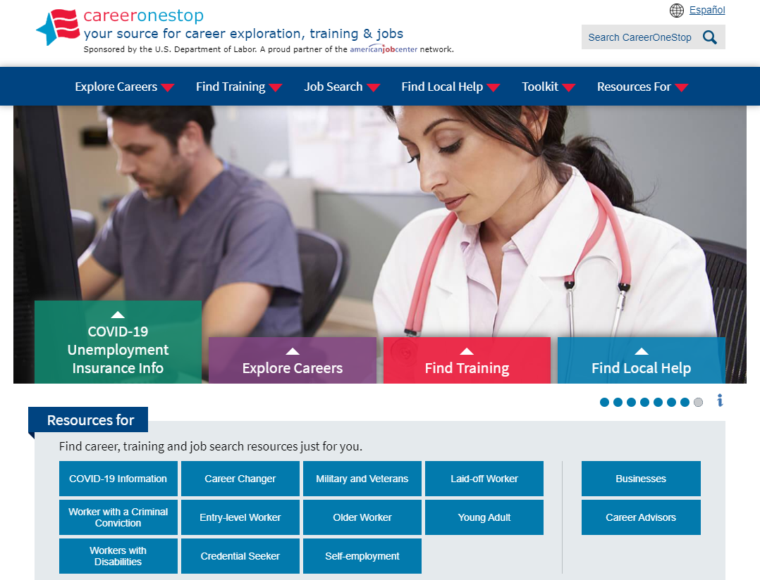
CareerOneStop
CareerOneStop is sponsored by the U.S. Department of Labor, Employment and Training Administration

Slide 9
Customer Needs
What benefits and other forms of assistance are available to me?
I need short term, immediate employment
I need a longer-term career plan
I just graduated from college, what do I do?
What options are available to develop new skills or knowledge?

Slide 10
CareerOneStop Paths
Find short term, immediate employment
Apply for unemployment and other benefits
Job search for new college graduates
Make longer-term career plans
Develop new skills and knowledge

Slide 11
Path 1: Immediate Employment
Goal
Help customers find short term, immediate employment. Provide steps and tools to focus their search, refresh their resume, and look for job postings and ideas on which kinds of organizations or jobs may be open to them during the COVID-19 pandemic.
Objectives
Learn about industries in the local area that are hiring
Identify 2-3 job titles to focus their search on
Refresh their resume or get tools to write one that targets their job search goal
Use online job search resources to find at least 3 viable job postings
Use Business Finder to identify 3 local businesses that hire workers in their field
Make a networking plan to reach out to at least 3 contacts about job openings in their identified fields

Slide 12
Path 1: Immediate Employment
Key Resources
Employment Recovery website
www.careeronestop.org/EmploymentRecovery/
Who’s Hiring?
Occupation Profile
Remote Jobs Finder
Update your resume
Job Finder
Business Finder
Networking Now

Slide 13
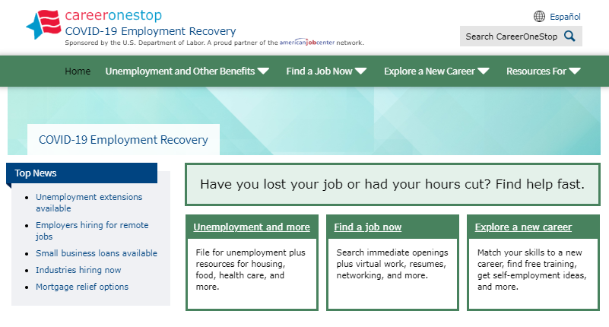
COVID-19 Employment Recovery

Slide 14
Occupation Profile

Slide 15
Find a Remote Job

Slide 16
Update Your Resume

Slide 17
Job Finder

Slide 18
Job Finder Results

Slide 19
Business Finder

Slide 20
Networking Now

Slide 21
Path 2: Unemployment Benefits and Assistance
Goal Help customers find and apply for unemployment benefits and other assistance to meet their essential needs during the COVID-19 pandemic.
Objectives
Identify their specific areas of need for financial assistance
Learn about their key state or local resources for unemployment insurance, housing, mental health, food assistance, and more
Learn how the local American Job Center can support their job search and local resource connections now and in the future

Slide 22
Path 2: Unemployment Benefits and Assistance
Key Resources
Employment Recovery website www.careeronestop.org/EmploymentRecovery/
Unemployment Benefits Finder
Unemployment FAQs
State Resource Finder
American Job Center Finder

Slide 23
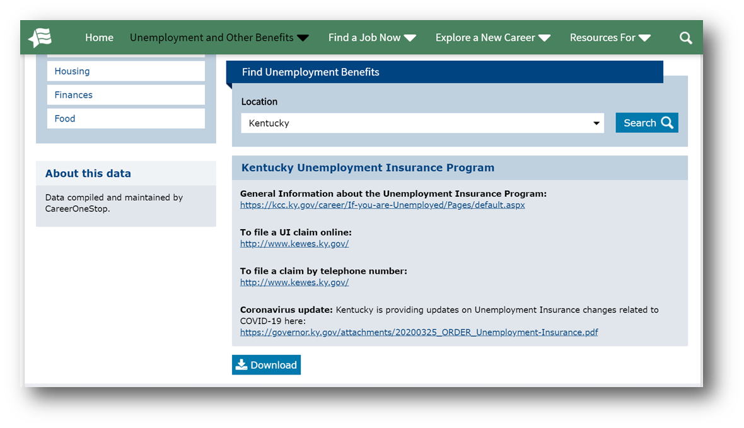
Unemployment Benefits Finder

Slide 24
FAQs About Unemployment

Slide 25
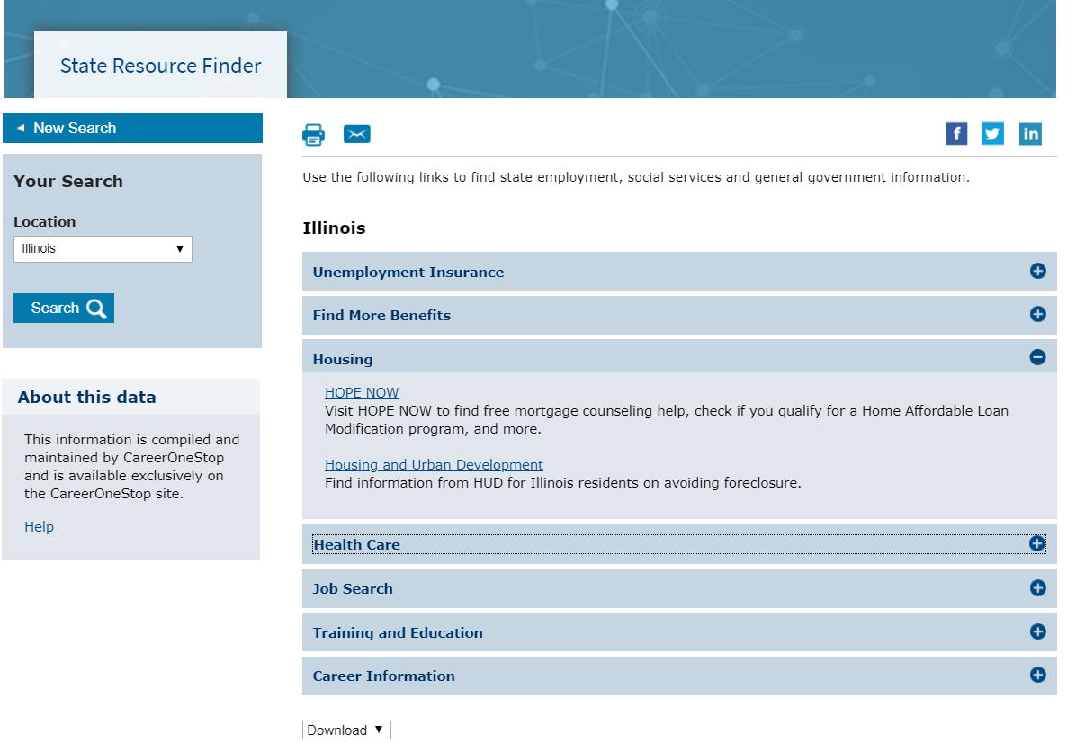
State Resources Finder

Slide 26
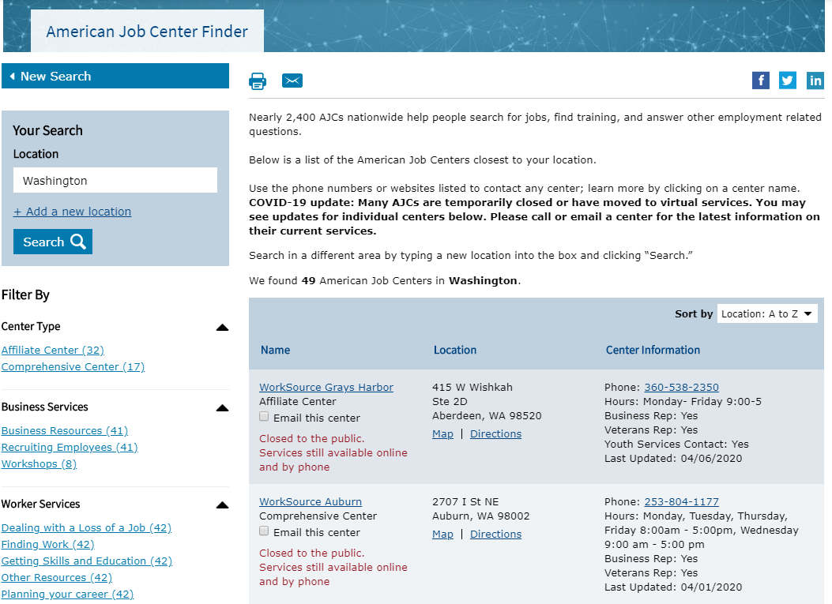
American Job Center Finder

Slide 27
Path 3: Job Search for New College Grads
Goal Help new college graduates and students who are anticipating graduation to conduct a job search. Provide tools such as self-assessment, career exploration, and resume writing guidance to support their job search process and success.
Objectives
Take an interest assessment
Research occupations from their assessment results and select 3-4 to focus on in their job search
Create or improve their resume and LinkedIn profile
Search job banks for jobs in their targeted fields
Identify 2 professional associations to research
Identify 3 networking connections related to their field
Notes:
.

Slide 28
Path 3: Job Search for New College Grads
Key Resources
CareerOneStop website www.careeronestop.org
Interest Assessment
Occupation Profile
Resume Guide
Job Finder
Professional Association Finder
Take Your Network Online

Slide 29
Interest Assessment

Slide 30
Occupation Profile

Slide 31
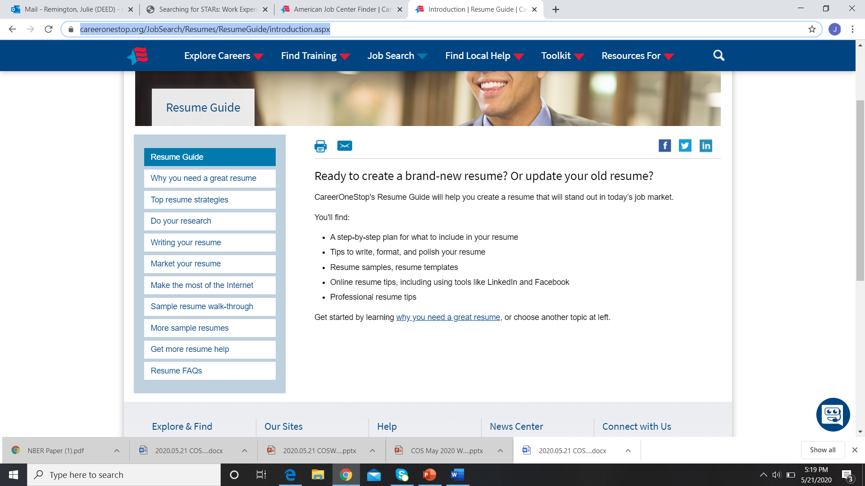
Resume Guide

Slide 32
Job Finder

Slide 33
Professional Association Finder

Slide 34
Social Media / Network Online

Slide 35
Path 4: Longer-Term Career Planning
Goal Help participants make longer-term career plans and update their resumes. Provide assessments and tools to research occupations and target their resume to targeted fields.
Objectives
Take interest and skills assessments and identify 3-4 prospective careers from their results to research
Use Occupation Profile to learn details about tasks, work settings, required education and training, projected employment demand and wages for their 3-4 prospective career options
Select 1-2 occupations to focus their efforts on
Create or update resume and online profile to reflect their targeted occupations
Develop a simple networking plan for their targeted occupation, including relevant contacts, local employers, and professional associations

Slide 36
Path 4: Longer-Term Career Planning
Key Resources
CareerOneStop website www.careeronestop.org
Interest Assessment
Skills Assessment
mySkills myFuture (www.mySkilllsmyFuture.org)
Occupation Profile
Networking is Your Most Important Strategy
Resume Guide

Slide 37
Interest Assessment

Slide 38
Skills Assessment

Slide 39
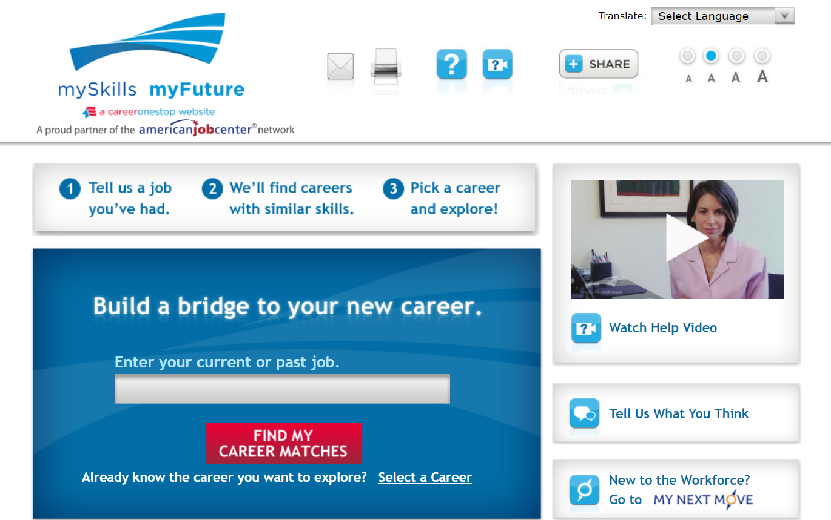
mySkills myFuture

Slide 40
Occupation Profile

Slide 41
Networking

Slide 42
Resume Guide

Slide 43
Path 5: New Skills and Knowledge
Goal Help participants develop new skills and knowledge, so they are better positioned to find a career job as businesses reopen. Provide links to free online education resources, information about in-demand credentials with short-term preparation requirements, and apprenticeship opportunities.
Objectives
Learn about a variety of free and low-cost online training and education websites and opportunities
Research training options in their local area for 1-2 occupation areas. Identify key information including school name and location, program name and contact information, prerequisites, program length, approximate cost, and options for online study/current delivery methods.
If interested, identify 1-3 apprenticeship sponsors in the local area to contact regarding potential current and near future opportunities

Slide 44
Path 5: New Skills and Knowledge
Key Resources
Employment Recovery website www.careeronestop.org/EmploymentRecovery/
CareerOneStop website www.careeronestop.org
Content on Free and Low-Cost Training
Local Training Finder
Certification Finder
Apprenticeship.gov

Slide 45
Training Options

Slide 46
Local Training Finder

Slide 47
Certification Finder

Slide 48
Apprenticeship.gov

Slide 49
Low-Tech Solutions
If you conduct phone meetings with customers, you may work through steps of any of these pathways using question and answer. You may choose to access CareerOneStop to walk the customer through tool results, and make recommendations for steps they can complete on their own.
For any of these pathways, you may print out and mail the “homework” documents for customer to complete at home with assistance from a more experienced internet user. Find links on the Career Advisors page.
Other ideas webinar participants have been practicing for low-tech service delivery?

Slide 50
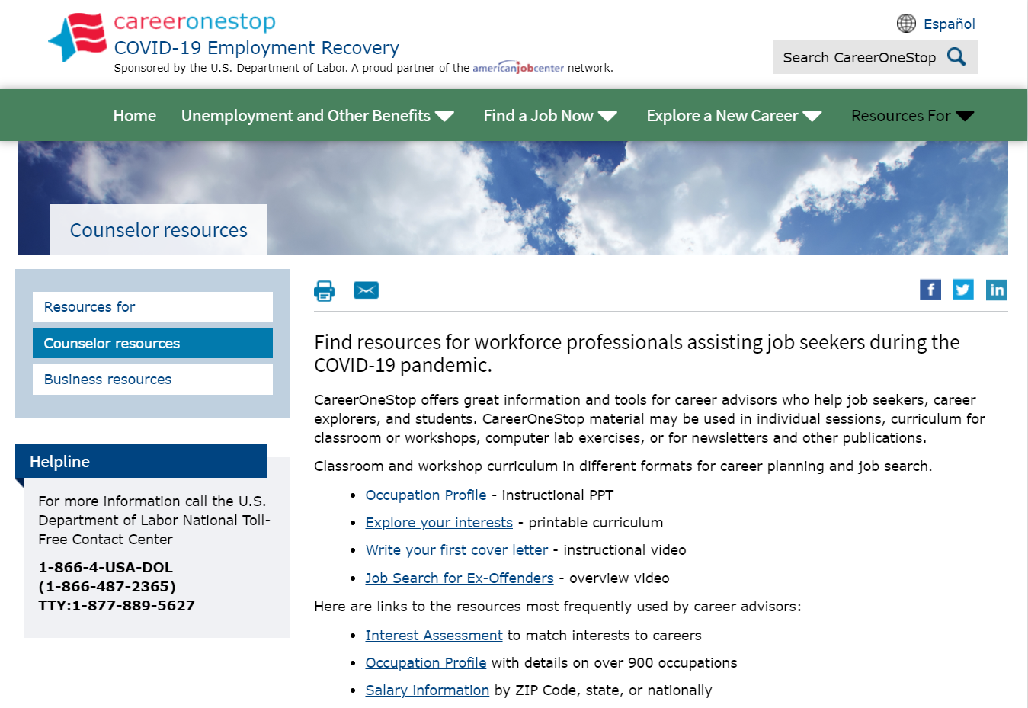
Counselor Resources

Slide 51
Outreach Materials

