Slide 1
CareerOneStop
Notes:
Welcome to this presentation, CareerOneStop – Find your Pathway to Career Success
CareerOneStop is sponsored by the U.S. Department of Labor Employment and Training Administration (ETA). This presentation is intended to provide you with brief information on ETA initiatives and its sponsored electronic tools to assist you and your organization in developing talent and becoming competitive leaders for the 21st century.
This presentation is focused on pathways to career success. I will:
* Introduce you to the U.S. Department of Labor Employment and Training Mission or (ETA)
* Describe WIRED, one of ETA’s foundational principles, for regional economic development and talent development
* Provide an overview of CareerOneStop and highlight various online resources
* Present other ETA online resources such as Workforce3One, Career Voyages and O*NET and
* Answer any questions you may have about CareerOneStop and partner online resources.
By the end of this presentation, you will gain valuable knowledge, resources, and conceptual models to enhance your effectiveness as a strategic leader and service provider in your local area. You can find all of the resources presented here at the end of this presentation.

Slide 2
About CareerOneStop
CareerOneStop offers free, online resources to meet the career, training, and employment needs of individuals and businesses.
CareerOneStop is sponsored by the U.S. Department of Labor, Employment and Training Administration.
Notes:
Now I’d like to focus on CareerOneStop and other ETA sponsored online tools that supports talent and regional economic development.
What is CareerOneStop?
CareerOneStop is a set of online tools that integrate economic and workforce development activities and support talent development and prosperity.

Slide 3
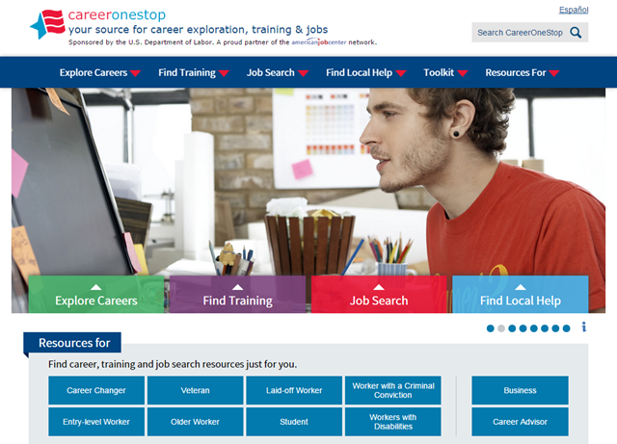
Your source for career exploration, training & jobs
Easy-to-use tools and resources right at your fingertips that can help you advance your education and career!
Notes:
CareerOneStop is a national Web site offers that career resources and workforce information to job seekers, students, businesses, and workforce professionals to foster talent development in a global economy.
CareerOneStop has been significantly updated over the last couple years. The new look is based on user feedback. It provides easier access to the key tools and resources needed by job seekers, students, businesses, and career professionals.
The new organization offers quick and easy access to valuable content. You can find all the CareerOneStop and related tools you need in six simple categories.
How many of you are familiar with this website? Polling question.
Now I’ll highlight some of CareerOneStop’s unique and easy to use online resources starting with Explore Careers.

Slide 4
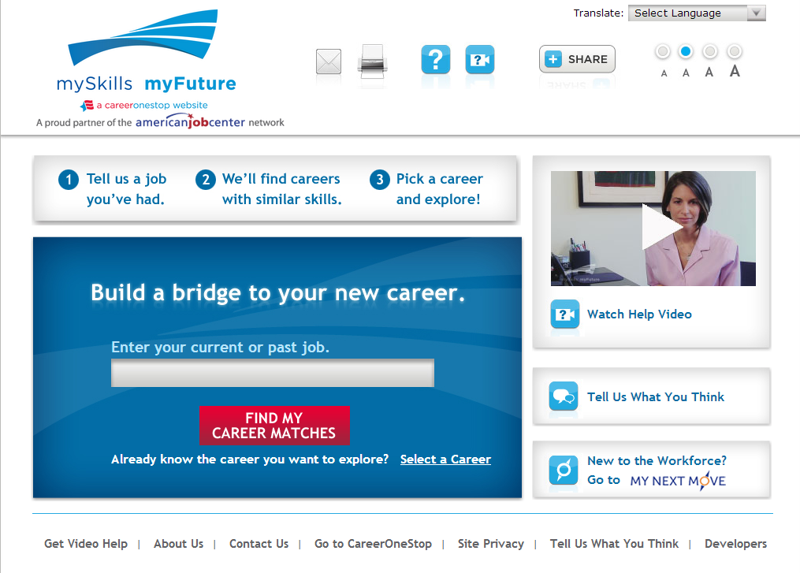
mySkills myFuture
Notes:
Laid-off workers and other career changers can:
Identify related careers to explore
Learn about transferable skills
Link to local training opportunities
View and apply for job listings

Slide 5
Notes:
Let’s say I just got laid off from Bright House Networks, the television cable provider in Bakersfield, California after three years. I was an installer there but I’d like to transfer into a green job because I’ve heard there is more opportunity in this type of job.
So I’d enter cable installer in the search box here.

Slide 6
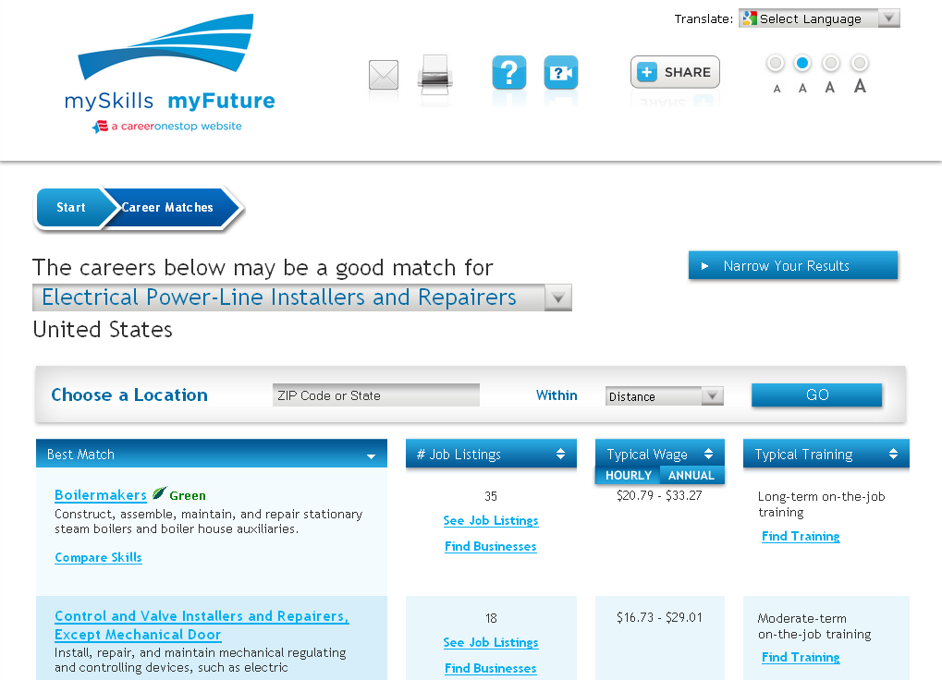
Notes:
mySkills myFuture does a keyword match with whatever was entered and presents the closest occupation title here. Clicking on this drop-down arrow will give the users a fuller list of occupations -- they’re asked to select the one closest to the job they meant.
I don’t think this is a great match to my previous occupation, so I would click

Slide 7
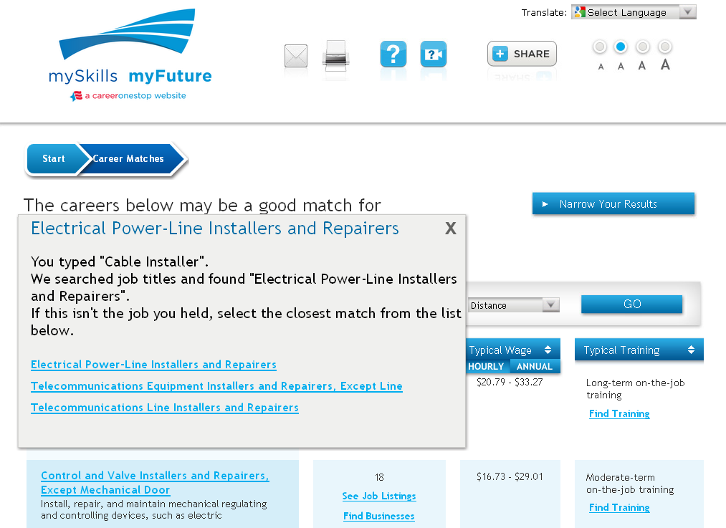
Notes:
. . . and then select Telecommunications Line Installers and Repairers.

Slide 8
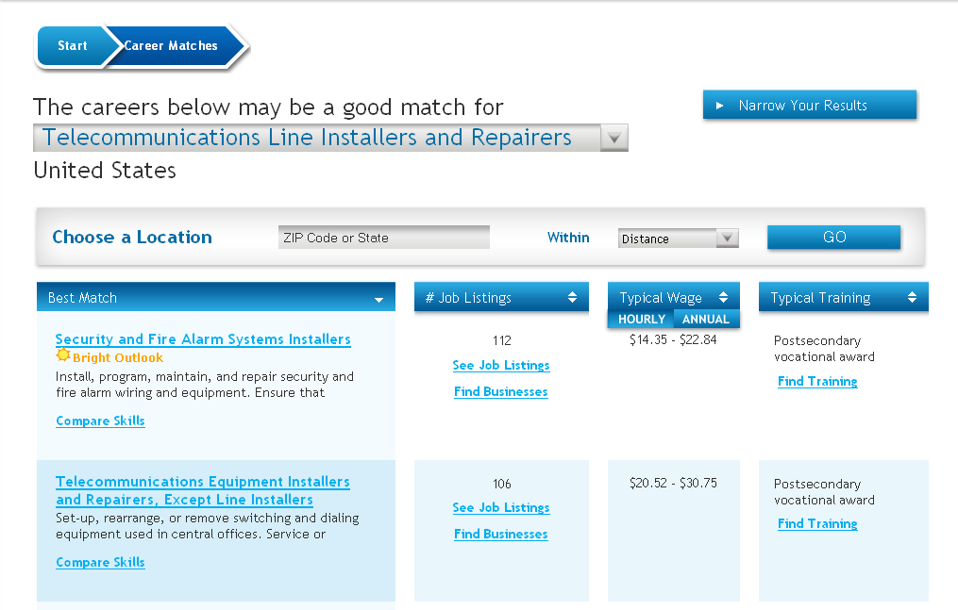

Slide 9
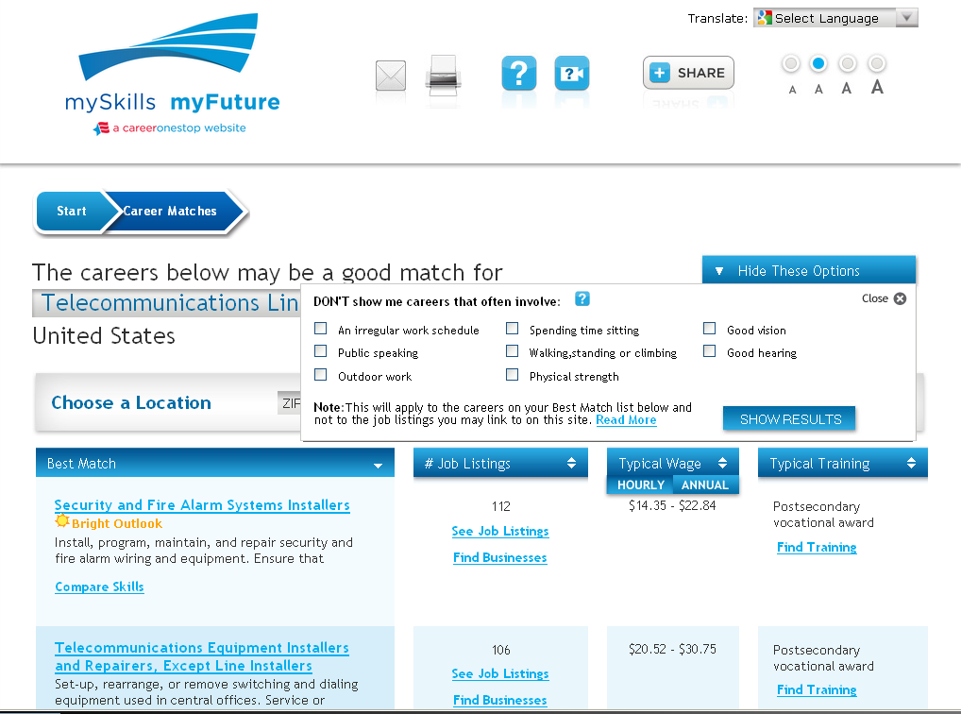

Slide 10
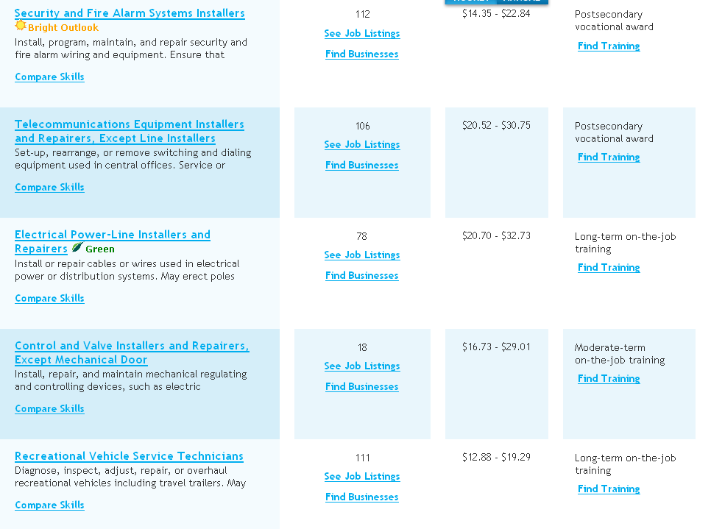
Notes:
Now I see the list of occupations matched to Telecommunications Line Installers and Repairers by skill, knowledge and ability attributes.
These occupations are sorted by the closest match. I can see the number of job listings, typical wages, and typical training required for each of these occupations. Note that all of this information is national since I haven’t entered a ZIP code or state here. We’ll go through that in a few minutes.
I can decide to sort this chart by jobs, wages, or training.
This yellow icon identifies occupations that are projected to grow quickly., according to O*NET’s Bright Outlook classification.
This green icon identifies jobs that are green, according to O*NET’s definition of green jobs.
You can scroll down to see more related jobs

Slide 11
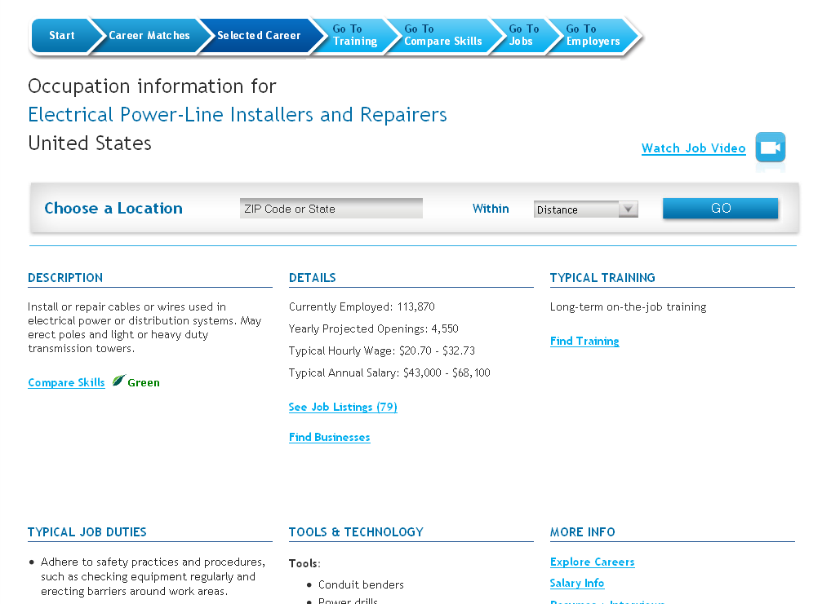
Notes:
Note that no geography has yet been selected.
Here you can see a description of the job as well as details, training, tools and technology and links to more information.
At this point, let’s compare skills.
Select Compare Skills

Slide 12
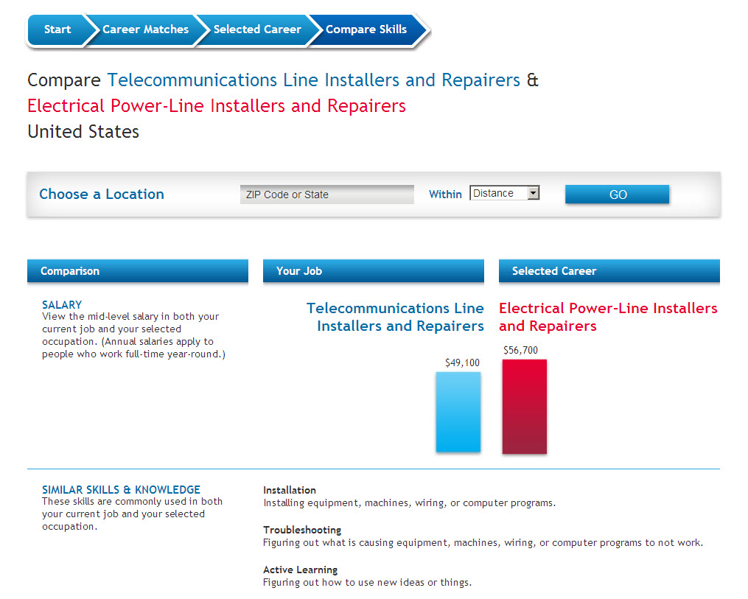
Notes:
This page will compare our skills from our previous job of a cable installer to our future possible job of an electrical power line installer.
Note salary increase from $49,100 to $56,700 for total US. - $7,600

Slide 13
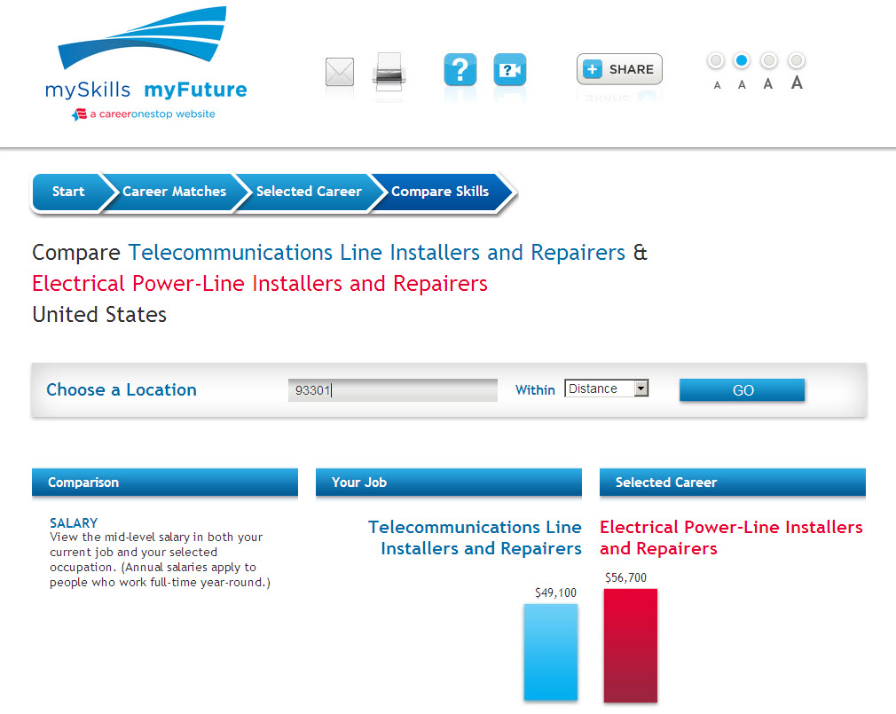
Notes:
To see information in our local area, let’s specify where we are living.
Enter ZIP: 93301 – Bakersfield, CA

Slide 14
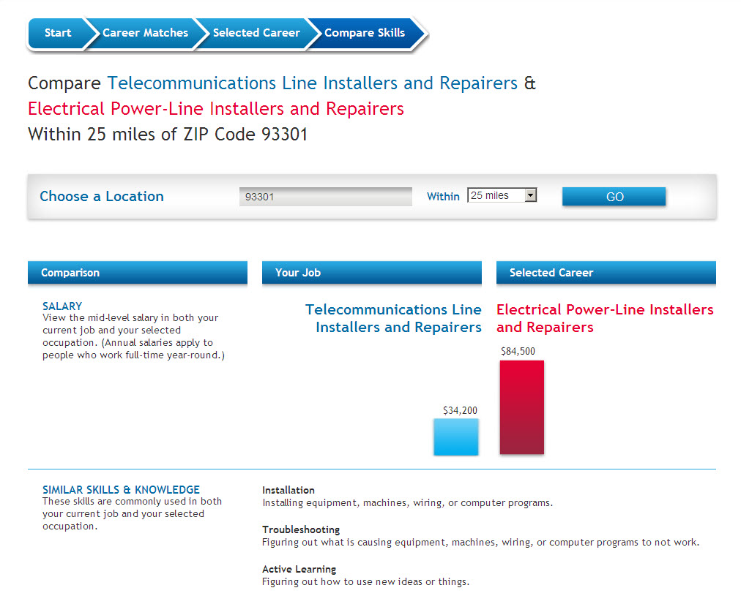
Notes:
Now we can see the comparisons for the local area.
Note salary increase from $34,200 to $84,500 for ZIP 93301- $50,300

Slide 15
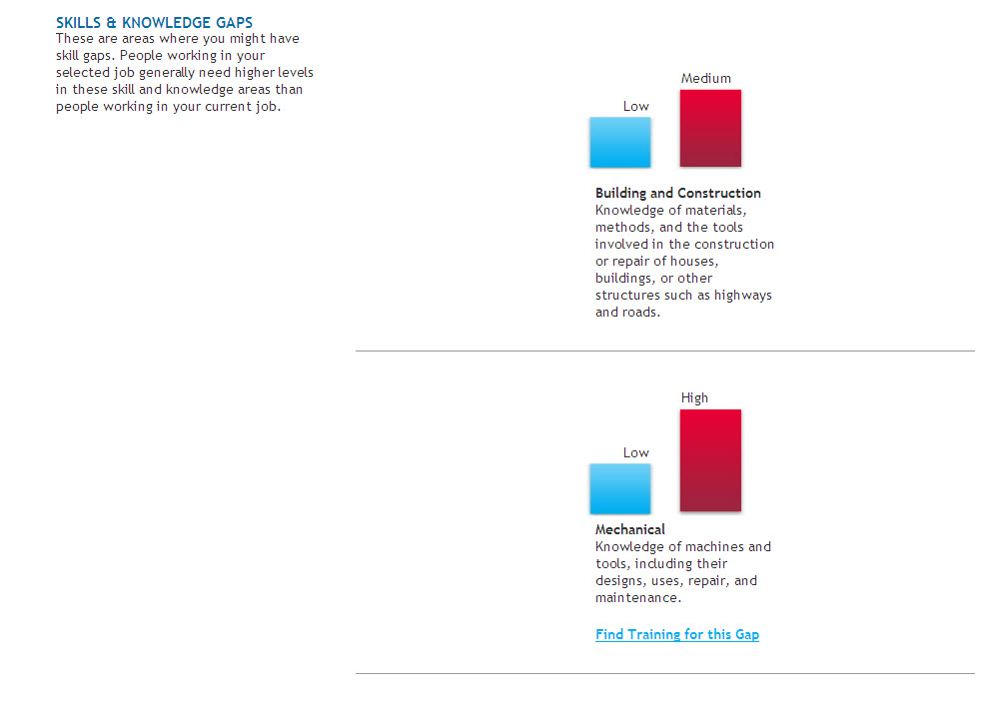
Notes:
When you scroll down the page you also find additional information about gaps between these two careers. R
Review Skills & Knowledge Gaps. You will see that you can get additonal training to fill these gaps.
Select Find Training for this Gap for Mechanical.

Slide 16
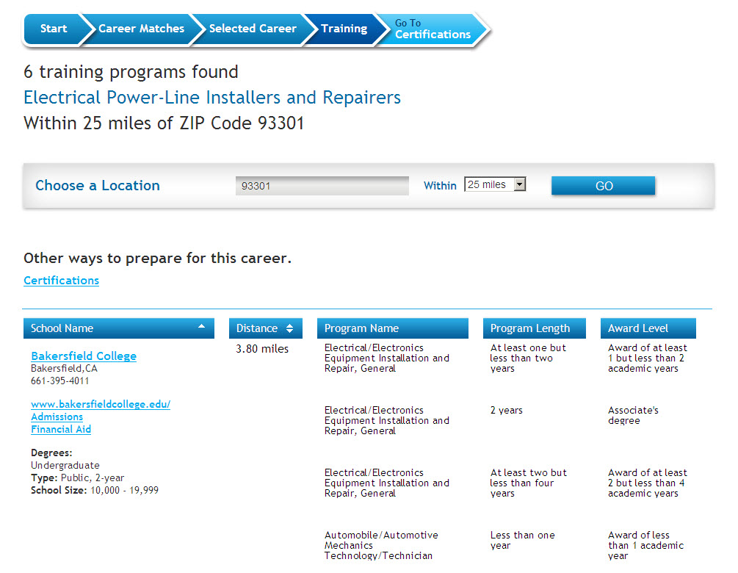
Notes:
For this specific occupation, there are 6 training programs found within 25 miles of our specified zip code.
Note “Electrical/Electronics Equipment Installation and Repair, General” program, “At least one but less than two years.”
Since that program looks short, we will go to Bakersfield to explore more information.
Select Bakersfield College.

Slide 17
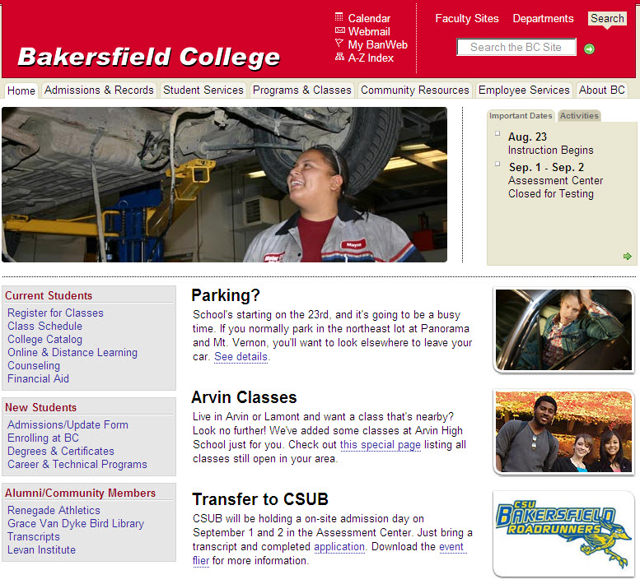
Notes:
It will bring us to that school’s web site where we can explore information about our program of interest.

Slide 18
Notes:
So you closed the external site and are back to the same training page.
We can see that in addition to school training, there are also certifications related to our selected occupation.
Select Certifications under Other ways to prepare for this career.

Slide 19
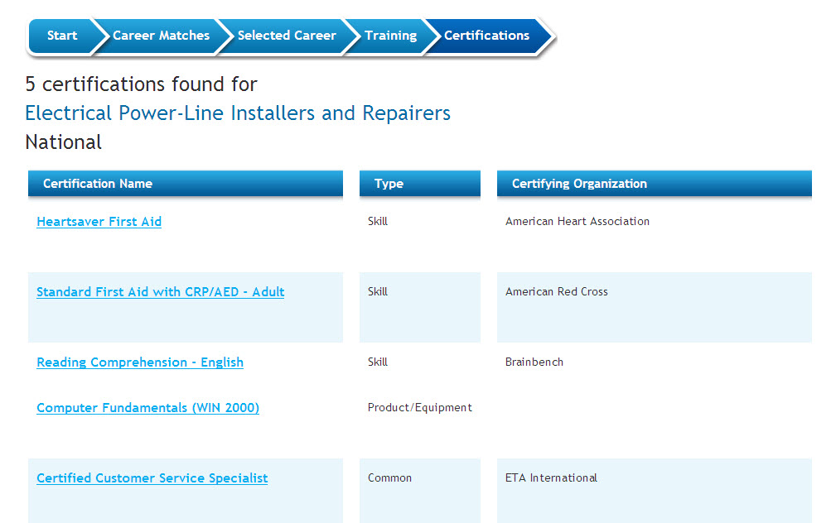
Notes:
In our area, there are 5 certifications related to our occupation.
The most common is the customer service specialist.
Select Certified Customer Service Specialist offered by the Electronics Technicians Association (ETA).

Slide 20
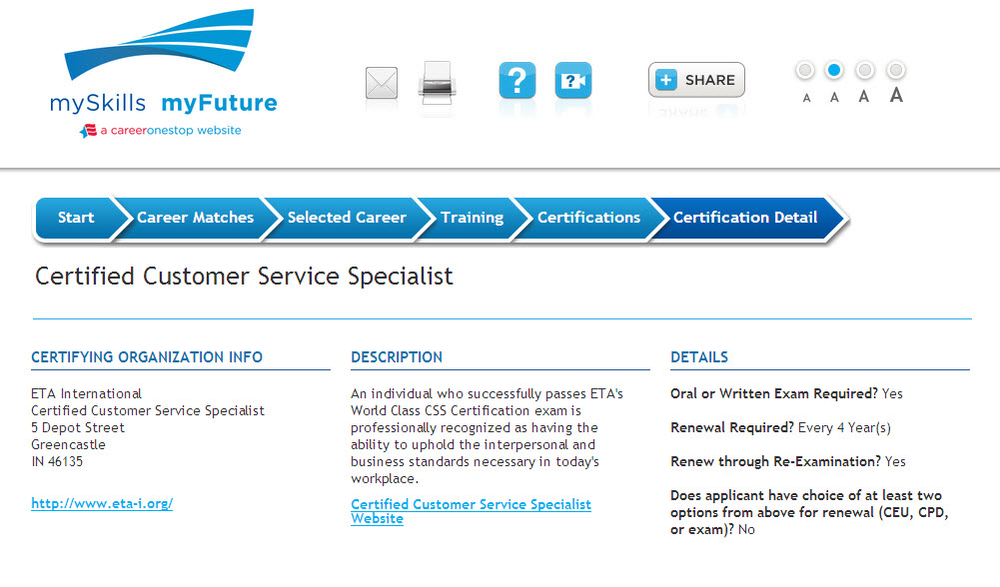

Slide 21
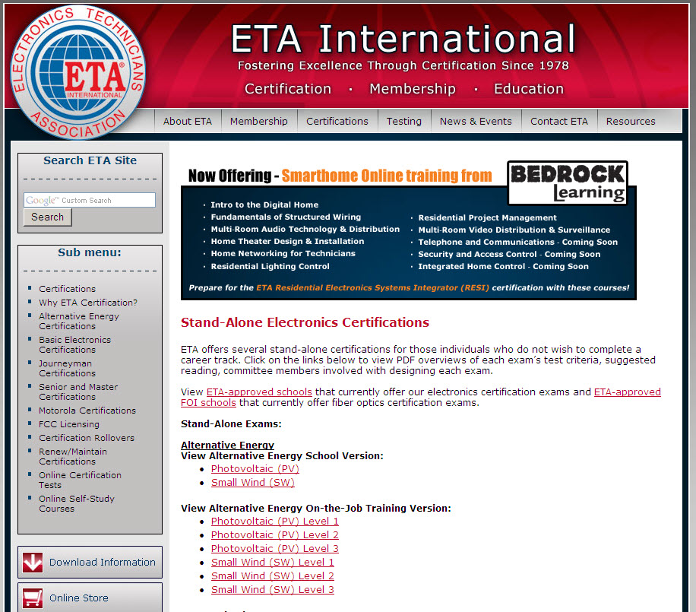

Slide 23
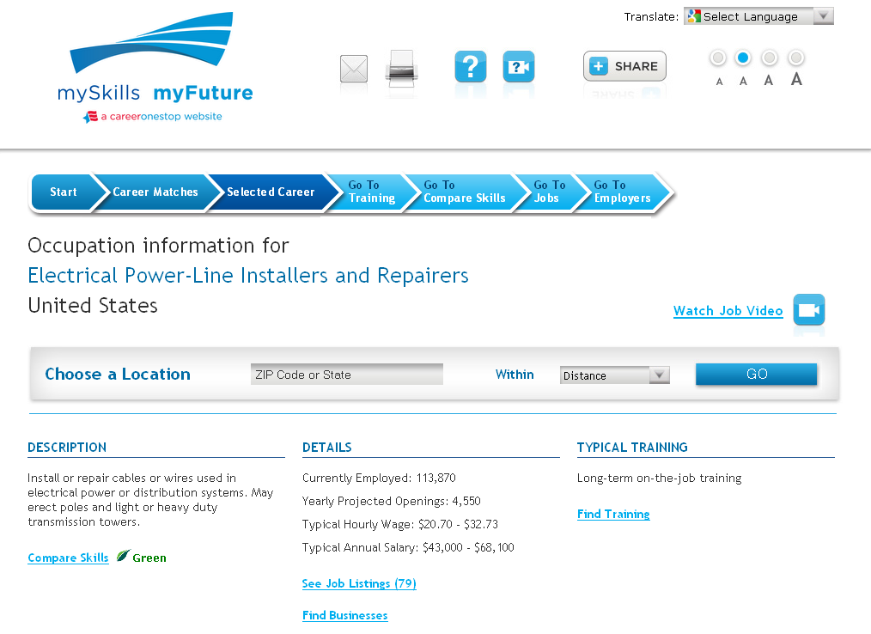

Slide 24
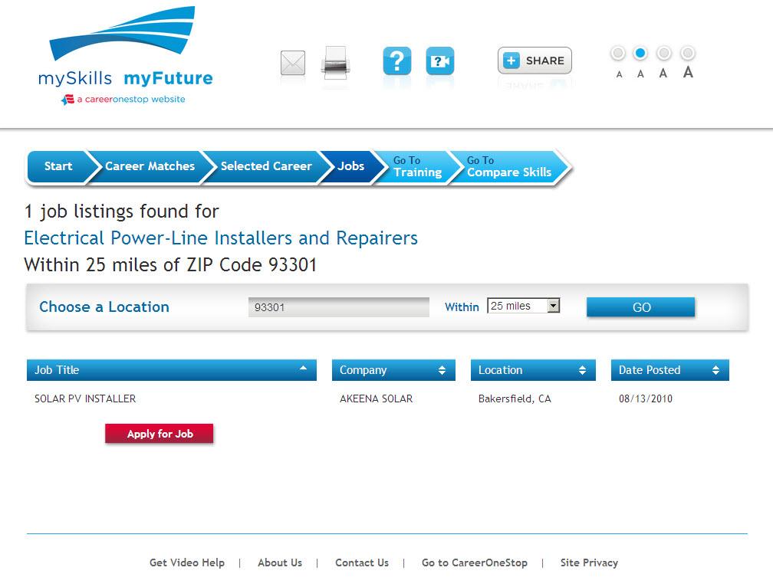

Slide 25
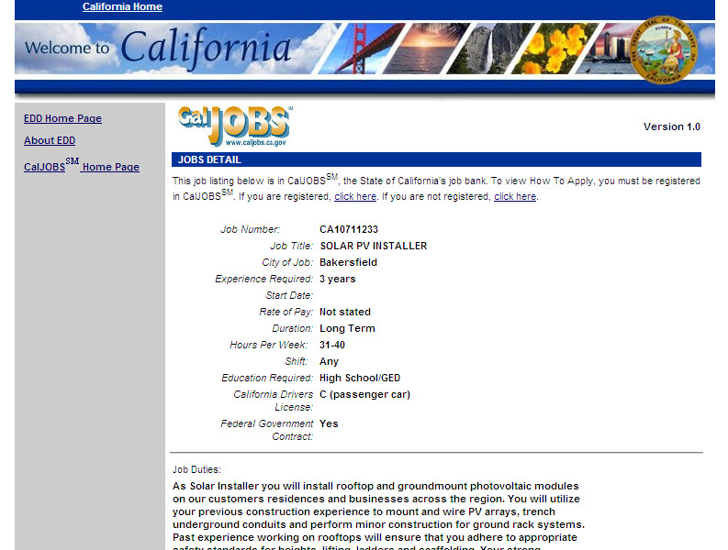

Slide 28
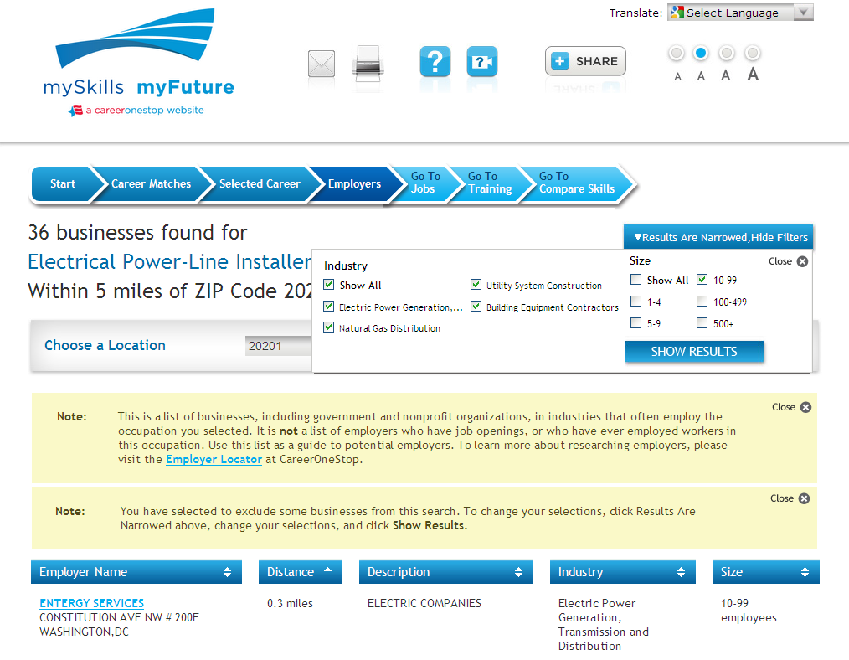

Slide 29
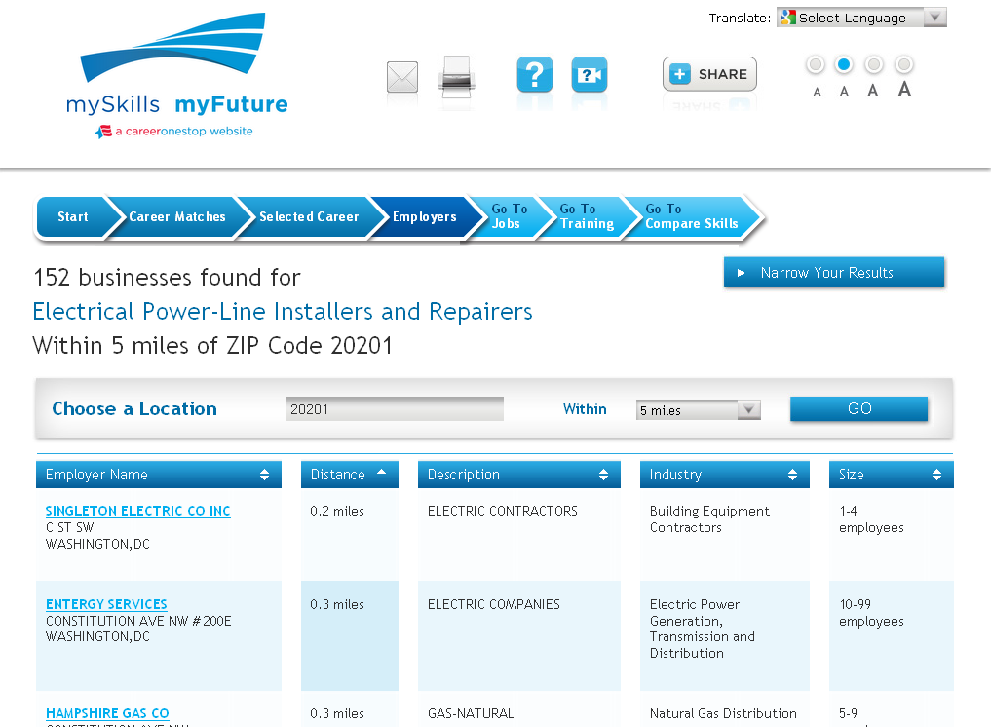

Slide 30
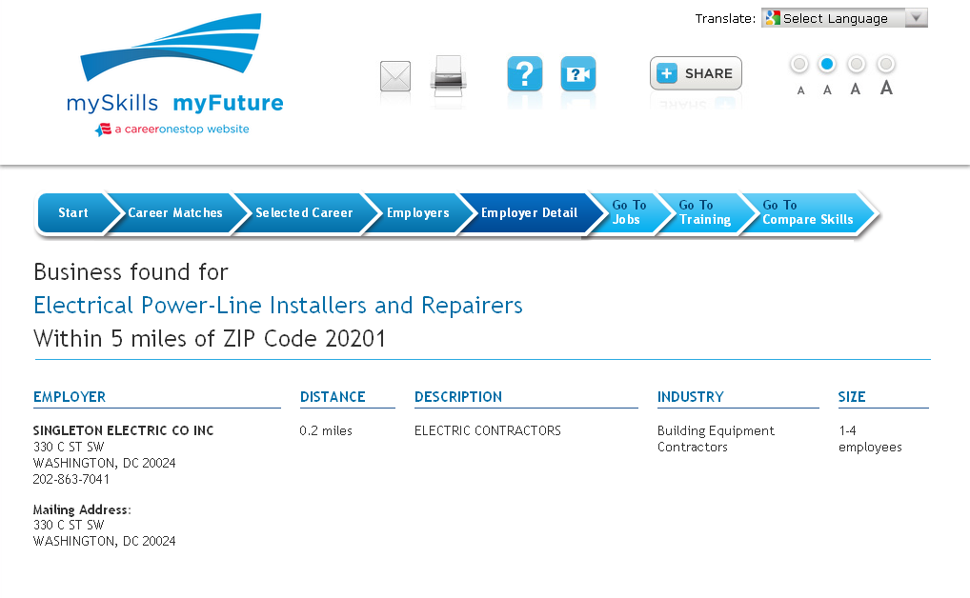

Slide 31
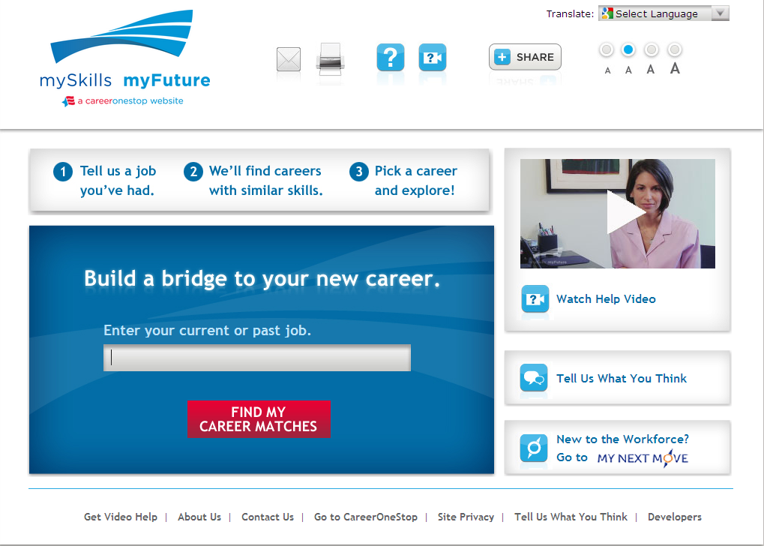

Slide 34
Notes:
Our newest feature is the “select a career” option under the red box. This allows you to select a specific career to explore rather than use the tool for a skills transferability analysis.

Slide 36
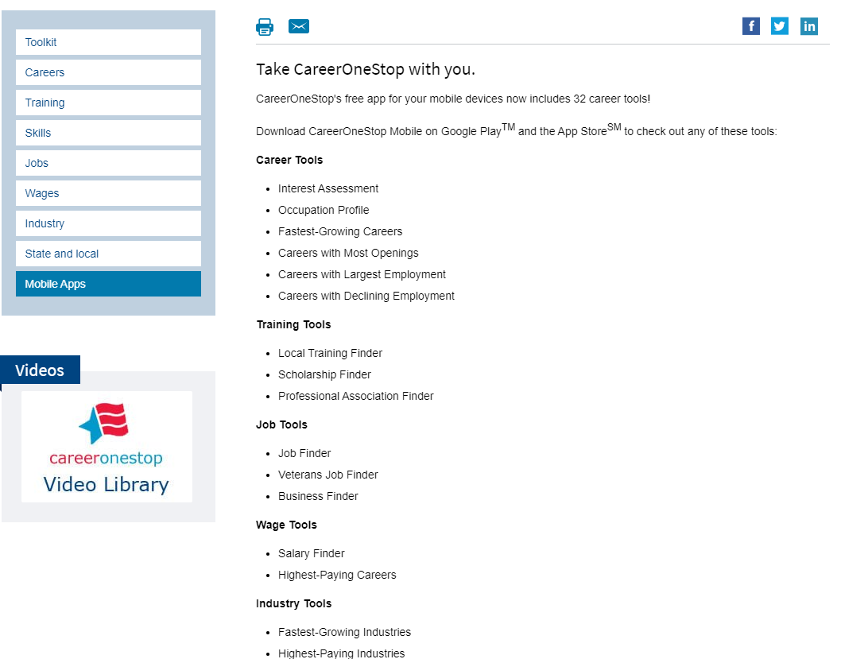
Mobile Tools
Notes:
You can now find CareerOneStop’s great resources in a easy way on your mobile device.
CareerOneStop now offers 32 mobile web applications:

Slide 37
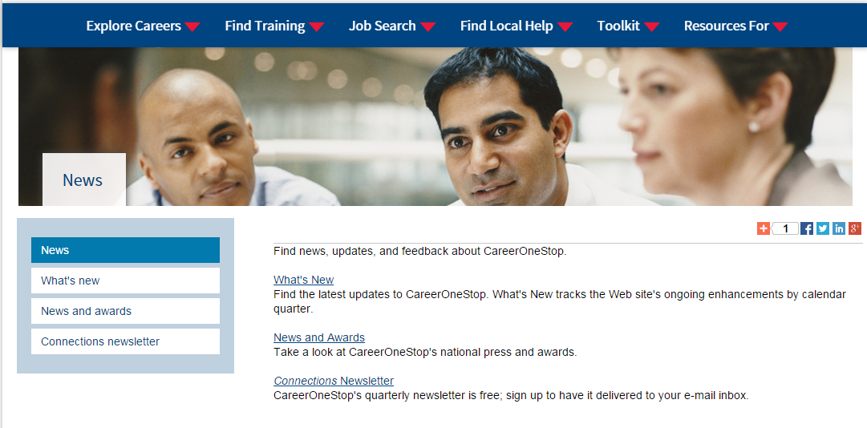
News
Notes:
Find news, updates, and feedback about CareerOneStop.
Also have a blog here: http://blog.careeronestop.org/

Slide 38
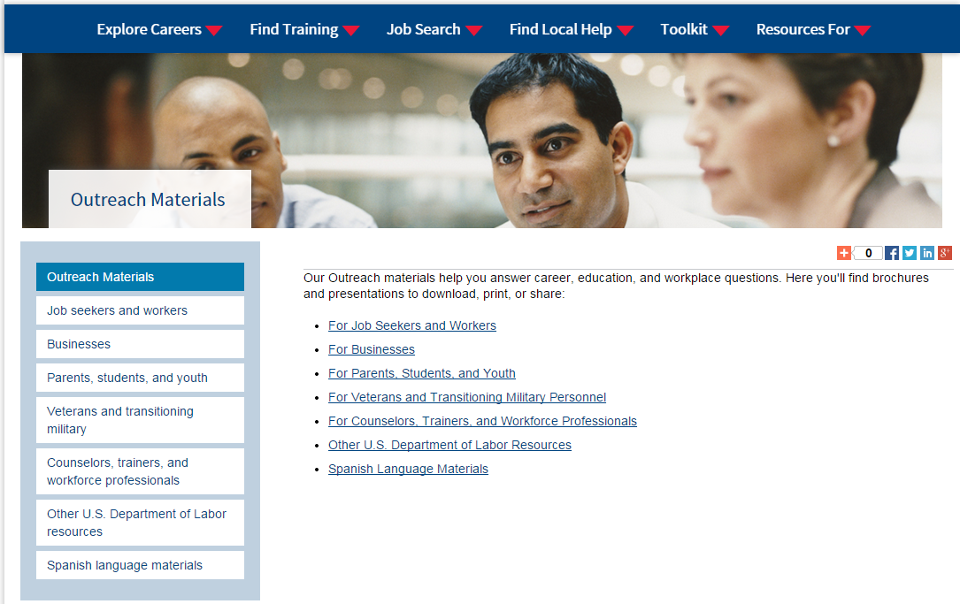
Outreach materials
Notes:
Our Outreach materials help you answer career, education, and workplace questions. Here you'll find brochures and presentations to download, print, or share:
For Job Seekers and Workers
For Businesses
For Parents, Students, and Youth
For Veterans and Transitioning Military Personnel
For Counselors, Trainers, and Workforce Professionals
Other U.S. Department of Labor Resources
Spanish Language Materials

Slide 39
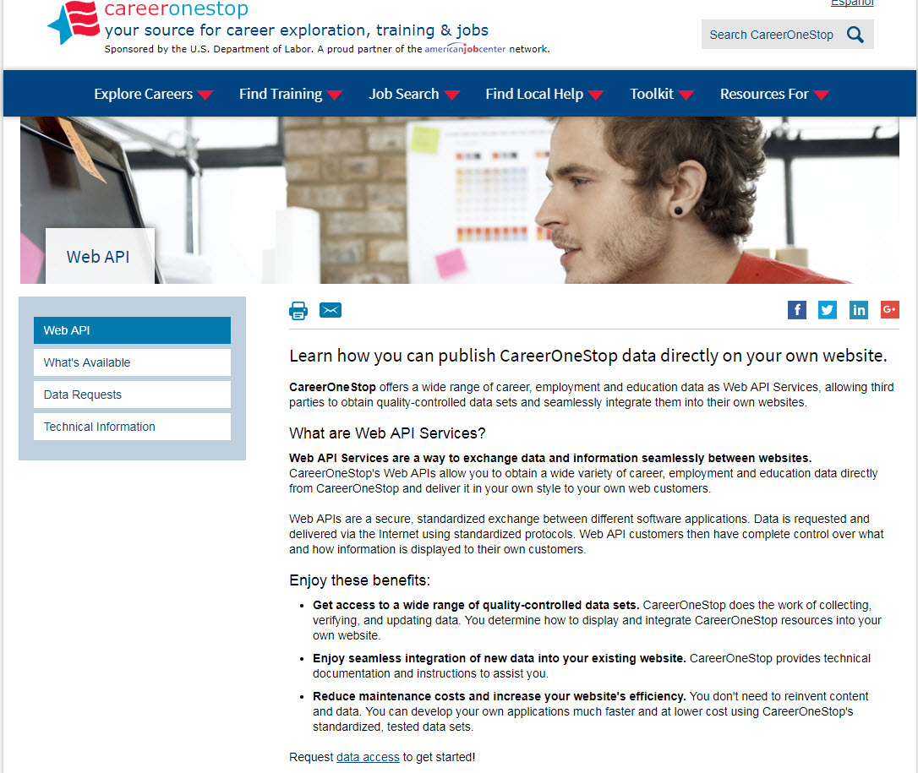
Web API
Notes:
* Does displaying CareerOneStop’s range of career, education, and employment data on your own site sound interesting?
* Would you be interested in a customized version of a Web-based salary tool or occupation profile?
* How about a searchable database of occupational licenses or certifications?
* What if you could add these features to your career information web site so that it looks like your web site and costs your nothing to do so?
If so, you may be a candidate for Web services.
CareerOneStop now offers Web services as a way to exchange data, information, and even online tools seamlessly between Web sites.
CareerOneStop does the work of collecting and updating the data, while you display a customized version on your site.

Slide 40
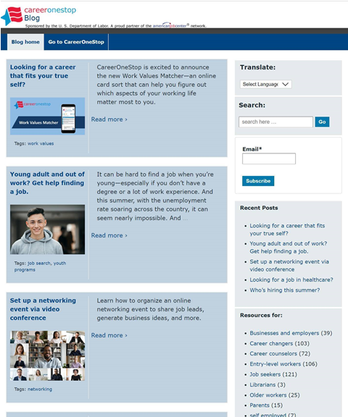
CareerOneStop Blog
blog.CareerOneStop.org

Slide 41
CareerOneStop on Social Media
Twitter: https://twitter.com/Career1Stop
LinkedIn: https://www.linkedin.com/company/careeronestop
Facebook: https://www.facebook.com/CareerOneStop.org/
Instagram: https://www.instagram.com/careeronestop/
Pinterest: https://www.pinterest.com/CareerOneStop/
YouTube: https://www.youtube.com/user/CareerOneStop

Slide 42
Contact Us
Contact CareerOneStop
E-mail: info@CareerOneStop.org
US2-JOBS Toll-Free Help Line
1-877-US2-JOBS (TTY: 1-877-889-5627)
Notes:
Thank you for attending this presentation about CareerOneStop and other pathways to career success.
If you have questions about CareerOneStop after this presentation, please feel free to contact us. Also, if you have questions about any U.S. Department of Labor Employment and Training Programs, please contact the US2-JOBS.

