Slide 1
CareerOneStop
Notes:
Welcome to this presentation, CareerOneStop – Find your Pathway to Career Success
CareerOneStop is sponsored by the U.S. Department of Labor Employment and Training Administration (ETA). This presentation is intended to provide you with brief information on ETA initiatives and its sponsored electronic tools to assist you and your organization in developing talent and becoming competitive leaders for the 21st century.
This presentation is focused on pathways to career success. I will:
* Introduce you to the U.S. Department of Labor Employment and Training Mission or (ETA)
* Describe WIRED, one of ETA’s foundational principles, for regional economic development and talent development
* Provide an overview of CareerOneStop and highlight various online resources
* Present other ETA online resources such as Workforce3One, Career Voyages and O*NET and
* Answer any questions you may have about CareerOneStop and partner online resources.
By the end of this presentation, you will gain valuable knowledge, resources, and conceptual models to enhance your effectiveness as a strategic leader and service provider in your local area. You can find all of the resources presented here at the end of this presentation.

Slide 2
About CareerOneStop
CareerOneStop offers free, online resources to meet the career, training, and employment needs of individuals and businesses.
CareerOneStop is sponsored by the U.S. Department of Labor, Employment and Training Administration.
Notes:
Now I’d like to focus on CareerOneStop and other ETA sponsored online tools that supports talent and regional economic development.
What is CareerOneStop?
CareerOneStop is a set of online tools that integrate economic and workforce development activities and support talent development and prosperity.

Slide 3
Your source for career exploration, training & jobs
Easy-to-use tools and resources right at your fingertips that can help you advance your education and career!
Notes:
CareerOneStop is a national Web site offers that career resources and workforce information to job seekers, students, businesses, and workforce professionals to foster talent development in a global economy.
CareerOneStop has been significantly updated over the last couple years. The new look is based on user feedback. It provides easier access to the key tools and resources needed by job seekers, students, businesses, and career professionals.
The new organization offers quick and easy access to valuable content. You can find all the CareerOneStop and related tools you need in six simple categories.
How many of you are familiar with this website? Polling question.
Now I’ll highlight some of CareerOneStop’s unique and easy to use online resources starting with Explore Careers.

Slide 4
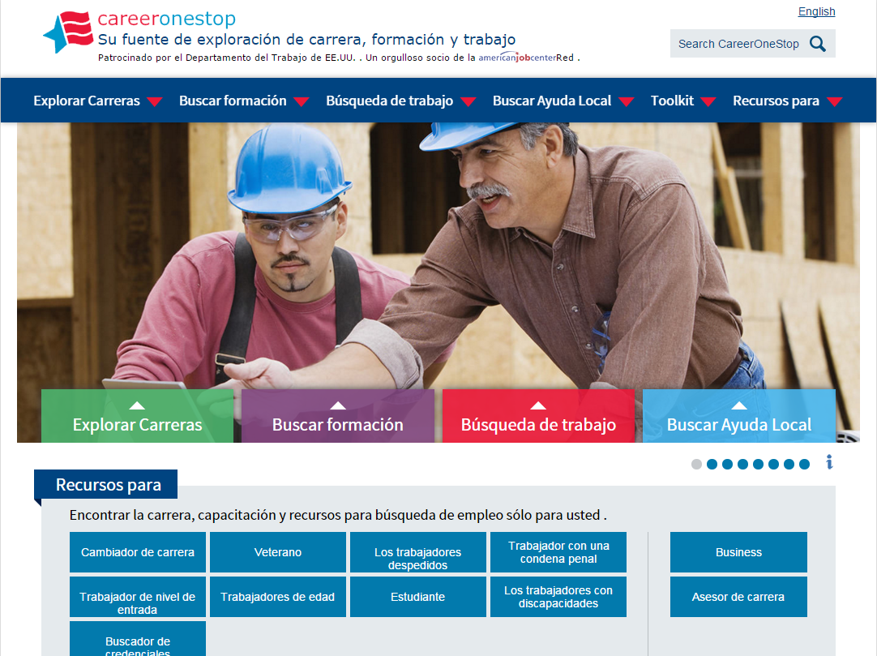
Spanish
Notes:
Our entire website can be translated into Spanish. Click in upper right corner.

Slide 5
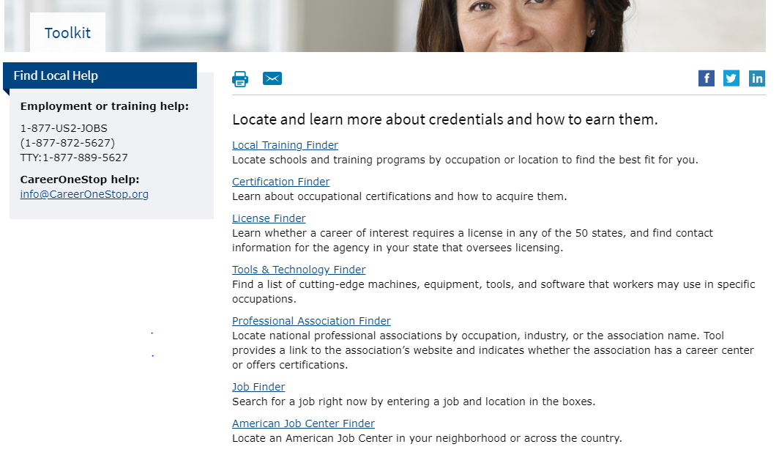
Credential Toolkit

Slide 6
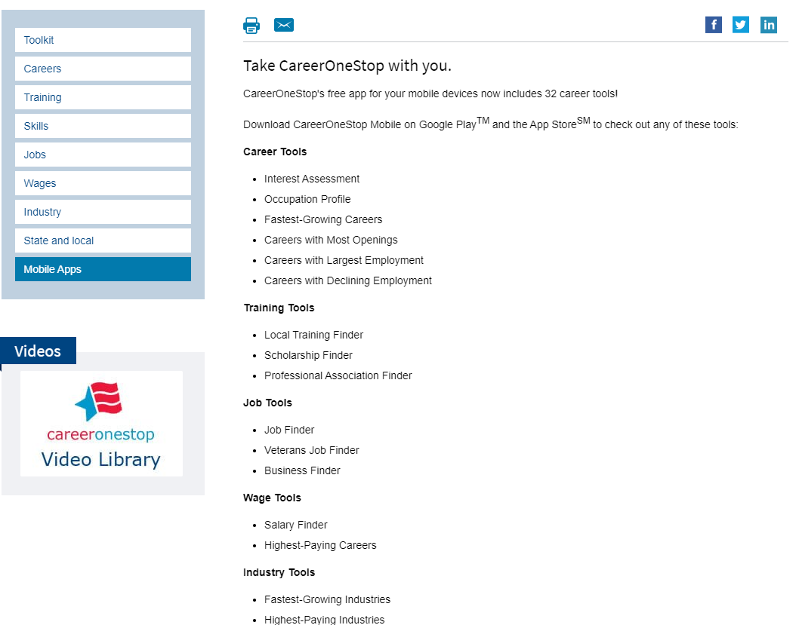
Mobile Tools
Notes:
You can now find CareerOneStop’s great resources in a easy way on your mobile device.
CareerOneStop now offers 32 mobile web applications:

Slide 7
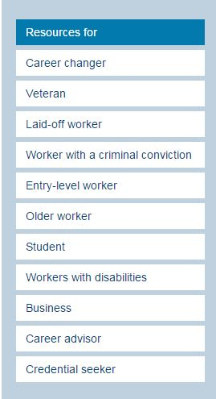
Resources For…
CareerOneStop offers resources targeted just for each of the audiences to the left!
Notes:
Bottom tab is Credential Seeker

Slide 8
Resources and tools for workforce analysis and development
www.CareerOneStop.org/Credentials
Notes:
CareerOneStop created the Credentials Center to consolidate its tools, resources and information related to training and education. The site helps users plan, pay for, and achieve education goals.

Slide 9
CareerOneStop
2
1
3
www.CareerOneStop.org/Credentials
Notes:
From the homepage, users select an entry point
Introduction video : site overview
Three main sections: Training Options, Afford Training, or Find your Path
Frequently asked questions / popular topics
Throughout the site, users can connect with assistance in person at an American Job Center; on the phone via the U.S. Department of Labor’s toll-free helpline; or online via CareerOneStop’s help center.

Slide 10
Notes:
Try to see if this works without internet
It should. It is an mp4 file

Slide 11
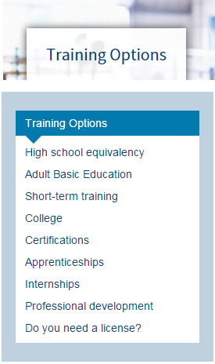
Section: Training Options
Information on the range of available training options
Direct access to tools for locating training options in any local area across the United States
www.CareerOneStop.org/Credentials
Notes:
4 main sections: training options, afford training, find your path, Toolkit
Left nav box explains content

Slide 12
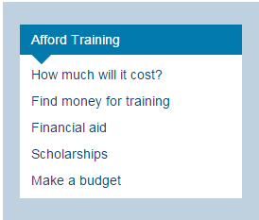
Section: Afford Training
Costs and benefits of training
Financial aid
Other sources of paying for training
www.CareerOneStop.org/Credentials
Notes:
4 main sections: training options, afford training, find your path, Toolkit
Left nav box explains content

Slide 13
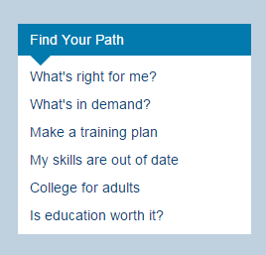
Section: Find Your Path
How to make a training plan
Using labor market information and employer demand data to get the most out of your education
Special tips for adults and other unique audiences
www.CareerOneStop.org/Credentials
Notes:
4 main sections: training options, afford training, find your path, Toolkit
Left nav box explains content

Slide 14
Section: Toolkit
Local Training Finder
Certification Finder
License Finder
Tools & Technology Finder
Professional Association Finder
Job Finder
American Job Center Finder
www.CareerOneStop.org/Credentials
Notes:
4 main sections: training options, afford training, find your path, Toolkit
Toolkit houses 7 tools
We will review those 7 tools in the following slides

Slide 15
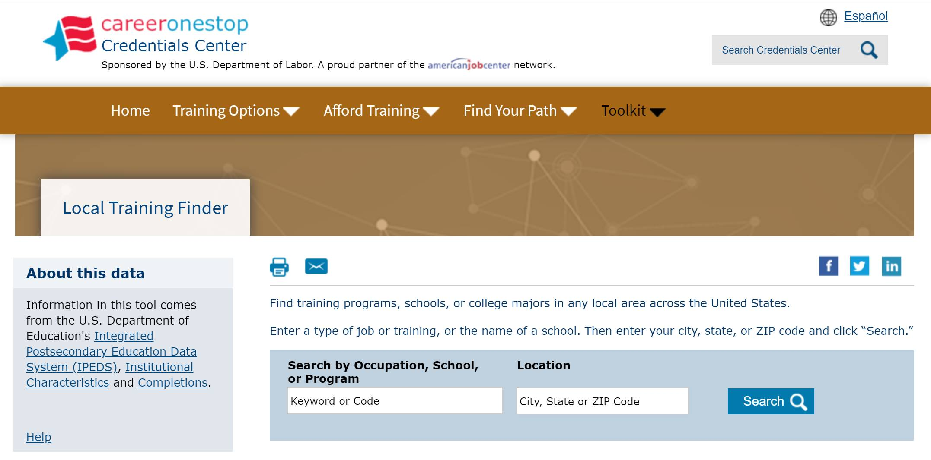
Section: Toolkit Local Training Finder
www.CareerOneStop.org/Credentials

Slide 16
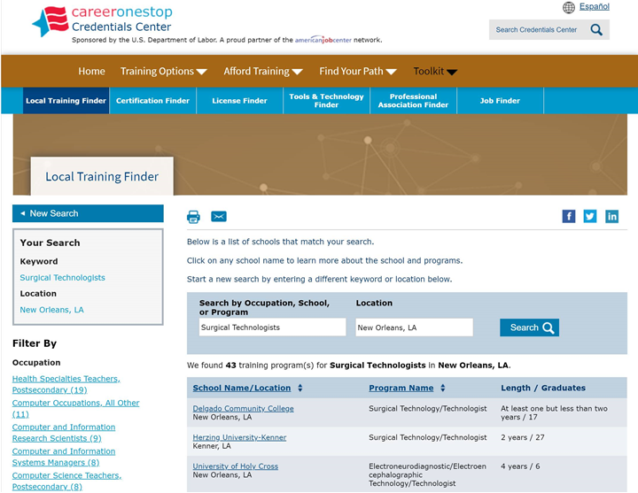
Section: Toolkit Local Training Finder Results
Notes:
Results of search

Slide 17
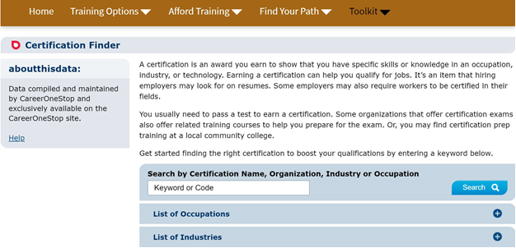
Section: Toolkit Certification Finder
www.CareerOneStop.org/Credentials

Slide 18
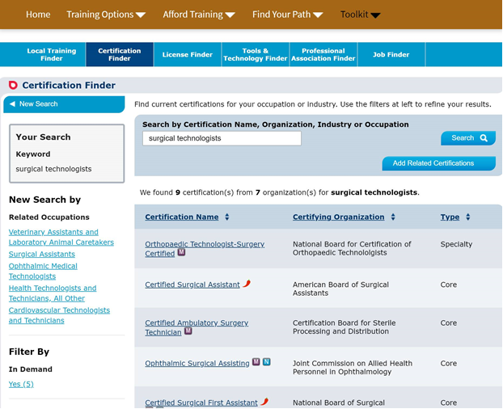
Section: Toolkit Certification Finder Results

Slide 19
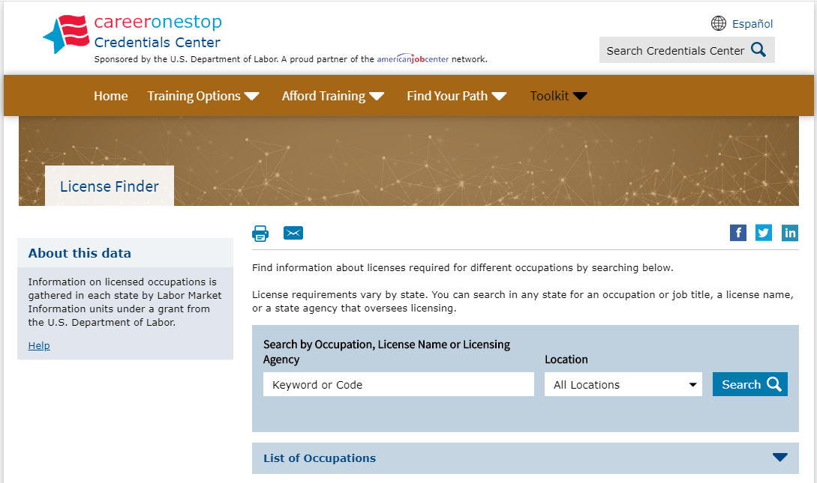
Section: Toolkit License Finder
www.CareerOneStop.org/Credentials

Slide 20
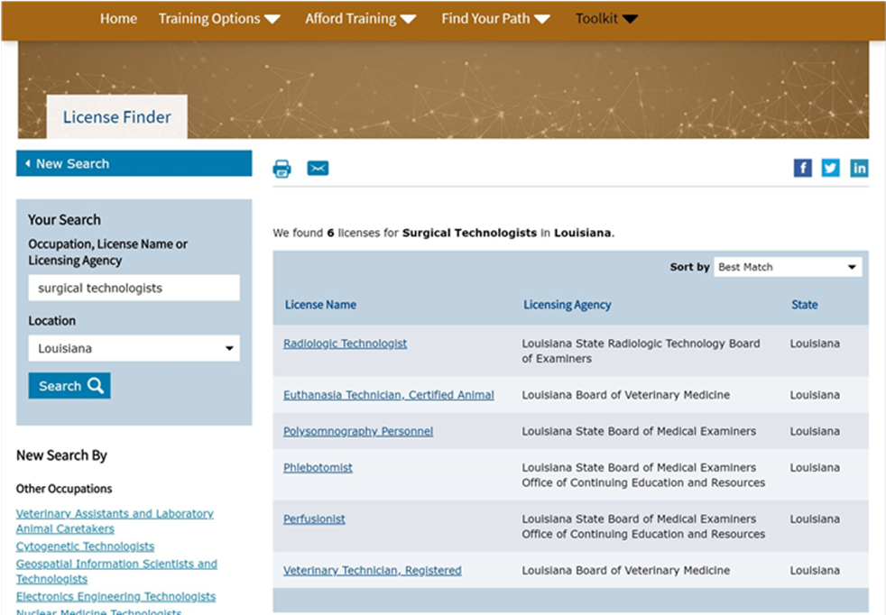
Section: Toolkit License Finder Results License Finder Results

Slide 21
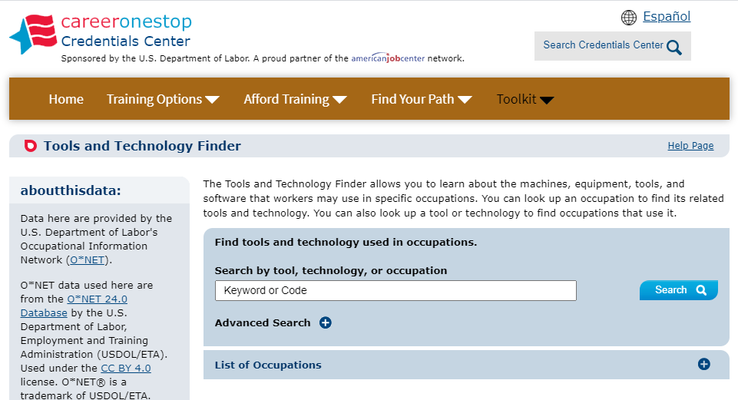
Section: Toolkit Tools and Technology Finder
www.CareerOneStop.org/Credentials

Slide 22
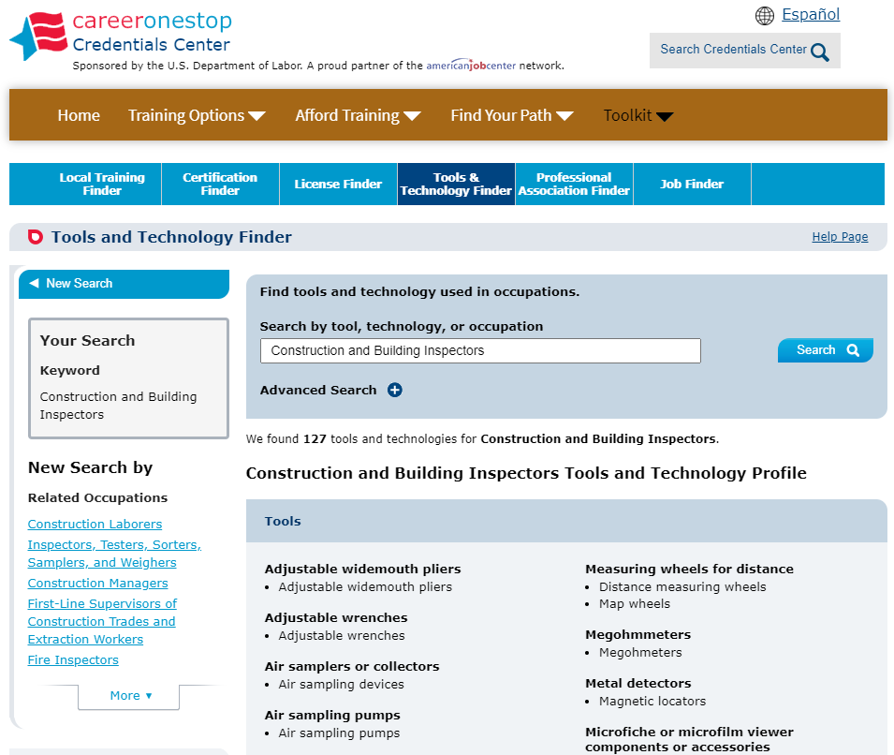
Section: Toolkit Tools and Technology Finder Results

Slide 23
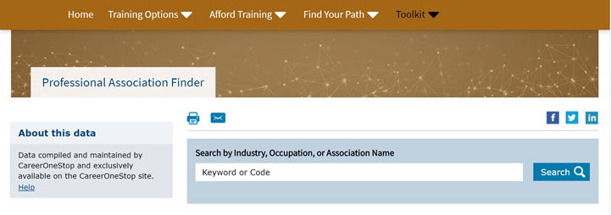
Section: Toolkit Professional Association Finder
www.CareerOneStop.org/Credentials

Slide 24
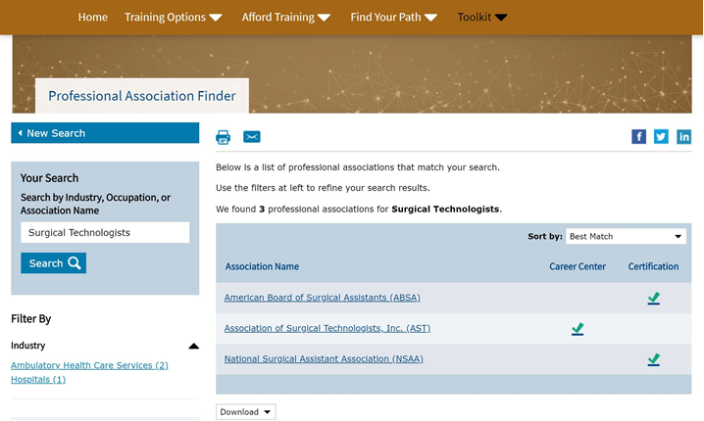
Section: Toolkit Professional Association Finder Results

Slide 25
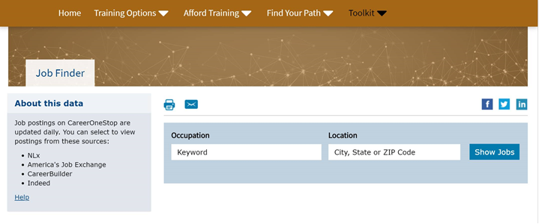
Section: Toolkit Job Finder
www.CareerOneStop.org/Credentials

Slide 26
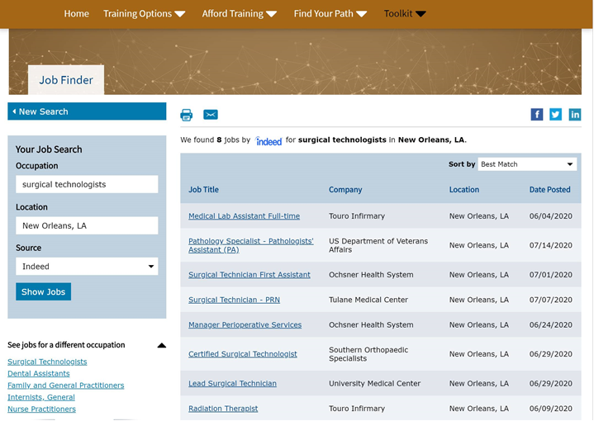
Section: Toolkit Job Finder Results
Notes:
Available from indeed, us.jobs, career builder, America’s job exchange

Slide 27
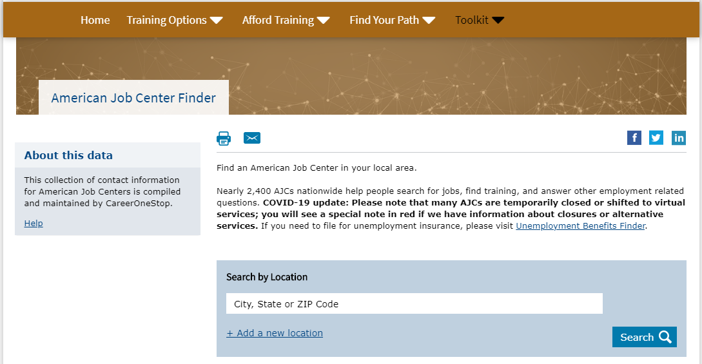
Section: Toolkit American Job Center Finder
www.CareerOneStop.org/Credentials

Slide 28
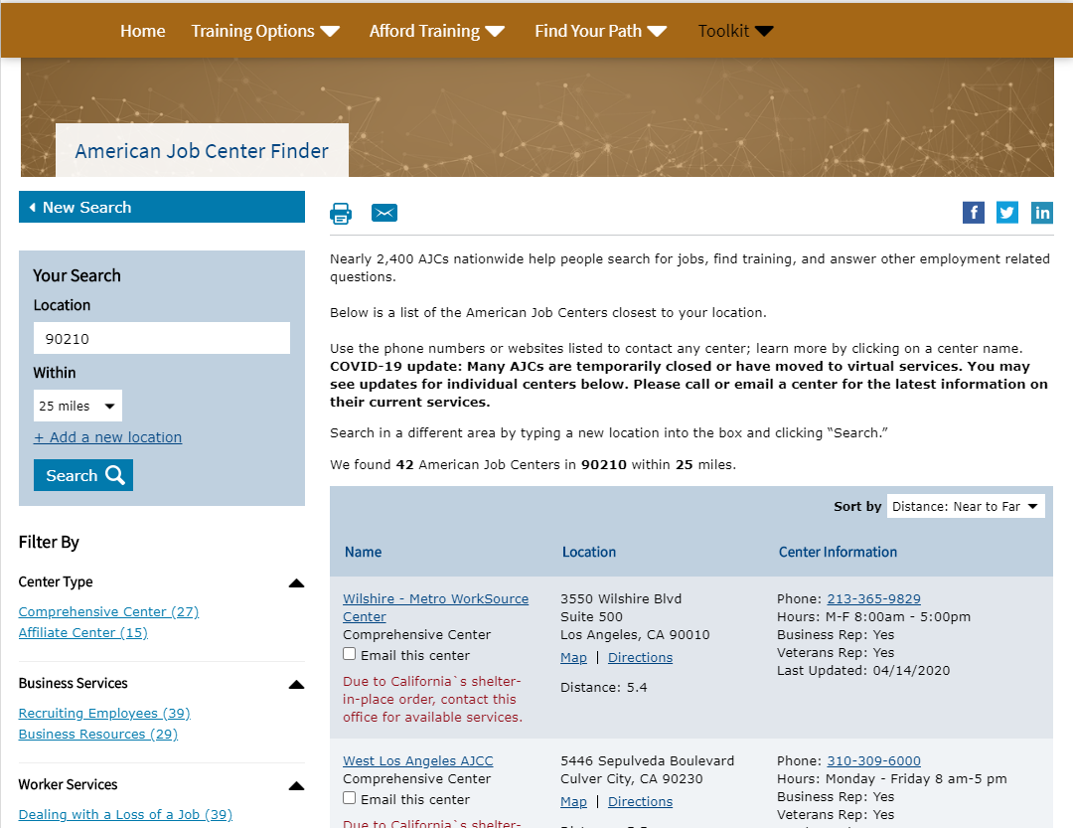
Section: Toolkit American Job Center Finder Results

Slide 29
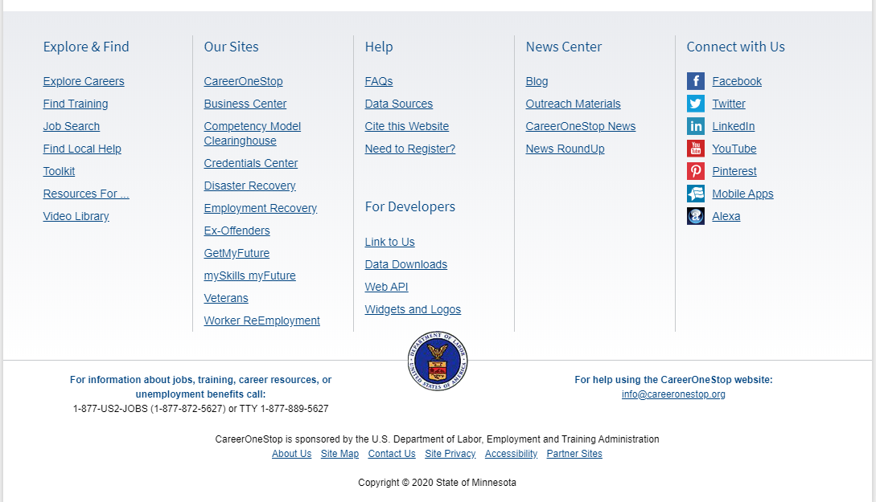
News
Notes:
Find news, updates, and feedback about CareerOneStop.
Also have a blog here: http://blog.careeronestop.org/

Slide 30
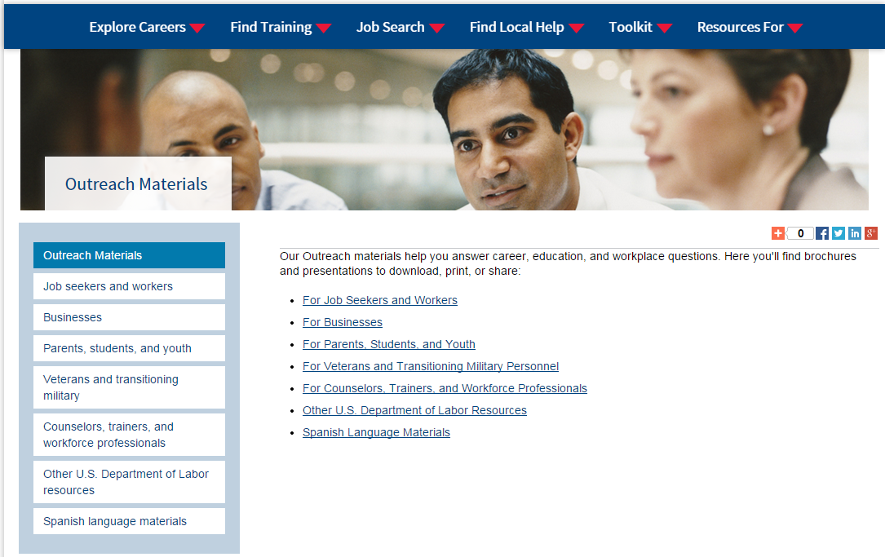
Outreach Materials
Notes:
Our Outreach materials help you answer career, education, and workplace questions. Here you'll find brochures and presentations to download, print, or share:
For Job Seekers and Workers
For Businesses
For Parents, Students, and Youth
For Veterans and Transitioning Military Personnel
For Counselors, Trainers, and Workforce Professionals
Other U.S. Department of Labor Resources
Spanish Language Materials

Slide 31
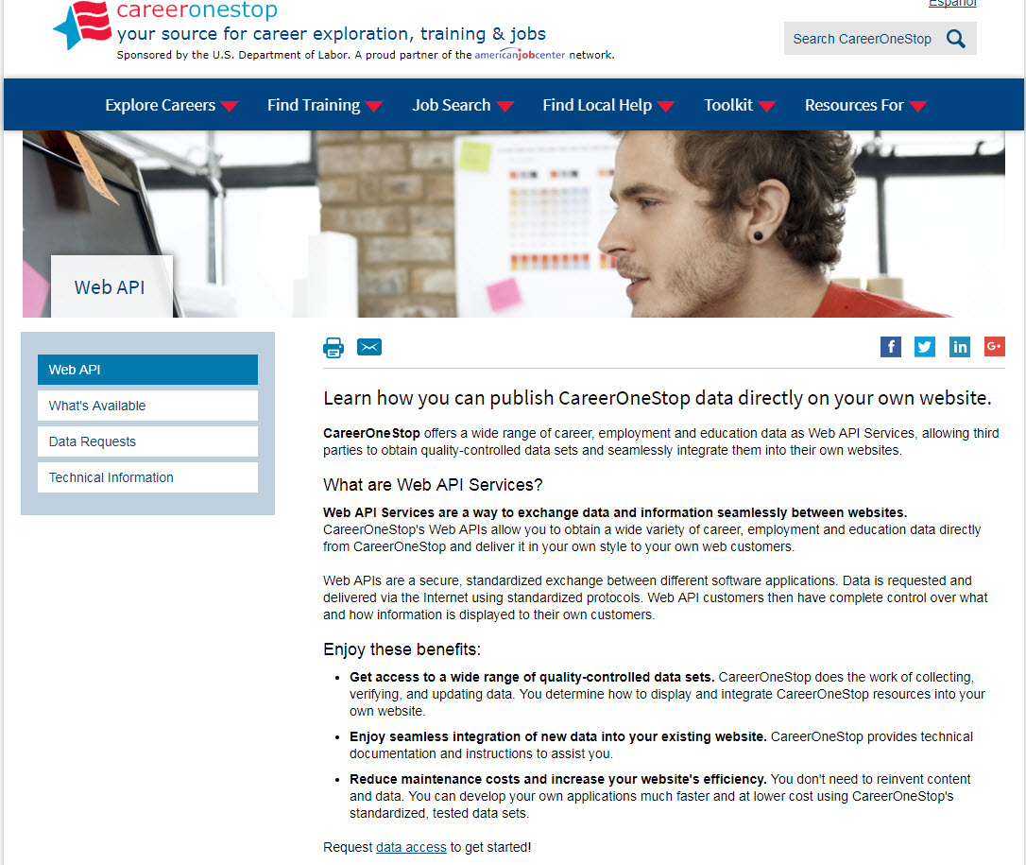
Web API
Notes:
* Does displaying CareerOneStop’s range of career, education, and employment data on your own site sound interesting?
* Would you be interested in a customized version of a Web-based salary tool or occupation profile?
* How about a searchable database of occupational licenses or certifications?
* What if you could add these features to your career information web site so that it looks like your web site and costs your nothing to do so?
If so, you may be a candidate for Web services.
CareerOneStop now offers Web services as a way to exchange data, information, and even online tools seamlessly between Web sites.
CareerOneStop does the work of collecting and updating the data, while you display a customized version on your site.

Slide 32
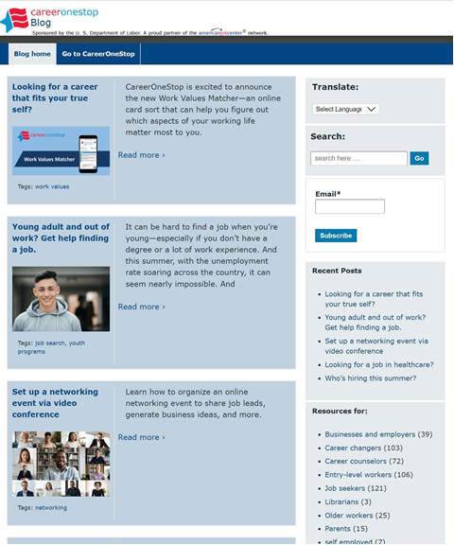
CareerOneStop Blog
blog.CareerOneStop.org

Slide 33
CareerOneStop on Social Media
Twitter: https://twitter.com/Career1Stop
LinkedIn: https://www.linkedin.com/company/careeronestop
Facebook: https://www.facebook.com/CareerOneStop.org/
Instagram: https://www.instagram.com/careeronestop/
Pinterest: https://www.pinterest.com/CareerOneStop/
YouTube: https://www.youtube.com/user/CareerOneStop

Slide 34
Resources
U.S. Department of Labor Employment & Training Administration: www.doleta.gov
CareerOneStop: www.careeronestop.org
GetMyFuture: www.GetMyFuture.org
Credentials Center: www.careeronestop.org/Credentials
Business Center: www.careeronestop.org/BusinessCenter
Veteran and Military Transition Center: www.careeronestop.org/Veterans
Competency Model: www.careeronestop.org/CompetencyModel
mySkills myFuture: www.mySkillsmyFuture.org

Slide 35
Contact Us
Contact CareerOneStop
E-mail: info@CareerOneStop.org
US2-JOBS Toll-Free Help Line
1-877-US2-JOBS (TTY: 1-877-889-5627)
Notes:
Thank you for attending this presentation about CareerOneStop and other pathways to career success.
If you have questions about CareerOneStop after this presentation, please feel free to contact us. Also, if you have questions about any U.S. Department of Labor Employment and Training Programs, please contact the US2-JOBS.

