Slide 1
GetMyFuture
Notes:
Welcome to the Powerpoint presentation on GetMyFuture.org
CareerOneStop is sponsored by the U.S. Department of Labor Employment and Training Administration (ETA). This presentation is intended to provide you with brief information on ETA initiatives and its sponsored electronic tools to assist you and your organization in developing talent and becoming competitive leaders for the 21st century.
This presentation is focused on GetMyFuture. I will:
Introduce you to the U.S. Department of Labor Employment and Training Sponsored Website www.GetMyFuture.org
Give you tools to help youth age 16-24 find education, training, and careers
Help youth deal with barriers to education and employment
By the end of this presentation, you will gain valuable knowledge, resources, and tools regarding the GetMyFuture website

Slide 2
GetMyFuture
Notes:
What can you do on the GetMyFuture website?
This website has information, tools, and links to resources to help anyone age 16 to 24:
Explore careers
Learn about and locate training or education programs
Conduct a successful job search
The goal of this site is to help young adults overcome barriers and plan and achieve a path to career success.
Explore the site using the navigation labels across the top—or jump right to our different types of resources below.

Slide 3
Navigation
GetMyFuture
Notes:
Explore Careers
Education
Employment
Find Support
Toolkit

Slide 4
ShortCuts
GetMyFuture
Notes:
I want to: (just click on the picture)
Find a career I like
Finish High School
Get Work Experience
Write a resume
Get A Job
Get Training
Work for Myself
Apply to College
Find Job Search Help USER GUIDE FOUND HERE

Slide 5
User Guide
Notes:
User guide- a walk through of the web site and what you can do
this section includes printable versions of the worksheets and checklists on the site, and links to all of the success-story videos

Slide 6
Videos
Notes:
Videos are stories from people who have overcome challenges and created success in their personal and work lives
Lonnie- First in his family to go to college
Gabby- found support for a better future
Ashley - Found stability and a career after homelessness
Alex - Getting An Internship
Cat - From foster system to successful adult
Johnny - Career goals to move forward
Stefan - Work experience to build his career
Joel - Dealt with drug abuse and a criminal record
Antoine - From poverty to parenthood and a career

Slide 7
Explore Careers
Watch Video
Notes:
Interest Assessment
Skills Checklist
Occupation Profile
Career Videos
Career Goals
Career Advancement
And more!

Slide 8
Education
Watch Video
Notes:
With more education, you're more likely to get a job you like, earn more money, and be satisfied with your life.
Finish High-School
Adult Basic Education
Short-term training
Apprenticeships/Internships
College
How to pay for school

Slide 9
Employment
Watch Video
Notes:
Ideas for your first job
Where to find work documents
How to get work experience
How to search for a job
How to work for yourself
How to fill out a job application
How to create a resume
How to ace an interview
What to expect on the job

Slide 10
Find Support
Watch Video
Notes:
Find the support you need to help you succeed.
Find job search help
Dealing with finances
Transportation
Parenting
Foster System
Criminal Record
Addiction Recover
Get food, money, and other support

Slide 11
TOOLKIT
Notes:
Find details and local resources to get a job, training, or someone to help with next steps.
Tools include”
Interest Assessment
Scholarship Finder
Occupation Profile
Local Training Finder

Slide 12
Tool: Interest Assessment
Notes:
Interest Assessment
Tell us what you like to do And what you don’t like to do by evaluating 30 questions
We’ll show you careers that fit your interests.
Your interests are the things you like to do, the ideas you want to know more about, and anything that inspires you
When your job includes your interests, you enjoy it more. And you usually become good at things you enjoy. With so many days and years in your working life, it’s absolutely important that you enjoy it
Powered by O*NET® Interest Profiler™

Slide 13
Tool: Occupation Profile
Notes:
Occupation Profile
You can look up more than 800 different careers and watch
video descriptions about each field.
Start by entering a career you’re interested in and your location.
You’ll see a job description, video, wages, employment trends, job outlook, education needs, and knowledge, skills and abilities associated with the job

Slide 14
Tool: Local Training Finder
Notes:
Local Training Finder
You can find a list of schools in any region you specify that match your search.
Click on any school name to learn more about the school and programs.
Start a new search by entering a different keyword or location

Slide 15
Tool: Scholarship Finder
Notes:
Scholarship Finder
Scholarships are financial gifts that help you pay for school.
They can come from a college, community group, business, or the government.
Scholarships are granted based on different criteria, including your location, race, ethnicity, life experience, music ability, sports ability, or other characteristics.
Search more than 7,500 scholarships, fellowships, grants, and other financial aid award opportunities. You can:
Look through the whole list of scholarships below, arranged in order of closest deadline
Narrow your list with "Search by keyword." Enter a keyword about the type of award you're looking for
Use the filters to see only awards for certain award types, locations, level of study, and more

Slide 16
News
Notes:
Find news, updates, and feedback about CareerOneStop.
Also have a blog here: http://blog.careeronestop.org/

Slide 17
Outreach materials
Notes:
Our Outreach materials help you answer career, education, and workplace questions. Here you'll find brochures and presentations to download, print, or share:
For Job Seekers and Workers
For Businesses
For Parents, Students, and Youth
For Veterans and Transitioning Military Personnel
For Counselors, Trainers, and Workforce Professionals
Other U.S. Department of Labor Resources
Spanish Language Materials

Slide 18
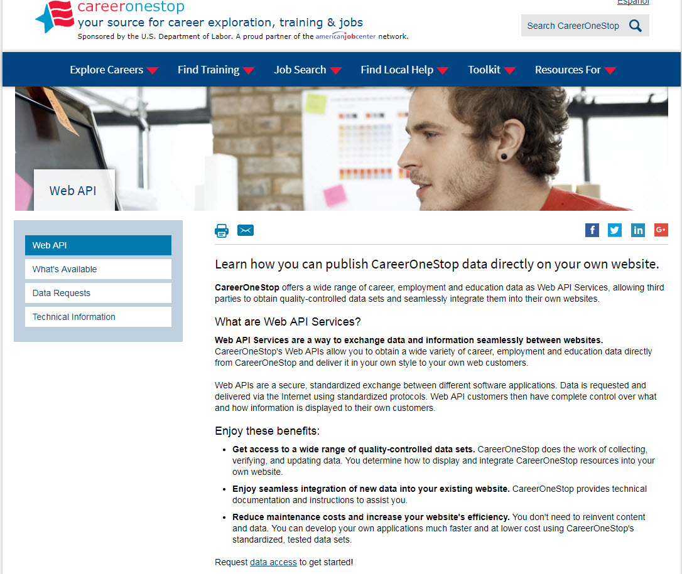
Web API
Notes:
* Does displaying CareerOneStop’s range of career, education, and employment data on your own site sound interesting?
* Would you be interested in a customized version of a Web-based salary tool or occupation profile?
* How about a searchable database of occupational licenses or certifications?
* What if you could add these features to your career information web site so that it looks like your web site and costs your nothing to do so?
If so, you may be a candidate for Web services.
CareerOneStop now offers Web services as a way to exchange data, information, and even online tools seamlessly between Web sites.
CareerOneStop does the work of collecting and updating the data, while you display a customized version on your site.

Slide 19
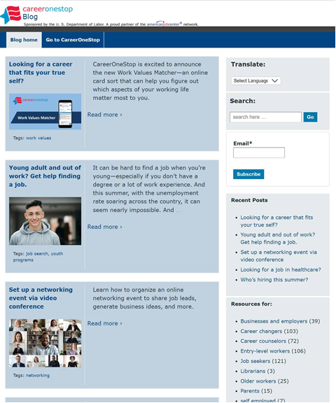
CareerOneStop Blog
blog.CareerOneStop.org
Notes:
The CareerOneStop Blog has great information for jobseekers, businesses, youth, counselors and more!

Slide 20
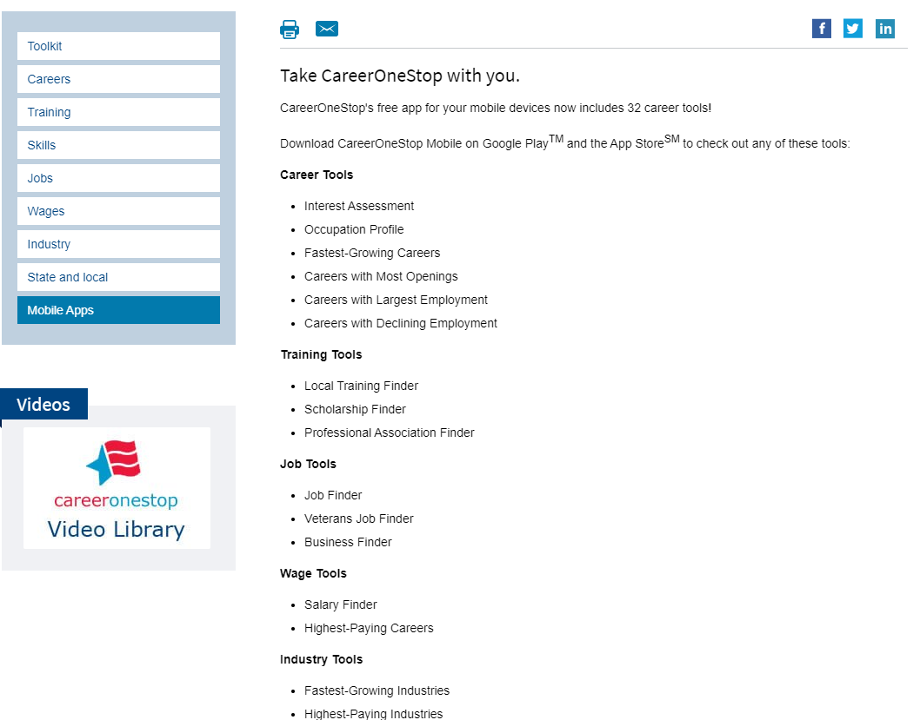
Mobile Tools
Notes:
You can now find CareerOneStop’s great resources in a easy way on your mobile device.
CareerOneStop now offers 32 mobile web applications:

Slide 21
CareerOneStop on Social Media
Twitter: https://twitter.com/Career1Stop
LinkedIn: https://www.linkedin.com/company/careeronestop
Facebook: https://www.facebook.com/pages/Careeronestop/135511219941994
Instagram: https://www.instagram.com/careeronestop/
Pinterest: https://www.pinterest.com/CareerOneStop/
YouTube: https://www.youtube.com/user/CareerOneStop
Notes:
Find CareerOneStop on Social Media!

Slide 22
Resources
U.S. Department of Labor Employment & Training Administration: www.doleta.gov
CareerOneStop: www.careeronestop.org
GetMyFuture: www.GetMyFuture.org
Credentials Center: www.careeronestop.org/Credentials
Business Center: www.careeronestop.org/BusinessCenter
Veteran and Military Transition Center: www.careeronestop.org/Veterans
Competency Model: www.careeronestop.org/CompetencyModel
mySkills myFuture: www.mySkillsmyFuture.org
Notes:
Print these page for easy access to our web sites!

Slide 23
Contact Us
Contact CareerOneStop
E-mail: info@CareerOneStop.org
US2-JOBS Toll-Free Help Line
1-877-US2-JOBS (TTY: 1-877-889-5627)
Notes:
Thank you for attending this presentation about CareerOneStop and GetMyFuture
If you have questions about CareerOneStop after this presentation, please feel free to contact us. Also, if you have questions about any U.S. Department of Labor Employment and Training Programs, please contact the US2-JOBS.

