Slide 1
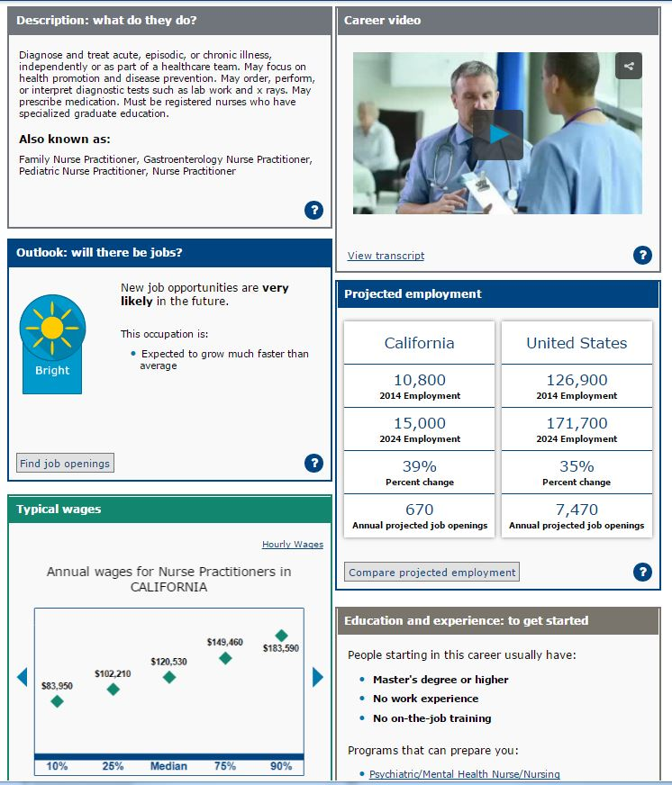
How to:
Explore careers using the Occupation Profile

Slide 2
How to explore careers using the Occupation Profile
This presentation will:
Introduce you to CareerOneStop’s Occupation Profile www.CareerOneStop.org/OccupationProfile
Demonstrate how to use the Occupation Profile to answer five key questions about any one of 950+ occupations:
What would I do on the job in this career?
What’s the outlook for jobs in this career?
How much money could I earn in this career?
How much education or training would I need for this career?
Is this career a good fit for my interests, skills, and abilities?

Slide 3
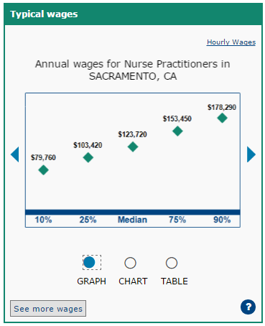
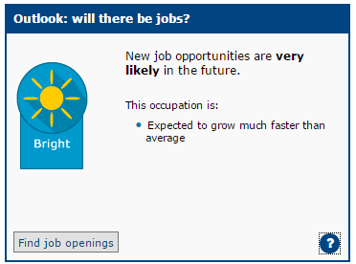
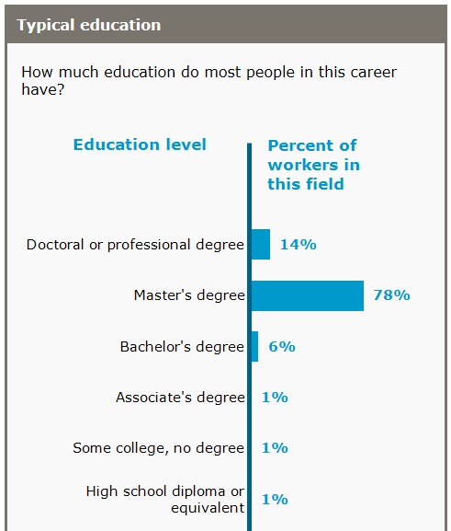
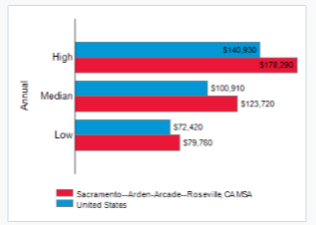
What is the Occupation Profile?
CareerOneStop’s Occupation Profile provides details on more than 900 careers.
For each career, you’ll find 17 cards with information including:
Career overview
Typical wages
Local and national employment
Education requirements
Employment outlook
Related tasks, skills, abilities and more
Links to local job postings
Links to local training programs

Slide 4
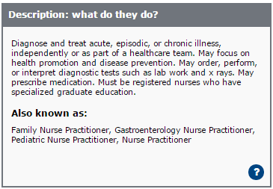
Learn: What do workers do on the job in this career?
Find an overview of the Career Description
Watch a
Career Video
1
2

Slide 5
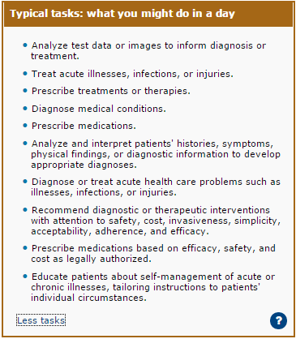
Learn: What do workers do on the job in this career?
3
See a list of tasks that workers might do on the job in this career.

Slide 6
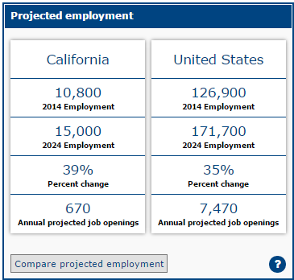
Learn: What’s the outlook for jobs in this career?
1
Find out if a career is expected to be
in demand
3
See detailed data on
projected employment growth or decline
Link directly to
local job postings
2

Slide 7
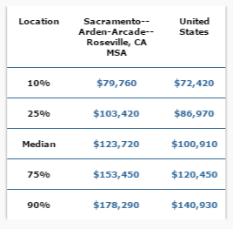
Learn: How much money do workers earn in this career?
1
See the typical wages earned by workers in this career—in the nation, state, or your local area.
Graph view
Chart view
Table view

Slide 8
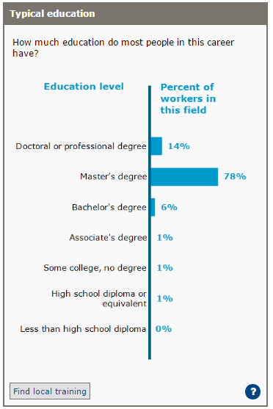
Learn: What’s the typical education and training?
See the range in education levels of people working in this career
1
Link to local training programs that can help you prepare for this career
2

Slide 9
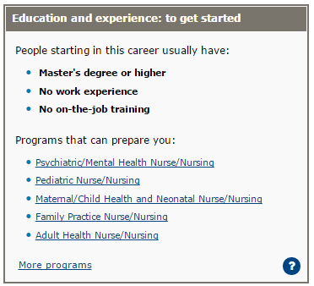
Learn: What’s the typical education and training?
See what’s typical for workers starting out in this career.
See the:
Typical degree or level of education
Typical level of work experience
Typical on-the-job training
3
4
Select from training programs that may prepare you for this career—and link directly to schools in your local area

Slide 10
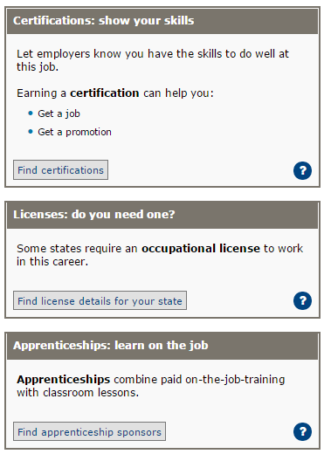
Learn: What’s the typical education and training?
Learn about other credentialing options that can help you get a job in this career:
Certifications
Licensing requirements
Apprenticeship options
And link to local and national opportunities.
5

Slide 11
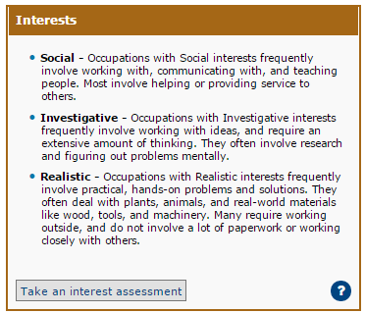
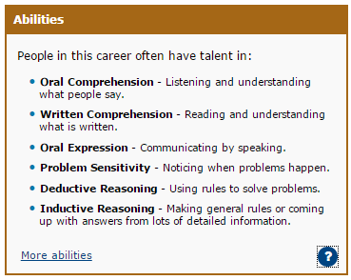
Learn: What interests and abilities are related to this career?
1
Interests: see a list of interests that are engaged by this career
2
Abilities: learn about the personal qualities that are needed for this career

Slide 12
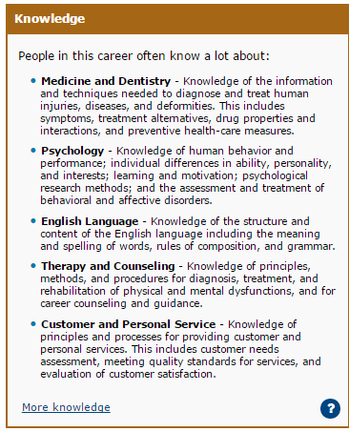
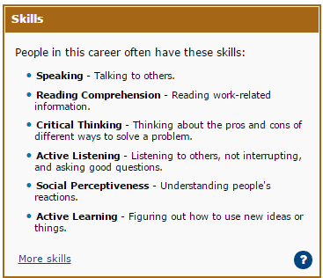
Learn: What skills and knowledge are needed in this career?
1
Skills: see a list of work-related skills that are most commonly required for jobs in this career
2
Knowledge: see what’s most commonly required

Slide 13
Next steps: Get started on the Occupation Profile
Ready to create your own Occupation Profile? www.CareerOneStop.org/OccupationProfile
Ready to customize your profile?
Click “Edit page” to add or delete information
Want more information?
Click the “?” at the bottom of any card to learn more and see data sources
Need more help?
Click “Help” to find answers to frequently asked questions and contact information for CareerOneStop.

